Slide 1
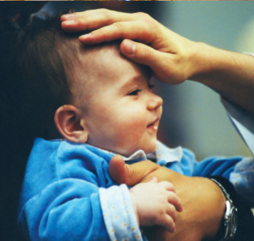
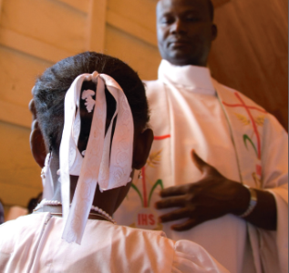
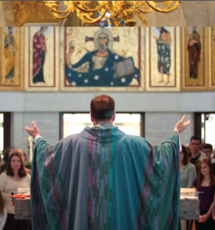
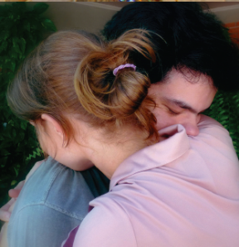
Our Sacraments and Social Mission
In the sacraments, we are formed as Christ’s disciples, then sent on his mission in the world!
Notes:
Preparation:
Pass out copies of the Sacraments and Social Mission: Living the Gospel, Being Disciples / Los Sacramentos y la misión social: Vivir el evangelio, ser discípulos booklets, if available.
Invite three volunteers to read the opening prayer (one per slide).
As possible, presenter should consider adding stories and personal examples into the presentation notes.

Slide 2
Opening Prayer
Loving Father,
Open our hearts to hidden realities:
your love for all people
your presence in the community
your call to justice and peace.
May the sacraments stir in us that same love for those with whom we worship and all members of our human family.

Slide 3
Opening Prayer
Christ Jesus,
Help us to imitate your example:
healing the sick
welcoming the stranger
assisting those who are poor and vulnerable.
May the sacraments remind us of your love and self-giving which we strive to imitate.

Slide 4
Opening Prayer
Holy Spirit,
Make visible to our eyes what is invisible:
your call to your people
your summons to live our faith daily
as witnesses of justice and peace.
May the sacraments move us to engage in love-inspired action that transforms ourselves and the world. Amen.
Amen.

Slide 5
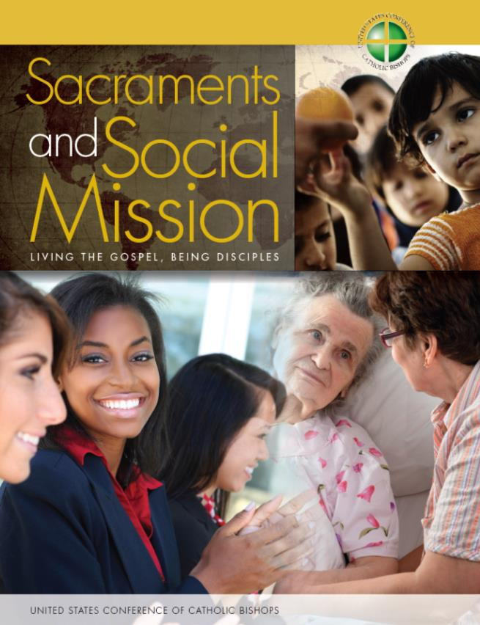
www.usccbpublishing.org (print) www.usccb.org/jphd (electronic)
Notes:
This presentation is based on the 2013 publication from the USCCB Department of Justice, Peace and Human Development called Sacraments and Social Mission: Living the Gospel, Being Disciples, also available in Spanish, entitled Los Sacramentos y la misión social: Vivir el evangelio, ser discípulos.
[Presenter may which to introduce self, then find out who is present in the room, instructing participants to raise their hands for multiple categories if applicable. For example: How many of you are here from a parish? How many are involved in social ministry or social justice efforts? Religious education? Sacramental preparation? Youth ministry? Clergy? Paid staff? Volunteer?]

Slide 6
Sacraments and the “Ministry of Charity”
“The Church's deepest nature is expressed in her three-fold responsibility of
proclaiming the word of God (kerygma-martyria)
celebrating the sacraments (leitourgia), and
exercising the ministry of charity (diakonia).
These duties presuppose each other and are inseparable. For the Church, charity is not a kind of welfare activity which could equally well be left to others, but is a part of her nature, an indispensable expression of her very being.”
- Pope Benedict XVI, Deus Caritas Est, no. 25
Notes:
Let’s begin with this quote from Pope Benedict XVI in his encyclical, Deus Caritas Est, or God is Love. [Read quote.]
[Presenter may wish to provide example of how he or she experiences celebration of the sacraments and the concrete practice of love as inseparable. For example: At a friend’s wedding celebrations, I had the opportunity to converse with the celebrant. After asking about what type of work I do, he responded, “Your work for social justice is nice, but I believe that we have to first start by introducing the faithful to Christ. Helping them have a relationship with Christ is my highest priority.” I responded, “I agree that deepening the faithful’s relationship with Christ is of highest priority. And I, too, am seeking this in my work! I work to introduce the faithful to the Jesus who touched the leper, healed the sick, welcomed the outcast, and challenged the rich to remember the poor, God’s beloved. Faith, and the ministry of love, are inseparable!”]

Slide 7
A Missionary Church
“The Church must step outside herself. To go where? To the outskirts of existence, whatever they may be, but she must step out. Jesus tells us: ‘Go into all the world! Go! Preach! Bear witness to the Gospel!’ (cf. Mk 16:15). . . In this ‘stepping out’ it is important to be ready for encounter.”
- Pope Francis, Q&A Session with members of movements, communities and ecclesial associations
Notes:
And another quote, from Pope Francis, which also sets the stage for our time together today. For Francis, we are a missionary Church. [Read Quote.]
Today we are gathered to reflect on the essential connection between our faith and the way we put our love in action in the world.
We are going to briefly look at each of the seven sacraments to explore the reality that the sacraments make present. I’ll provide some teaching and commentary. Then we’ll discuss and bring in your own experience. We have only an hour so I may at times have to move us forward even if it feels like there’s a lot more to discuss.
It is important to note that our goal today is not to provide a complete catechesis of the sacraments. Rather, we are fleshing out one very important aspect of sacramental catechesis—the reality of Christ’s presence in the Church community, his Body, and how the sacraments both point to this and make it a reality. The recognition of Christ’s presence in the community should lead to a stronger awareness of being sent on mission to engage in love-inspired action in the world.
We’ll begin first with Baptism.

Slide 8
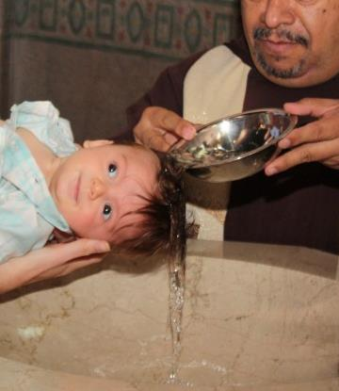
Baptism
“In one Spirit we were all baptized into one body, whether Jews or Greeks, slaves or free persons, and we were all given to drink of one Spirit.”
- 1 Cor. 12:13
Notes:
We begin with a quote from St. Paul…

Slide 9
Baptism
Members of “one another” (CCC 1267)
A “common dignity” (LG, 32)
Reject sin, re-assess attitudes, practices
A new vision
A life of charity
Participants in Christ’s mission
Disciples in the world, lights in
darkness
Notes:
Baptism is the rite of initiation into the Christian community of the Church. The Catechism says that through Baptism, we become members of the Body of Christ and members of one another. John Paul II describes the result of Baptism as a “mystical unity” between Christ and his disciples, and the disciples with one another like “branches of a single vine” (Christifideles Laici 12). Pope Francis describes faith as “a reality lived within the community of the Church, part of a common We’” (Lumen Fidei 43).
What implications does this have for our attitudes and actions towards one another? As one Body, we all share “a common dignity,” for we are one in Christ. Inequalities due to race, class, or sex disappear. We have equal dignity.
During the rite of Baptism, we reject sin and renounce what is opposed to Christ. This includes sinful attitudes that degrade the dignity of others, such as racism and sexism, as well as practices that prevent some members of the human family from living in dignity.
We are called to replace those attitudes and practices with a new vision and new values—those of the community of the Church which prioritize love of God and love of neighbor. The rest of the community joins in our profession of faith.
In Baptism, we receive a “vocation to holiness,” through which we are called to live a “life of charity” and work to make present the “Kingdom of God in history” (Christifideles Laici, 17, 19)
The Compendium of the Social Doctrine of the Church reminds us, “By Baptism, the laity are incorporated into Christ and made participants in his life and mission” (no. 541). We work to imitate Christ’s example as articulated in Luke 4:18 to preach good news to the poor, proclaim release to captives, recovery of sight to the blind, and set free the oppressed.
We join the community, and in doing so, we receive a mission. Baptism makes us disciples in the world, carrying out Jesus’ work in our local and global communities, and in our daily lives, contributing to the sanctification of the world. Joining the community means receiving the mission! Part of this is working to protect the lives and dignity of all people and to care for God’s creation.
We receive a white garment to signify that we are risen with Christ, and a lighted candle to show that we are new creation, enlightened by Christ to carry light into the dark world.
It is an exciting and empowering task to join with others to carry light into the dark world! Just imagine—for new parents who approach the parish priest, deacon or lay minister charged with Baptism preparation on behalf of the community, how might this message serve as an invitation and empowering call to leadership, service, and ownership in their parish, and as they raise their families?
And for all baptized Catholics!
[Presenter may choose to discuss questions in small groups with large group report back, or have a large group discussion only, depending on the size of the group and time constraints.]
DISCUSSION QUESTIONS:
What are you currently doing to help Catholics in your parish live their Baptism?
How does this help Catholics respond to the call to leadership and service in their parish community?

Slide 10
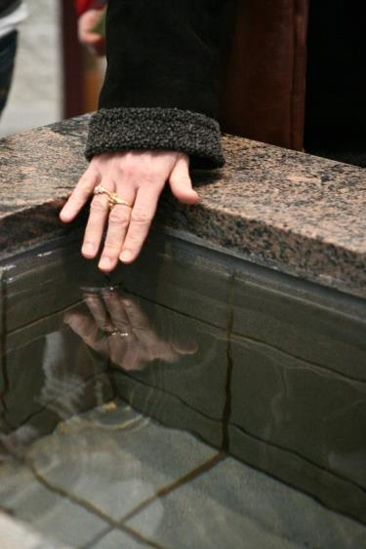
Baptism
What are you currently doing to help Catholics in your parish live their Baptism?
How does this help Catholics respond to the call to leadership and service in their parish community?

Slide 11
Confirmation
“The Holy Spirit is truly transforming us, and through us he also wants to transform the world in which we live.”
Pope Francis, Homily at Holy Mass
with the Rite of Confirmation
Notes:
Let’s move on to the sacrament of Confirmation. Pope Francis noted, in a Homily at Mass with the rite of Confirmation…

Slide 12
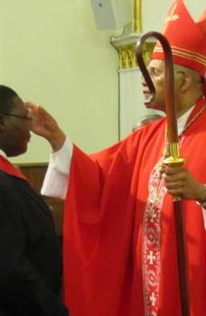
Confirmation
“Confirm” or strengthen our bond
Connect to local and Universal Church
Receive gifts of Holy Spirit
Give off “aroma of Christ”
Commissioning for mission
Evangelization includes social mission
Notes:
Confirmation enriches the baptized with the strength of the Holy Spirit so they can better witness to Christ in word and deed (Catechism of the Catholic Church [CCC] 1285).
Anointed by the Spirit, our bond with the Church is strengthened and we become better equipped to carry out the Church’s mission of love.
Lets unpack this.
At Confirmation, we renew our Baptismal promises and receive the Holy Spirit in a new way, which strengthens our “bond” with the Church and its members. (CCC 1316)
We reflect on our connection to our local parish community and to a larger, universal Church, which is global (CCC 1309). The sacred Chrism oil points to the community’s sharing of one Spirit, since the same oil is used at Baptism, and to anoint bishops and priests during Holy Orders.
At Confirmation, we receive the same Spirit that descended on Jesus during Baptism and the Apostles at Pentecost (CCC 1285-87). The Spirit gives us diverse spiritual gifts that work together, as Pope John Paul II notes in Christifideles Laici, for the “common good” and “the building up of the Church, to the well-being of humanity and to the needs of the world” (no. 24).
APPLICATION: We are called to use our spiritual gifts for the good of humanity! Let’s pause for a moment to reflect ourselves, as we can help our confirmation candidates reflect: What “needs of humanity or of the world” might John Paul II be talking about? What needs do you see locally?
The Spirit moves us to imitate the love and service of Christ and the saints whose names we often take at Confirmation. With our lives and witness we are likewise called to “give off the aroma of Christ” (CCC 1294) and be “instruments of grace” to a world in need.
This is all part of being workers in the vineyard as active participants in the Church’s mission. Confirmation is not only an anointing, but a commissioning that continues for the rest of our lives. The root word in “commissioning” is “mission.” We live our faith every day, in the world, encountering all of its joys and hopes, griefs and anxieties of our time, in the words of the Second Vatican Council (Gaudium et Spes 1).
The Church’s evangelizing, missionary activity includes “a commitment to peace, development and the liberation of peoples; the rights of individuals and peoples, especially those of minorities; the advancement of women and children; safeguarding the created world,” and many other areas of action in the world (John Paul II, Redemptoris Missio 37).
QUESTION FOR LARGE GROUP DISCUSSION: What questions might you ask those preparing for Confirmation (and those recently Confirmed) to help them reflect on how this sacrament is a lifelong call to all of us to mission in the world?
Possible responses:
What gifts have you received and how might you be called to use those gifts to benefit others?
Who are you called to be? What are you called to do with your life?
How do the lives of the saints inspire you to “give off the aroma of Christ”?
What is the mission of the Church? What role do you play in carrying it out?

Slide 13
Confirmation
What questions might you ask those preparing for Confirmation, or those recently Confirmed, to help them reflect on how this sacrament equips us for lifelong mission in the world?

Slide 14
Eucharist
“The Eucharist is the sacrament of communion that brings us out of individualism so that we may follow him together, living out our faith in him. Therefore we should all ask ourselves before the Lord: how do I live the Eucharist?”
- Pope Francis, Corpus Christi Homily
Notes:
Let’s begin our discussion of the Eucharist with this quote from Pope Francis.

Slide 15
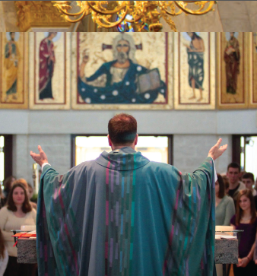
Eucharist
“A Eucharist which does not pass over into the concrete practice of love is intrinsically fragmented.”
- Pope Benedict XVI, Deus Caritas Est, no. 14
Notes:
Likewise, Pope Benedict XVI tells us…

Slide 16
Eucharist
Eucharistic “communion”
Insincere if divisions due to class, etc.
Common dignity
Sensitizes us to suffering
Imitate Christ’s self-sacrifice
Transform structures of sin
Live it in our daily lives
Sent on mission
Notes:
The Eucharist is the “sign” and “cause” of our communion with God and our unity as the People of God. In the Eucharist, we “unite ourselves with the heavenly liturgy” and with one another. Together transformed, we are then sent forth to fulfill God’s will in our daily lives (Catechism of the Catholic Church 1325-26, 1332).
Let’s unpack that.
First, we never worship alone. At the Eucharistic liturgy, we gather with the young and old, the rich and poor, as well as millions around the world and the saints in heaven. We experience the Eucharist as a community, just as we live as a community.
St. Paul taught that celebrating the sacrament challenges us to unity as one family. He said the celebration of the Eucharist is insincere if there are divisions within the community based on class (1 Cor. 11), status or privilege (Rom. 12), or there are factions within the community (1 Cor. 1).
In fact, the Eucharist causes us to recognize “what value each person, our brother or sister, has in God's eyes, if Christ offers Himself equally to each one” (Pope John Paul II, Dominicae Cenae 6).
As we meditate on the Eucharist, we experience Christ’s love for us—and for others. In the depth of prayer, we become so moved and sensitized to His love for those who suffer that the words of St. Augustine become a reality for us: “the pain of one, even the smallest member, is the pain of all” (Sermo Denis).
We meditate on Christ’s self-sacrifice and feel compelled to do likewise. Pope John Paul II writes that doing likewise, in imitation of Jesus’ washing of the disciples feet is the “criterion by which the authenticity of our Eucharistic celebration is judged” (Mane Nobiscum Domine 28).
But we must go beyond service, to justice—recognizing and confronting “the structures of sin in which individuals, communities and at times entire peoples are entangled” (Pope John Paul II, Dies Domini #73; also Pope Benedict XVI, Sacramentum Caritatis 89). These structures include racism, violence, injustice, poverty, exploitation, and all other systemic degradation of human life or dignity.
We do this in our daily lives, as men and women in various professions at different levels of society “contributing with the light of the Gospel to the building of a more human world, a world fully in harmony with God's plan” (John Paul II, Ecclesia de Eucharistia 20).
Eucharist, then, is not about being a community closed in upon itself, but being a mission community, called to glorify the Lord by our lives, and our work of service, charity, as well as justice and transformation of those unjust structures, policies, and laws which degrade human life and dignity. (Ecclesia de Eucharistia 39)
QUESTION FOR REFLECTION/DISCUSSION: Pope Francis says we are to be a “Church which ‘goes forth’”—a “community of missionary disciples” in the world (Evangelii Gaudium 24). What do you think it looks like to be a Church that “goes forth”?

Slide 17
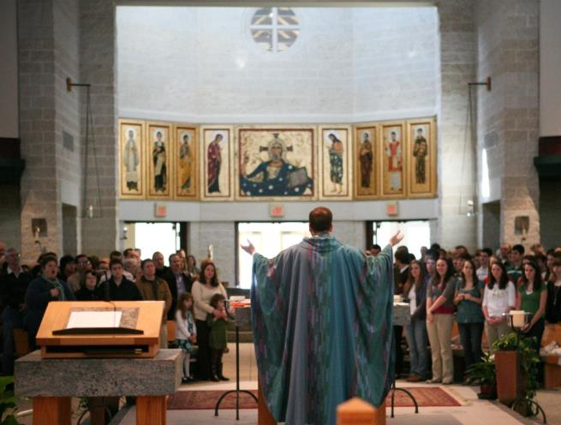
Eucharist
Pope Francis says we are to be a “Church which ‘goes forth’”—a “community of missionary disciples” in the world. What do you think it looks like to be a Church that “goes forth”?

Slide 18
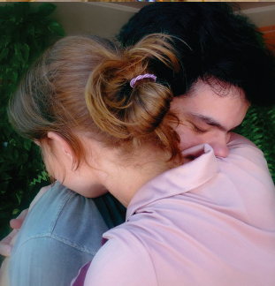
Penance and Reconciliation
“There is no sin, not even the most intimate and secret one, the most strictly individual one, that exclusively concerns the person committing it. With greater or lesser violence, with greater or lesser harm, every sin has repercussions on the entire ecclesial body and the whole human family.”
- Pope John Paul II, Reconciliatio et Paenitentia, no. 16

Slide 19
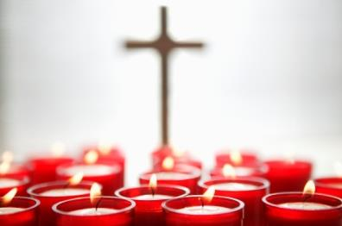
Penance and Reconciliation
Sin is never an individual affair
Personal sin
Social sin
Called to examine hearts and lives
Restore broken communion/community
Work to repair damage
Be instruments of reconciliation
Notes:
How can we understand penance and reconciliation and the call to mission?
First, sin ruptures our relationships with God, and also our brothers and sisters and the Body of Christ.
So sin is never an individual affair. It affects us as individuals, but it also has social dimensions. We can see, without stretching our imaginations too far, how personal sin might hurt others. Our sacramental formation, particularly for young children, often emphasizes the personal aspect of sin.
But there is also the aspect of social sin. The collective actions (or failures to act) by individuals create “structures of sin,” which “grow stronger, spread, and become the source of other sins” (Pope John Paul II, Sollicitudo rei Socialis 35-37). There is an extensive section on “social sin” in John Paul II’s apostolic exhortation on Reconciliation and Penance, no. 16.
For example, widespread poverty, discrimination, denial of basic rights, and violence result from many peoples’ actions (or failures to act) because of greed, racism, selfishness, or indifference (Reconciliatio et Paenitentia 2, 16).
This is an area of the theology of sin which often doesn’t receive as much attention as it should. How do our personal, economic, and public choices contribute to the suffering of others? For example: where we put our money through investments, or through purchases we make every day, do we support companies that treat workers well or ill? That respect or degrade the environment?
We are called to examine our hearts, to look at our lives to see how we are or are not living the Gospel. We recognize the areas where we need God’s mercy and wisdom.
The Sacrament of Penance allows us to receive forgiveness and to be reconciled with God, self, the Church family, and the human family, restoring our broken communion/community.
Reconciliation absolves us of sin, but it does not repair the damage that was caused—we have to work to repair what sin impaired.
The Catechism of the Catholic Church provides these examples: return stolen goods, restore the reputation of someone slandered, and pay compensation for injuries (1459).
We also must work to transform structures of sin that threaten human life and dignity.
How can we be involved in addressing familial, educational, economic, or environmental brokenness in our communities?
We must be instruments of reconciliation in our communities and world, working for peace, justice and love.
REFLECTION QUESTION: What structures of sin do you see which exist? Where do you see familial, educational, economic, or environmental brokenness? How can we be agents of healing?
Possible answers:
Growing inequality, both domestic and globally
Economic system largely governed by profit, and in need of redirection to benefit the common good.

Slide 20
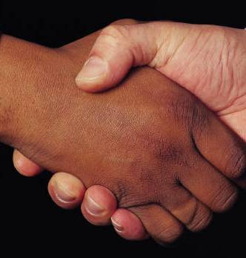
Penance and Reconciliation
What structures of sin do you see which exist? Where do you see familial, educational, economic, or environmental brokenness? How can we be agents of healing?

Slide 21
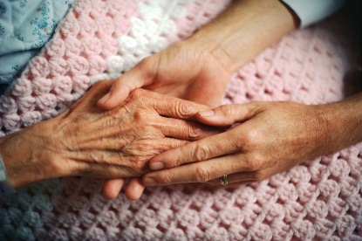
Anointing of the Sick
“It was when Francis embraced a leper. This suffering brother was the ‘mediator of light ... for Saint Francis of Assisi’ because in every suffering brother and sister that we embrace, we embrace the suffering Body of Christ.”
- Pope Francis, Address at St. Francis of Assisi of the Providence of God Hospital
Notes:
In this quote, Pope Francis reflects on the moment when St. Francis of Assisi came to understand that true joys and riches come from encountering others. The Holy Father says…

Slide 22
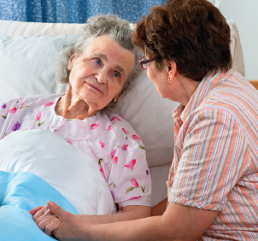
Anointing of the Sick
Liturgical, communal celebration
Body of Christ
Christ’s ministry of compassion and encounter
Walking with others
A gift, not a burden
Notes:
Anointing of the Sick is both “a liturgical and a communal celebration.” Often, members of the Body of Christ gather in the family home, hospital or church, for the sacramental rite led by a priest. These sacramental celebrations are a “source of strength amid pain and weakness, hope amid despair” for both those who are ill, and their family and friends. Blessing with the Oil of the Sick is a reminder of the sick person’s connection to the entire Body of Christ and Communion of Saints.
The sacrament reminds the community of the call to imitate Christ’s ministry of compassion and his “preferential love for the sick” and all who suffer (Catechism 1503, 1506; Pope Benedict XVI, Sacramentum Caritatis 22).
As St. Paul writes, when one part of the Body of Christ suffers, we all suffer (1 Cor. 12:26).
We remind those who are sick that “[the Church] shares your suffering. She takes it to the Lord, who in turn associates you with his redeeming Passion” (Synod of Bishops, Per Concilii Semitas ad Populum Dei Nuntius 12).
But solidarity with those who are sick is not a burden. It is a gift! We who accompany those who are sick are blessed as they unite their suffering to that of Christ on the cross. Those who are sick minister to us, in their uniting their suffering to Christ, and in allowing us to accompany them.
We are also blessed to encounter Christ himself (Mt. 25:40-45) when we visit those who are sick.
Question for Small Group Discussion: How does my parish or faith community minister to those who are sick and dying? In what ways does the larger community relate to these members of the Body? Why is this important?

Slide 23
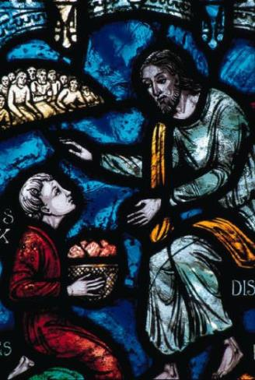
Anointing of the Sick
How does my faith community minister to those who are sick and dying? In what ways does the larger community relate to these members of the Body of Christ? Why is this important?

Slide 24
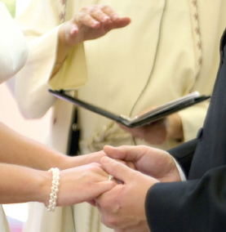
Matrimony
“The Christian family is thus called upon to offer everyone a witness of . . . dedication to social matters, through a ‘preferential option’ for the poor and disadvantaged. . . . [I]t must have special concern for the hungry, the poor, the old, the sick, drug victims and those who have no family.”
- John Paul II, Familiaris Consortio, no. 47
Notes:
Pope John Paul II notes that “By taking up the human reality of the love between husband and wife in all its implications, the sacrament gives to Christian couples and parents a power and a commitment to live their vocation as lay people and therefore to ‘seek the kingdom of God by engaging in temporal affairs and by ordering them according to the plan of God.’ . . . (Second Vatican Council, Lumen Gentium 31)
In his Exhortation on the Family in the Modern World, he tells us… [Read Quote]

Slide 25
Matrimony
Spouses reflect God’s love
Trinitarian communion
Imitate Christ’s example
Serve each other, family, community
“Domestic church” of the family
Family and public policy
Notes:
In Christian marriage, the love of spouses reflects God’s love for humanity and Christ’s love for the Church (CCC 1604).
Marriage reflects the communion and union of the Trinity. Exchanging rings in the name of the Father, Son and Holy Sprit, the spouses also become a “communion of persons.” The spouses model the mutual love of the Trinity.
They also reflect the self-gift of Christ, as they pledge to love and support each other despite shortcomings, failings, and whatever challenges may come. They help each other “overcome self-absorption” and love, forgive and serve (CCC 1609, 1642).
They serve one another, their family, and their community. Their love for each other is realized, according to the Catechism, in “the common work of watching over creation” (CCC 1604). They help each other live their vocation as lay people, seeking God’s Kingdom in their daily lives by working for justice, peace and respect for the life and dignity of all. (Familiaris Consortio 47)
Marriage provides a foundation for a family committed to community, solidarity and Jesus’ mission in the world. The home is called the “domestic church” (Catechism 1666)—the place where parents teach faith, love, justice, and concern for others to their children. Parents are “the principal and first educators of their children,” teaching moral values, solidarity, communal responsibilities (CCC 1653, 2207, 2224) and care for “the material and spiritual needs of their neighbor” (Apostolicam Actuositatem 30). The family is the “original cell of social life”—our formation in our families is the foundation where we learn how to live in society (CCC 2207).
This reflection on the foundation of family can help us ask how we can protect and strengthen families in public policy on marriage, housing, education, working conditions, wages, social security, taxes, and migration (Apostolicam Actuositatem 11).
Question for Reflection: In marriage preparation, how can we help married couples see the connection between their own love for each other, and the call to live as beacons of God’s love in life and society?

Slide 26
Matrimony
In marriage preparation, how can we help married couples see the connection between their own love for each other, and the call to live as beacons of God’s love in life and society?

Slide 27
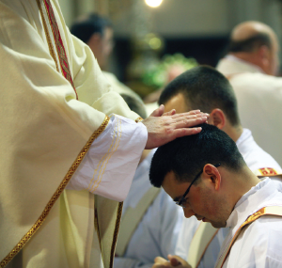
Holy Orders
“We need to ‘go out’, then, in order to experience our own anointing, its power and its redemptive efficacy: to the ‘outskirts’ where there is suffering, bloodshed, blindness that longs for sight, and prisoners in thrall to many evil masters.”
Pope Francis, Homily at Chrism Mass
Notes:
In his homily at the Chrism Mass, Pope Francis told priests in attendance…

Slide 28
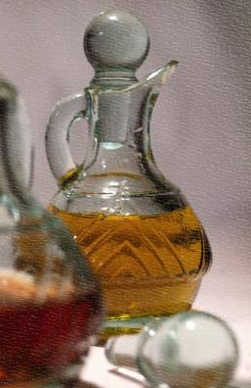
Holy Orders
Imitating Christ’s ministry of healing and accompaniment (Lk. 4:18)
Proclamation of the Word, including social teaching
Encounter with those who are poor and marginalized
Eucharistic, missionary communities
Notes:
Bishops and priests exercise a ministerial priesthood; deacons assist the ministry of bishops and priests.
Those who are ordained are called to imitate Christ in his ministry of healing and accompaniment. Part of this ministry is, as Christ himself said in Lk. 4:18, to “preach good news to the poor. . . proclaim release to the captives and recovery of sight to the blind, to set at liberty those who are oppressed, to proclaim the acceptable year of the Lord” (Lk. 4:18).
Those who are ordained proclaim the Word of God to his people in word and deed. This includes education about the social teaching of the Church. In the Compendium of the Social Doctrine of the Church: “the primary responsibility for the pastoral commitment to evangelize social realities falls to the Bishop, assisted by priests, religious men and women, and the laity. With special reference to local realities, the Bishop is responsible for promoting the teaching and diffusion of the Church's social doctrine” (no. 539).
The U.S. bishops’ Program for Priestly Formation says that priests should become familiar with Catholic social teaching (nos. 169, 204, 208, 229) and that “if seminarians are to be formed after the model of Jesus, the Good Shepherd, who came ‘to bring glad tidings to the poor,’ then they must have sustained contact with those who are privileged in God’s eyes—the poor, the marginalized, the sick, and the suffering. . . . They also need to become aware of the social contexts and structures that can breed injustice as well as ways of promoting more just contexts and structures” (no. 239).
As pastors, bishops, priests and deacons can help the local church attend to problems facing the community and world in the light of the Gospel.
As presiders of the Eucharist, bishops and priests offer the sacrifice in the name of the whole Church, and the Holy Spirit transforms the people of God for mission.
Pope John Paul II notes (and the opening quote by Pope Francis reflects this): “All priests must have the mind and the heart of missionaries,” whether they serve near their home or across the world (Redemptoris Missio 67). They must work to form their communities to likewise be a truly missionary community.
Priests give themselves in service for the Church and world. The celibate lifestyle fosters such self-emptying service. Deacons serve by assisting the bishops and priests and dedicate themselves to the ministry of charity.
Discussion Question: How does this reflection help you to better understand the role of the bishop, priest or deacon to imitate Christ’s mission to bring glad tidings to the poor, liberty to captives, sight to the blind, and freedom to the oppressed (Lk. 4:18)?

Slide 29
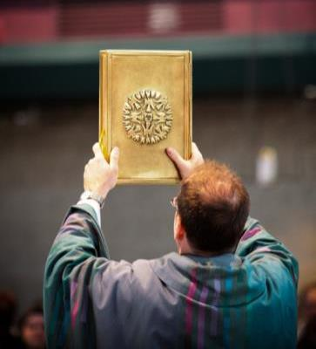
Holy Orders
How does this reflection help you to better understand the role of the bishop, priest or deacon to imitate Christ’s mission to bring glad tidings to the poor, liberty to captives, sight to the blind, and freedom to the oppressed (Lk. 4:18)?

Slide 30
Practical ideas
Priests and deacons
Religious education
Adult faith formation
Small faith sharing groups
Families
Youth ministers
Extraordinary ministers
Prayer before the Blessed Sacrament
Advent and Lent
Discuss: What ideas will you take home with you?
Notes:
Now that we’ve explored how the seven sacraments lead us to mission in the world, here are some practical ideas for how you might help disciples put love in action.
Priests and Deacons - Help make these connections in sacramental preparation—parents baptizing children, couples who meet with you about marriage. Remind the entire parish family about the call to discipleship in homilies, in your bulletin columns, etc.
Religious Education - Integrate content into your lesson plans and sacramental preparation of young people—in preparation for First Communion, Confirmation, and Penance.
Youth Ministry Programs – Make service requirements more meaningful by grounding them in the reality of being empowered by the spirit and sent as disciples to our neighbors at home and abroad.
Adult Faith Formation – RCIA coordinators and sponsors; pre-cana retreats; small faithsharing groups – help parish adults learn and reflect on our call to discipleship in daily life. Offer a program for parents while children meet for religious education programming.
Advent and Lent are often when we plan communal Penance services, or when we offer special opportunities for Confession. Help parishioners reflect on the social dimensions of sin. There are questions that can help penitents examine their consciences in the sacraments booklet.
Extraordinary Ministers, Caretakers, and Persons who are Ill – Offer opportunities to deepen the experience of those who minister to the sick, and help those who are ill and their families be witnesses to others.
Prayer before the Blessed Sacrament- Ask those who participate in this ministry to bring the concerns of our parish, neighborhood, and beyond before the Blessed Sacrament.
Families- Use the handouts or the session outline as a basis for dinner conversation and family discussion.
Let’s take a few minutes to discuss with others around you: What ideas will you take home with you? What have you heard that you might suggest or implement at your parish? Please assign someone from your group to report back what you discussed.
Report back: What ideas has this discussion sparked that you would like to share with the group?

Slide 31
Closing Prayer
For all who are part of the family of Christ, that awareness of our membership in the community will inspire us to care for all its members. We pray to the Lord…
For all who were recently confirmed, or who will be confirmed, that they may imitate the love and service of Christ and the saints. We pray to the Lord…
For all believers, that the Eucharist may challenge us to right relationship and solidarity with all who suffer. We pray to the Lord…

Slide 32
Closing Prayer
For all sinners, that we may recognize the ways in which sin damages our relationships both with God and with others, prompting us to repentance and conversion. We pray to the Lord…
For the Church, that we may all imitate the compassion and love of Christ toward those who suffer. We pray to the Lord…
For all married couples, that their marriages will provide a strong foundation for families committed to community, solidarity, and Christ’s mission of love. We pray to the Lord…
For our bishops, pastors, and deacons, that through their ministry, they may serve as models of love and service, justice and peace. We pray to the Lord…

