Slide 1
For the Safety and Protection of Children Safe Environment Second Grade

Slide 2
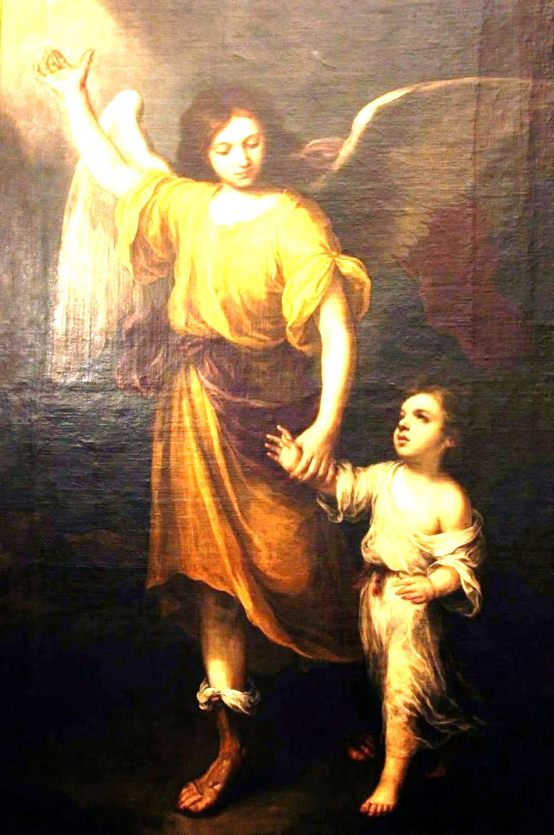
Prayer
Angel of God,
my guardian dear,
to whom God’s love commits me here.
Ever this day
be at my side,
to light and guard,
to rule and guide.
Amen.
Notes:
Open the lesson by praying together.
“Angel of God,
my guardian dear,
to whom God’s love commits me here.
Ever this day
be at my side,
to light and guard,
to rule and guide.
Amen.”
God has given each person an angel, always to be with you. You cannot see this angel but he is always with you. The angel is to love you, protect you and guide you on our journey to Heaven.
Note: If a student asks if this is what a guardian angel looks like, you will want to say no. An angel is a person but does not have a body. An angel is a spiritual being, which in sacred art is portrayed as a strong young boy with wings.

Slide 3
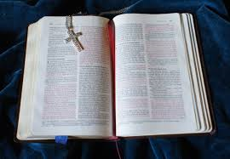
God made you!
God knows you and He loves you.
You have incredible worth because you are a child of God. This means that you have dignity as a person.
You are to be treated with respect.
Every other person is also made by God and deserves respect.
Notes:
God tells you in the Bible that He loves you. He also tells you in the Bible that you are to love Him with all your heart, soul, mind and strength. In order to love God, you need to know who God is. You come to know God through learning about Him and speaking with Him in prayer every day.”
Explain the difference between
being treated with respect,
being treated without respect which is always harmful.
Being treated without respect needs to be stopped. This is different from being disciplined for doing something wrong.

Slide 4
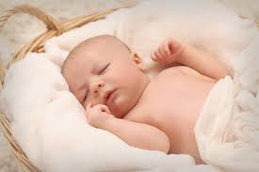
God tells us in the Bible
“I have called you by name: you are Mine.” (Isaiah 43:1b)
Notes:
God created each person and knows each person by name. God has given us our parents and all of us belong to Him.

Slide 5
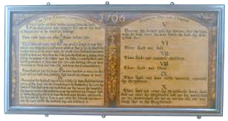
You are a child of God
God created all things and He created you.
YOU ARE IMPORTANT!
God loves you and wants you to be happy.
We are happiest when we love God.
To show God that we love Him, we follow the Ten Commandments,
His Laws of Love.
These Laws help us know how to live as His children.
Notes:
“God made everything and all that He made is good. God created you and loves you very much. You are important! He made you in His image. It is right and good to be thankful to God for all his gifts. God loves you very much and wants you to be happy. When you love God and follow Him, you will be happy. You show your love for God, by following His Ten Commandments. God gave us these laws of love to help you know how to live as His children, living a life of joy and peace.
You may consider going through the Ten Commandments as a class.
There is only one God, and you should love Him with all your heart. (We should say our prayers everyday)
Keep God’s name holy. (We should say God’s name with great respect.)
Go to Church every Sunday. (We should listen and participate at Mass and not misbehave in Church.)
Obey your mom and dad. (We should obey our parents and teachers.)
Be kind to other people. (We should not hurt other people.)
You should love everyone as a child of God, created in His image.
Do not take things that do not belong to you from others or from stores.
You should tell the truth. (We should not tell lies.)
Do not be jealous of other people, how they look or what they can do.
Do not be jealous of the things other people have.

Slide 6
The Ten Commandments
The first 3 Commandments are about our love for God.
The last 7 Commandments are about how we are to love others.
Notes:
They are to love others as a response to God’s love, including respecting, honoring and obeying their parents and other adults in authority over them.
“We love God by listening and following His Commandments and we love our parents by doing what they ask. God tells you in the Bible that you are to love Him with all your heart, soul, mind and strength. In order to love God, you need to know who God is. You come to know God through learning about Him and speaking with Him in prayer every day.”

Slide 7
All of us are God’s children
In living by the last 7 Commandments, we are to treat others with respect.
Notes:
Students will learn and practice the virtue of respect.
“As a child of God, you have amazing dignity (you are worth so much!) because of the love He has for you. Because you are so important to God and precious in His eyes, you are to love and respect others and yourself. One way of showing respect is being obedient to God through obeying the rules of your parents, teachers and those in authority over you so that you are safe and free from harm. Respect means we treat others like we want to be treated. We don’t like it when others don’t listens to us, so we should make sure we listen when our parents or teachers are talking to us. We like it when people are nice to us, so we should try to be nice to others.”

Slide 8
Respect
You are to be shown respect by other persons.
And you are to treat other persons with respect.
Notes:
Students will learn and practice the virtue of respect.
“As a child of God, you have amazing dignity (you are worth so much!) because of the love He has for you. Because you are so important to God and precious in His eyes, you are to love and respect others and yourself. Respect means we treat others like we want to be treated. We don’t like it when others don’t listen to us, so we should make sure we listen when our parents or teachers are talking to us. We like it when people are nice to us, so we should try to be nice to others.”

Slide 9
Respect
1. How do you want to be treated?
2. How do you treat others?
Notes:
How you want to be treated and how you treat others is at the core of the meaning of respect.

Slide 10
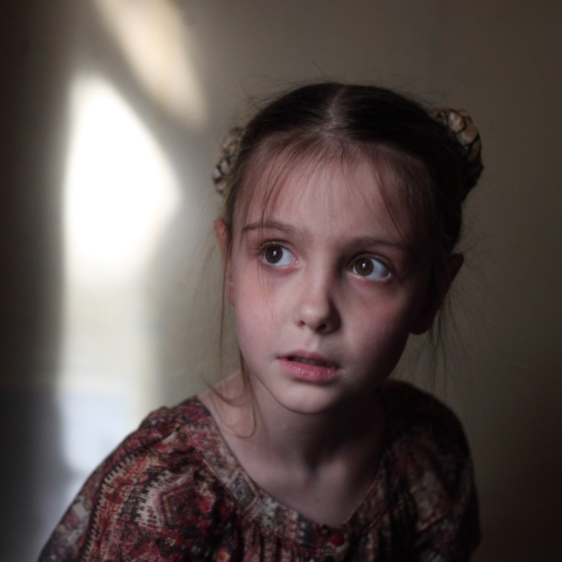
Being Safe
Our Heavenly Father want you to feel safe at all times.
Even though we need to respect all people, some people might want to hurt us.
If someone is hurting you, you MUST tell an adult you can trust. Tell them right away!
It might be another child
or adult who is hurting you.
You should always tell
the truth about being
hurt and not keep it a
secret.
Notes:
Students will learn about safety, safe environment and the care that is to surround them.
“God loves you very much and wants you to feel safe at all times. You are safe when you are not in danger. Even though we need to respect all people, some people might want to hurt us. If someone is hurting you, you MUST tell an adult you can trust, such as your parents, a teacher, a principal, an aunt or uncle. And you must tell them right away! It could be an adult or another child who is hurting you. You should always tell the truth about being hurt, even if someone tells you not to tell anyone.”

Slide 11
For you, who is a trusted adult?
A trusted adult is a person who loves you and respects you as a child of God.
You feel totally safe with this person.
A trusted adult would never do anything to harm you on purpose.
A trusted adult wants the best for you and does not do anything that makes you feel uncomfortable or scared.
Notes:
What is trust? It is good to explore the issue of trust with the students.
A good way to explain trust might be to have the students answer these questions: Who trusts you? What does it mean to trust you?

Slide 12
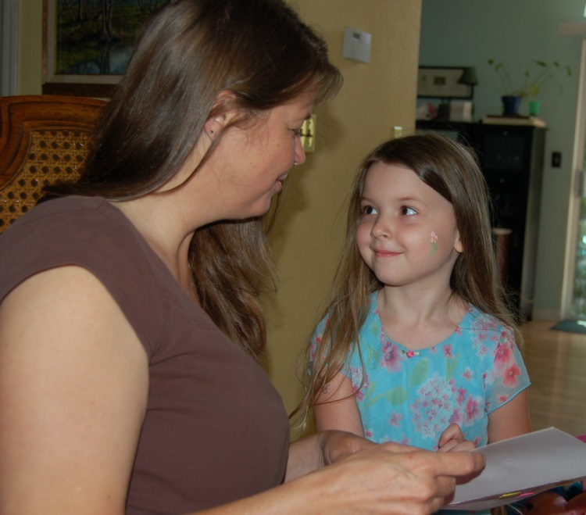
Things to tell a person you trust
If you are being told to look at something that makes you feel uncomfortable.
If you were/are in a place that is scary or unfamiliar.
If you are told to do something you think might be wrong or you know is wrong.
If someone touches you
in a way that makes you
feel uncomfortable.
Notes:
Students will learn about safety, safe environment and the care that is to surround them.
“Think of an adult that you know and trust. This adult should love you and would not make you feel uncomfortable. That person is who you should tell if someone else is making you uncomfortable.
If a friend or family member wants to play a game or watch a video that makes you feel uncomfortable, tell the adult you trust.
If you are made to look at something that makes you feel uncomfortable, tell the adult you trust.
If you were in a place that makes you feel uncomfortable, tell the adult you trust.
If you are told to do something that you think might be wrong or you know is wrong, tell the adult you trust.
If someone touches you in a way that makes you uncomfortable, tell the adult you trust.”

Slide 13
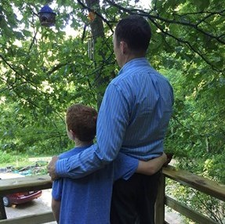
Know the difference
If you are being hugged or touched by someone who loves you, you will feel safe and secure.
If you are being hugged or touched by someone who does not love you, you might feel scared or uncomfortable, or it might hurt.
If you are scared or uncomfortable, you should tell the person who is making you feel that way to STOP.
Then tell a person you trust what happened RIGHT AWAY!
Notes:
Students will learn the respect that each person deserves as a child of God and the difference between appropriate, kind actions and behavior that make them feel safe, secure and loved and inappropriate, harmful actions and behavior that makes them feel uncomfortable or unsafe. Students will learn the difference between good touch and bad touch.
Students will learn the importance of saying ‘no’ to inappropriate, harmful actions and behavior that makes them uncomfortable or unsafe. Children will be encouraged to immediately tell a trusted adult when these situations arise.
“Some actions like hitting, shoving, grabbing and pushing are not good and kind – they are not good forms of touch. If you are being hugged or touched by someone who loves you, you will feel safe and secure. If you are being hugged or touched by someone who does not love you, you might feel uncomfortable. If you are scared or uncomfortable you should tell that person to STOP. Then go tell the adult you trust what happened.”

Slide 14
Remember
God loves you very much and wants you to feel safe and happy.
He gave you your guardian angel and others to help you be safe and secure.
If you are being harmed, or if you feel sad, scared, unsafe, or uncomfortable, tell an adult that you trust right away.

Slide 15
Exercises
1. What safety rules do you know that keep you safe?
2. Why are we to show respect for parents? How do we show disrespect toward parents and thereby sin against them? How do you show your love for your parents, grandparents, and friends that make you feel safe and joyful inside?
3. How do you show respect for your health? How are you called to have respect for the goods of others?
Notes:
Examples: Look both ways when crossing the street, wear a seat belt, do not play with matches, wear a helmet when riding a bicycle, always go with someone to a public restroom etc.
2. Parent’s hug, a friend’s High –5, shaking hands when meeting someone for the first time, snuggling up with grandmother when reading a book. See Catechism of the Catholic Church paragraphs 2196 – 2200, 2214-2219, 2227.
Health: See Catechism of the Catholic Church, paragraphs 2288-2291.
Respecting the goods of others: Catechism, paragraphs 2407-2414, the 7th Commandment.
Which of the following make you feel safe and which ones make you feel sad and scared?
Teacher reads:
o Mommy hugs you for cleaning up your room.
o Your friend gets angry at you and pushes you and you fall down
o You are watching TV and your sister’s friend sits real close to you and you do not like it.
o Your friend gives you a High-5 for running very fast in gym class
o Your teacher gives you a pat on your back for spelling a word correctly.

