Slide 1

For the Safety and Protection of Children
Safe Environment
Third Grade

Slide 2
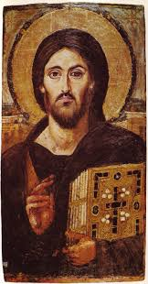
“Our Father Who art in heaven, hallowed be Thy name.
Thy kingdom come.
Thy will be done,
on earth as it is in Heaven.
Give us this day our daily bread, and forgive us our trespasses as we forgive those who trespass against us, and lead us not into temptation, but deliver us from evil. Amen.”
(Matthew 6:9-13)
Notes:
Open the lesson by praying together the Our Father, the prayer that Jesus gave us.
“Our Father who art in heaven,
hallowed be thy name.
Thy kingdom come.
Thy will be done,
on earth as it is in heaven.
Give us this day our daily bread,
and forgive us our trespasses
as we forgive those who trespass against us,
and lead us not into temptation,
but deliver us from evil.
Amen.”
Our Heavenly Father knows and loves each one of us. Jesus taught the Apostles this prayer and they handed it on to others

Slide 3
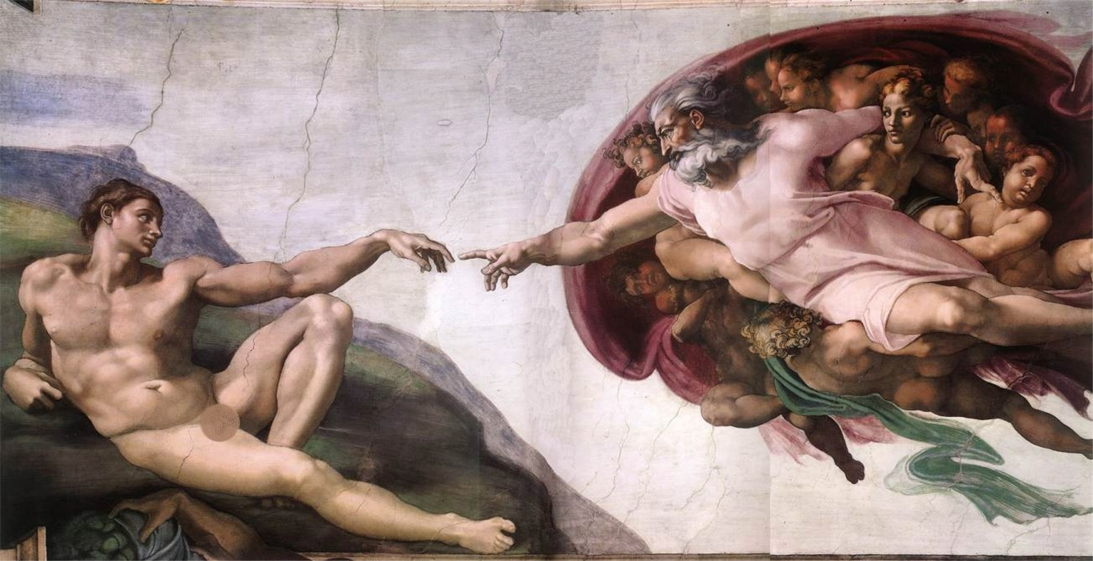
God created you!
and every person, in His image and likeness.
Notes:
God is love. God reveals His love through creation. God created us in His image and loves each person completely. We are children of God, and He is our loving Father.
God created us in His image, which means that we can think and we can choose. We can choose to be selfless and think of others first. Or we can choose to act in a way that is unkind and selfish, which will make us unhappy and even miserable and offends God because we are offending another person.
When Adam and Eve chose against God and sinned they separated themselves from God. Out of love, God promised a Savior.
Jesus loves you so much that He wants you to know Him, to develop a deep friendship with Him and to be so close to Him that He is united with you.

Slide 4
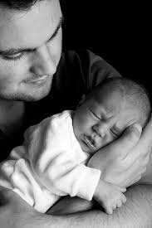
“Before I formed you in the womb I knew you, and before you were born I consecrated you.” (Jeremiah 1:5)
Notes:
God speaks to us through the Prophet Jeremiah:
Before I formed you in the womb I knew you, and before you were born I consecrated you” (Jeremiah 1:5)
God is our creator. All that God made is good.
God created you and He knows you. He knows everything about you. And He loves you!
We need to be grateful to God for His incredible love.

Slide 5
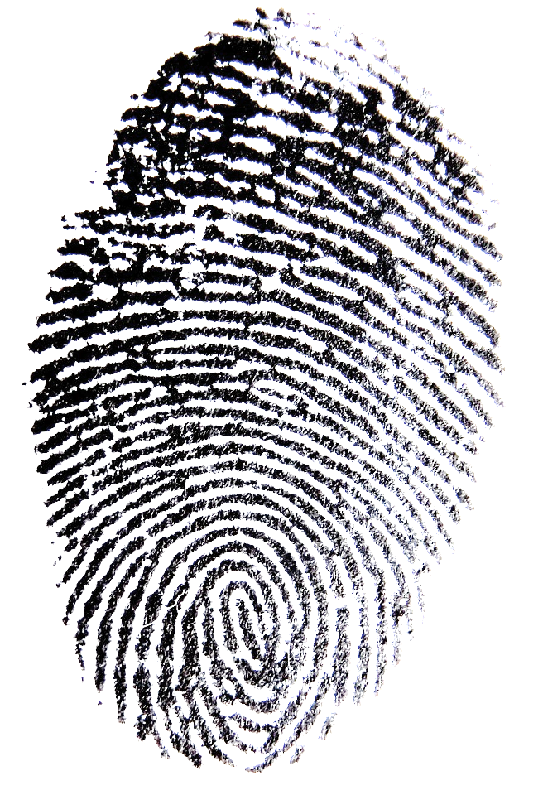
God made every person unique
& unrepeatable!
Notes:
What does the word unique mean?
What does the word unrepeatable mean?
What does it mean that God made every person unique and unrepeatable?
From the virtue of respect, Diocesan Virtue Program, page 1
Each person is unique, unrepeatable, and has inherent dignity from God. Further, each person has a unique role in God’s plan. Therefore, each person is to be shown respect, even if the individual is impaired in some way. Having respect toward another person means that we show him/her honor and esteem because he/she is a child of God who deserves consideration and regard.
A book or movie that the students are familiar with may help the children to understand the meaning of unique and unrepeatable.

Slide 6
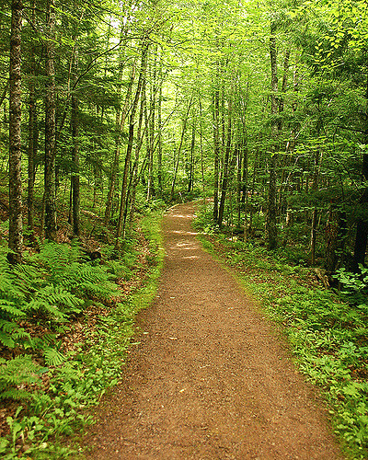
O Lord, You have searched me and know me!
You know when I sit down and when I rise up;
You discern my thoughts from afar.
You search out my path and my lying down and are acquainted with all my ways.
Even before a word is on my tongue, behold,
O Lord, You know it altogether.
(Psalm 139:1-4)

Slide 7
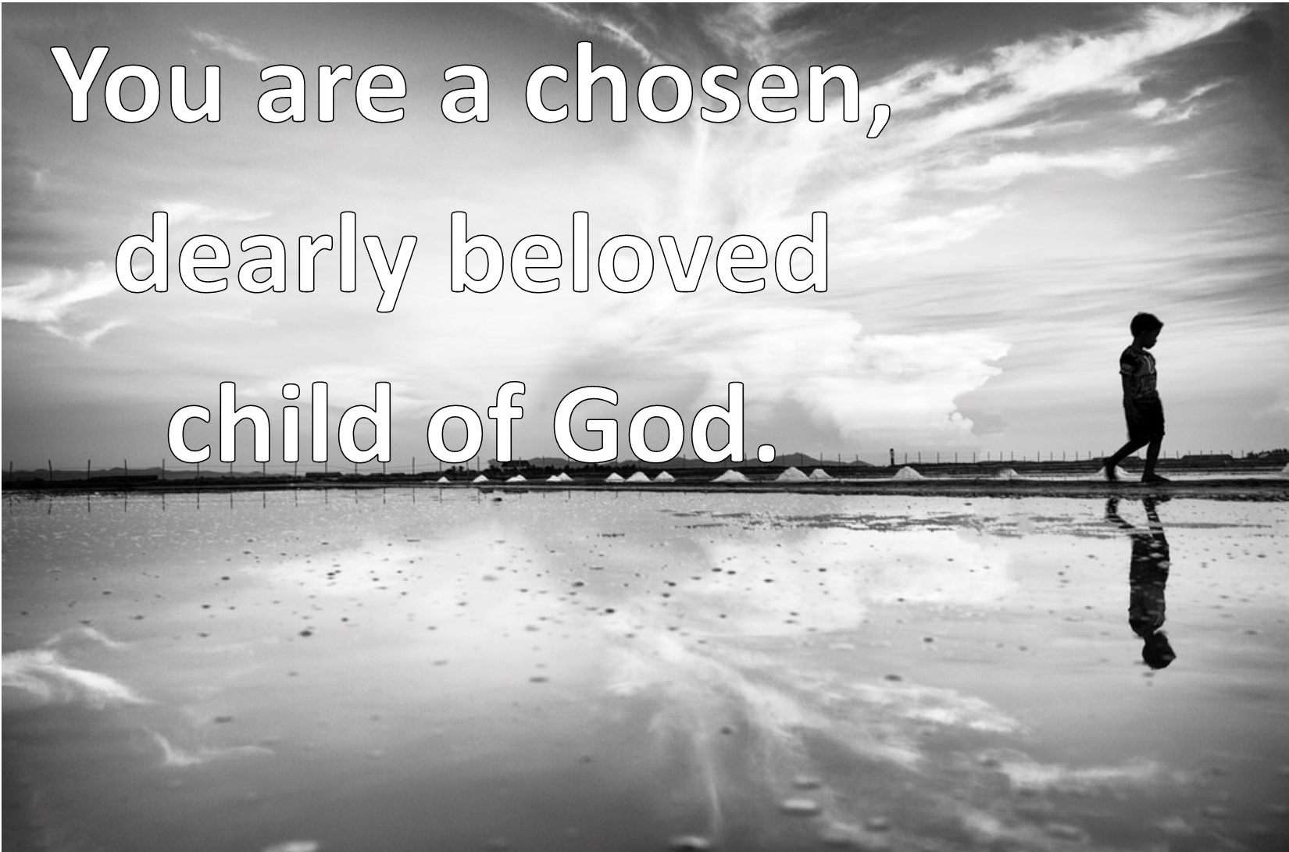
Notes:
God loves us so much that He sent His own Son to die on the Cross for each one of us. Read John 3:16
You are a chosen, dearly beloved child of God.
Because you are so important to God, and every other person is so important to God, you are to love yourself and others.

Slide 8
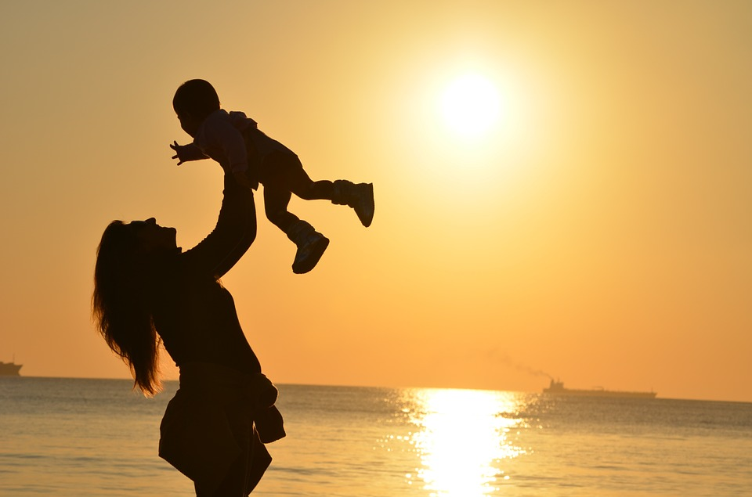
Each Person is a Child of God and Has dignity.
Notes:
What is dignity? Dignity means self-worth; it is the recognition of a person’s incredible importance as a person created by God with an immortal soul - a soul that will live forever and a body that needs to be taken care of, and not abused in any way. The dignity of the human person is rooted in his being created in the image and likeness of God.
God has created each person with the gift of freedom, so that we can choose freely to receive His love and love Him in return and then give His love to others.
God has created us with a desire for happiness placed in our heart in order that we draw closer and closer to Him, because He is the only One who can fulfill this desire for happiness.
God wants you to spend eternity with Him in Heaven. (Catechism paragraphs 1700-1709)
We should be grateful for God’s incredible love for each person.
With the students, use an example of a parent, grandparent, aunt or uncle or any trusted adult still loving them even after they did something wrong.

Slide 9
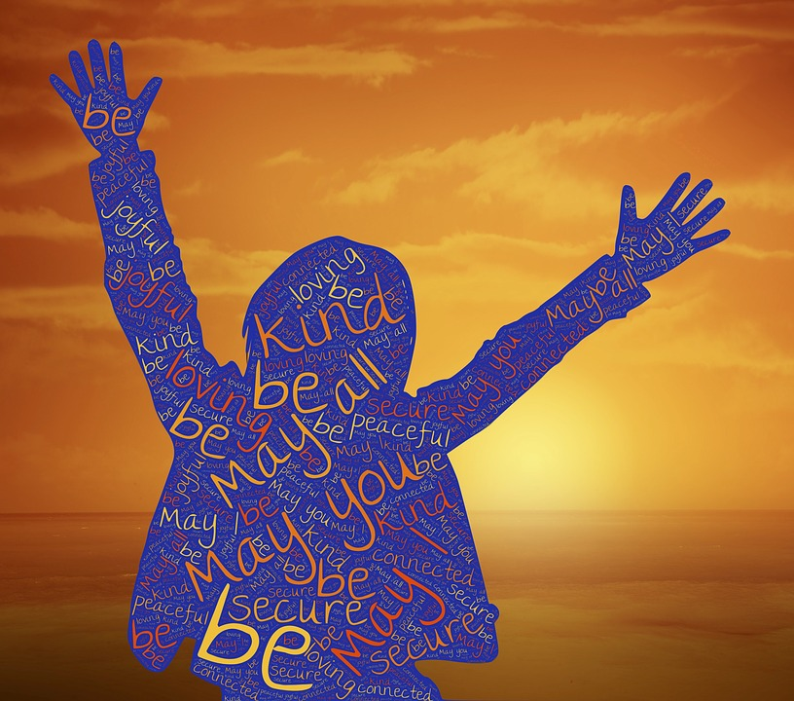
Each person Deserves Respect!
Respect is not just a word.
Notes:
John 15:12-13 This is my commandment, that you love one another as I have loved you. Greater love has no one than this, that someone lay down his life for his friends. You are my friends if you do what I command you.
Complete respect is to begin in your relationship with God in obeying His commands and responding to His desire that you spend time with Him in prayer each day. You show your love for God by loving others. You love others by showing them respect. Secondly, you are to respect yourself, maintaining a proper balance in all matters.
God has given you your parents and so you are to respect them. This is followed by a special respect for priests, religious, teachers, law enforcement offices, elders, siblings, relatives, neighbors and those in authority.
How do these actions show respect toward another person?
Speak kindly | Don’t speak ill of others
Refrain from idle complaints
Pay attention | Listen
Rediscover silence
Acknowledge and include others | Respect other’s opinions
Choose one from the list that you need to grow in. Pray to Jesus, asking Him to help you to practice and develop the habit of acting or speaking with respect.

Slide 10
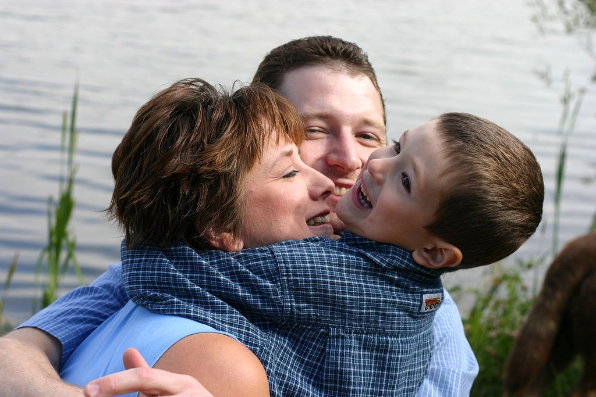
An important way of showing respect
Keep Yourself Safe.
Notes:
From the virtue of respect, Diocesan Virtue Program, page 1
Due to the effects of Original Sin, we are inclined toward selfishness and pride. Therefore, we have to develop the virtue of respect. If a child is not taught how to respect parents and those in authority, he will neither respect God, himself, nor anyone else.
One way of showing respect for yourself is by keeping yourself safe. God loves you very much and wants you to be safe. You are safe when you are not in danger. Some actions like hitting, shoving, grabbing and pushing are not good, kind or safe. These actions do not show respect toward another person(s).
What safety rules to you know that keep you safe? Examples if the students don’t say these:
Look both ways when crossing the street.
Be alert and attentive in all situations.
Wear a seat belt.
Do not play with matches.
Wear a helmet when riding a bike.
It is important to know the following rules to keep you from harm and danger. The following seven rules should be discussed and a short phrase for each should be memorized.

Slide 11
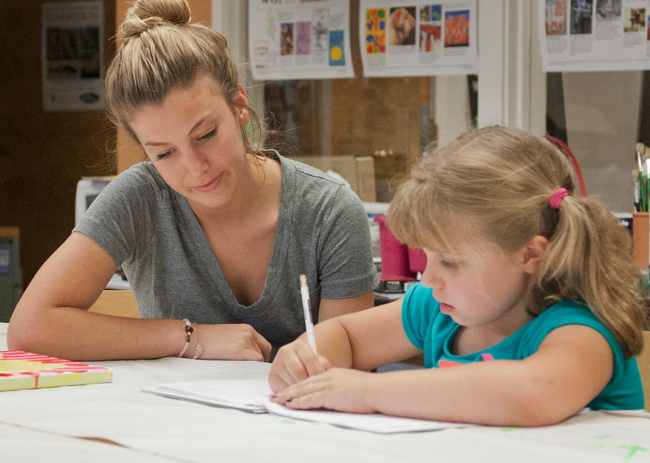
#1
Always tell someone
No person should ever treat you or touch you in a way that makes you feel uncomfortable or afraid. Always tell someone that you trust right away when you feel scared and not safe.
Notes:
After reading the slide: Who could you tell if you feel uncomfortable or afraid in a situation? This is different from being afraid when you are in trouble for doing something wrong.
You should tell someone like your mom, dad, teacher, or grandparents. You should tell them right away when you feel scared and not safe.
What signs of affection are appropriate and inappropriate?
Examples of appropriate signs of affection: a parent’s hug, a friends high-five; shaking hands when meeting someone for the first time; snuggling up with your grandmother when reading a book; hugging a friend who is moving away; hugging someone who is going through a difficult time.
Inappropriate signs of affection: a person that you do not know getting to close to you or wanting to spend time with you; a person that you know who touches you in a way that makes you feel uncomfortable, scared and not safe.
This is different from being scared when you do something that you were told not to and now you will be disciplined.

Slide 12

#2
Tell an offender to
If a person hugs or pats you, and if it makes you feel uncomfortable or scared, tell that person – either a young person or an adult – to STOP. It is also O.K. to run and scream for help.
Notes:
It is o.k. to tell that person, a child or an adult, to STOP. It is o.k. to tell a big person “NO”, I don’t like that – when you feel uncomfortable or scared.

Slide 13
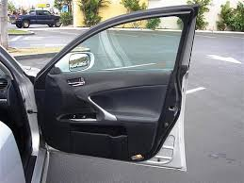

#3
Never get in a car with a
stranger!

Slide 14
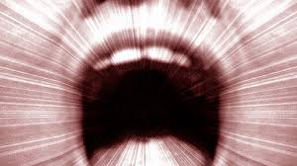
#4
Scream
“I don’t know you”, if someone tries to take you.
Notes:
It is helpful to scream (shout) “I don’t know you”, if someone tries to take you or yell “Help” because then other people in the area will know that you need help.
Do whatever you can to draw attention to what is happening to you.

Slide 15

#5
Parents need to be present
Never go to a friend’s house if their parents are not there.

Slide 16
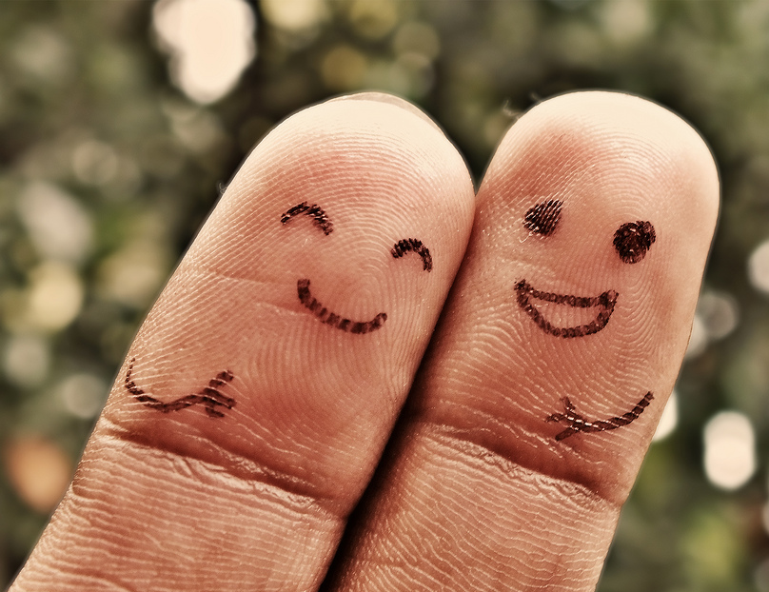
#6
Always go with a friend
If you are going for a bike ride, always go with a friend, and make sure to tell your parents when you leave. And call when you arrive at your friend’s house or the place of destination.
Notes:
Explain the “Buddy System”
Always go with a friend refers not just to bike rides, but anytime that you are going somewhere.

Slide 17

#7
Guard your eyes
If you are at a friend’s house and a TV program, video or computer program makes you feel uncomfortable, suggest that you would like to watch something different or play a different game. It is ok to say that your parents don’t allow you to watch certain programs and then call your parents.
Notes:
You do not want to watch things that are violent, or that do not show respect for people. You want to guard your eyes so that you don’t see these things, because your brain is like a computer and it holds what you see in your memory. You will want to watch good things so that you think about good things.
If you feel uncomfortable or scared when watching something on T.V. or a video program, it is a good sign that you don’t want to watch it.
Practice saying “NO” and acting in an assertive way by responding to these situations listed below.
You are walking home from school and a car with a young man /old man pulls up too close and asks you for directions. How can you respond to this situation.
You answer the telephone and you do not recognize the voice on the phone. The person says very unkind words to you. What will you do?
A person that you do not know says: “Your mom told me to come and pick you up and take you home.”

Slide 18
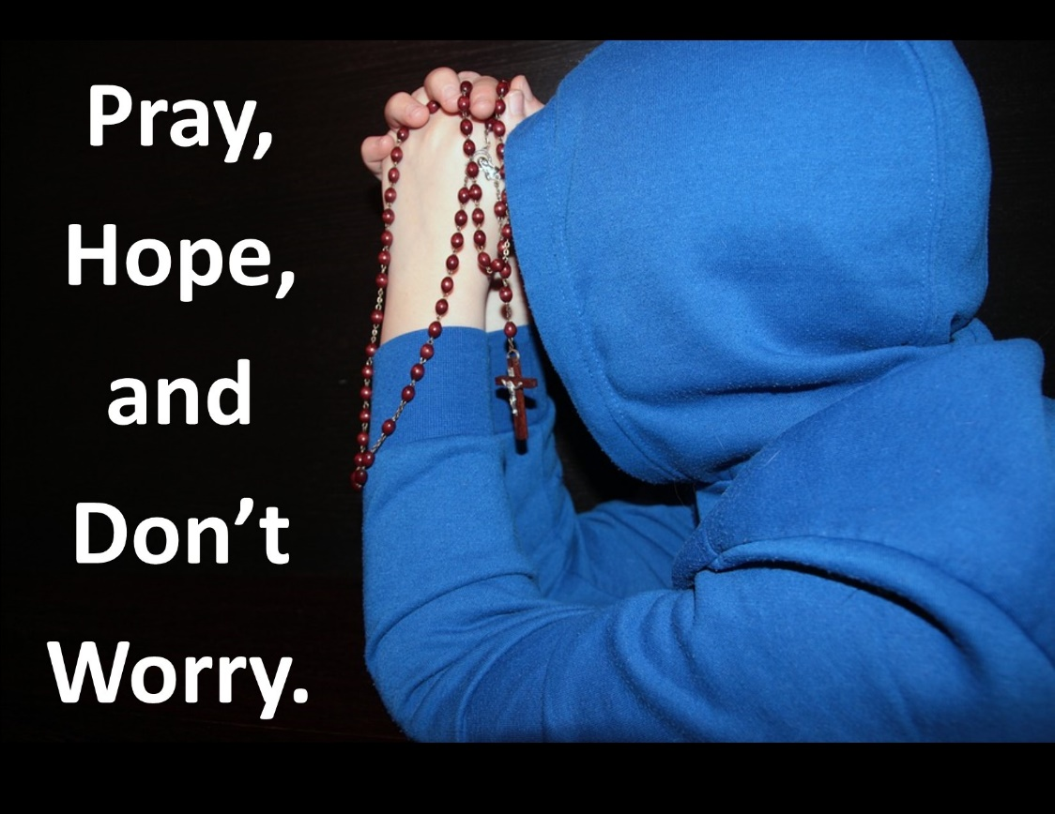
#8
Do not be afraid
You are loved by God and He wants you to live with peace and joy.

Slide 19
Remember!

Slide 20
God loves you very much!

Slide 21
You have incredible worth as a child of God.

Slide 22
You, and every person, are to be treated with respect.

Slide 23
If you are being harmed, or if you feel sad, scared, unsafe, or uncomfortable…
tell an adult that you trust right away!

Slide 24
Exercises
Notes:
The prayer to St. John Bosco, the patron of youth, in the virtue of respect, Diocesan Virtue Program, page 3. http://diolc.org/catechesis/ click on Virtue Program.
Make a copy for each student:
O Saint John Bosco, father and teacher of youth, you labored so much for the salvation of souls.
Help us to respect ourselves and each person as a child of God. Be our guide in seeking the good of our souls and the salvation of our neighbor.
Teach us to love Jesus in the Blessed Sacrament, Mary Mother of Christ and our Mother, and our Holy Father the Pope.
And obtain for us from God, the grace of a happy death, so that we may all be gathered together with you in Heaven. Amen.
See Catechism of the Catholic Church,
souls of others: paragraphs 2284-2287
A person’s name: paragraphs 2158
health: paragraphs 2288-2291

Slide 25
Pray the prayer to St. John Bosco, asking for his intercession to help you grow in the virtue of respect.
Notes:
The prayer to St. John Bosco, the patron of youth, in the virtue of respect, Diocesan Virtue Program, page 3. http://diolc.org/catechesis/ click on Virtue Program.
Make a copy for each student:
O Saint John Bosco, father and teacher of youth, you labored so much for the salvation of souls.
Help us to respect ourselves and each person as a child of God. Be our guide in seeking the good of our souls and the salvation of our neighbor.
Teach us to love Jesus in the Blessed Sacrament, Mary Mother of Christ and our Mother, and our Holy Father the Pope.
And obtain for us from God, the grace of a happy death, so that we may all be gathered together with you in Heaven. Amen.
See Catechism of the Catholic Church,
souls of others: paragraphs 2284-2287
A person’s name: paragraphs 2158
health: paragraphs 2288-2291

Slide 26
How Do We respect the souls of others?
*
How Do we show respect for a person’s name?
*
What do we do to show respect for our
health?
Notes:
The prayer to St. John Bosco, the patron of youth, in the virtue of respect, Diocesan Virtue Program, page 3. http://diolc.org/catechesis/ click on Virtue Program.
Make a copy for each student:
O Saint John Bosco, father and teacher of youth, you labored so much for the salvation of souls.
Help us to respect ourselves and each person as a child of God. Be our guide in seeking the good of our souls and the salvation of our neighbor.
Teach us to love Jesus in the Blessed Sacrament, Mary Mother of Christ and our Mother, and our Holy Father the Pope.
And obtain for us from God, the grace of a happy death, so that we may all be gathered together with you in Heaven. Amen.
See Catechism of the Catholic Church,
souls of others: paragraphs 2284-2287
A person’s name: paragraphs 2158
health: paragraphs 2288-2291

Slide 27
Memorize the safety rules that keep you safe!
Notes:
The prayer to St. John Bosco, the patron of youth, in the virtue of respect, Diocesan Virtue Program, page 3. http://diolc.org/catechesis/ click on Virtue Program.
Make a copy for each student:
O Saint John Bosco, father and teacher of youth, you labored so much for the salvation of souls.
Help us to respect ourselves and each person as a child of God. Be our guide in seeking the good of our souls and the salvation of our neighbor.
Teach us to love Jesus in the Blessed Sacrament, Mary Mother of Christ and our Mother, and our Holy Father the Pope.
And obtain for us from God, the grace of a happy death, so that we may all be gathered together with you in Heaven. Amen.
See Catechism of the Catholic Church,
souls of others: paragraphs 2284-2287
A person’s name: paragraphs 2158
health: paragraphs 2288-2291

