Slide 1
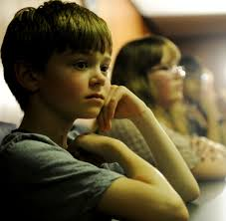
For the Safety & Protection of Children
Safe Environment Fourth Grade

Slide 2
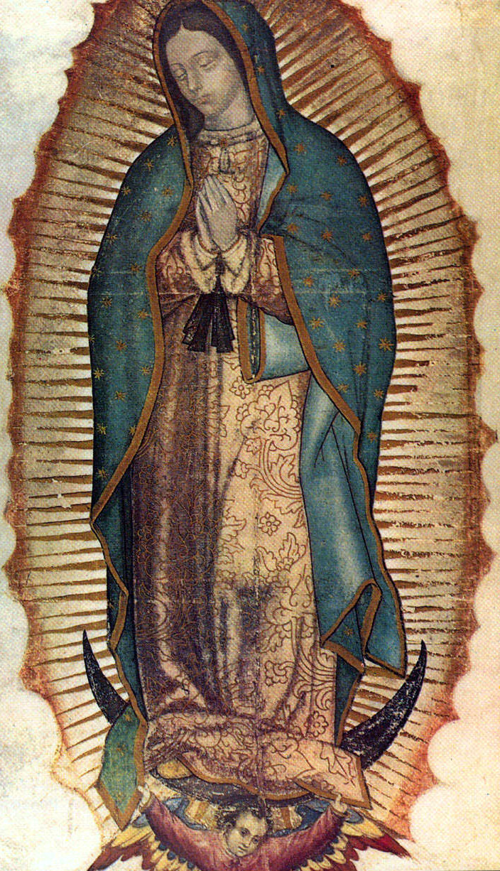
Hail Mary, full of grace, the Lord is with thee;
Blessed art thou amongst women, and blessed is the fruit of thy womb, Jesus.
Holy Mary, Mother of God, pray for us sinners, now and at the hour of our death. Amen.
Notes:
We speak with Mary as our Spiritual Mother, asking for her help in what we need. Mary is our Spiritual Mother as Jesus gave her to us when He was dying on the Cross. (See John 19:26-27) The beloved disciple represents each one of us.
Begin by praying the Hail Mary.
Hail Mary, full of grace, the Lord is with thee; blessed art thou amongst women, and blessed is the fruit of thy womb, Jesus. Holy Mary, Mother of God, pray for us sinners, now and at the hour of our death. Amen.

Slide 3
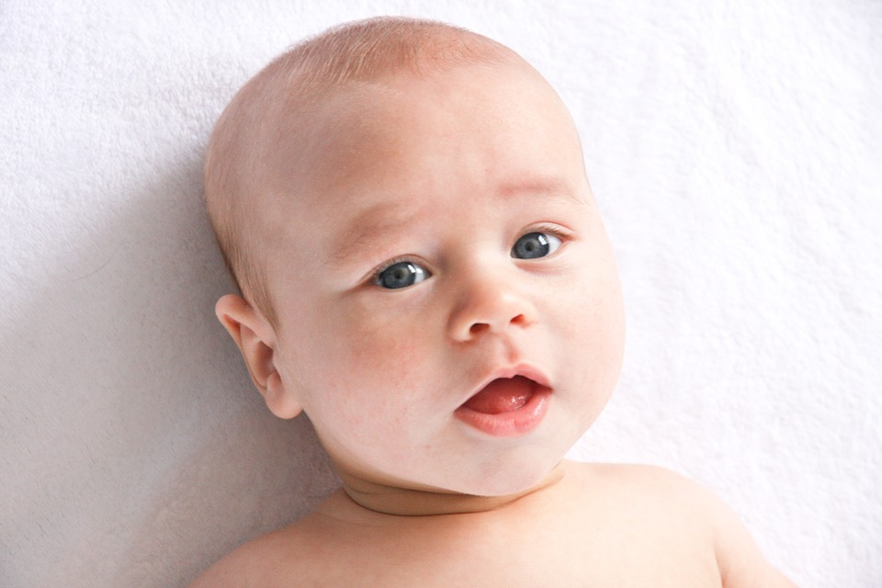
God created you!
God created you and every person, in His image and likeness.
Notes:
God is love. God reveals His love through creation. God created us in His image and loves each person completely. We are children of God, and He is our loving Father.
God created you in His image, which means that you can think and you can choose. You can choose to be selfless and think of others first. Or you can choose to act in a way that is unkind and selfish, which will make you unhappy and even miserable and offends God because you are offending another person.
When Adam and Eve chose against God and sinned they separated themselves from God. Out of love, God promised a Savior.
Jesus loves you so much that He wants you to know Him, to develop a deep friendship with Him and to be so close to Him that He is united with you.

Slide 4
God speaks to us in the Bible:
“I will never forget you. See, upon the palms of My hands I have written your name.”
(Isaiah 49:15-16)
Notes:
In the Bible, God speaks to us through the Prophet Isaiah:
“I will never forget you. See, upon the palms of My hands I have written your name.” (Isaiah 43:15b – 16a)
God is our creator. All that God made is good.
God created you and He knows you. He knows everything about you. And He loves you!
We need to be grateful to God for His incredible love.

Slide 5
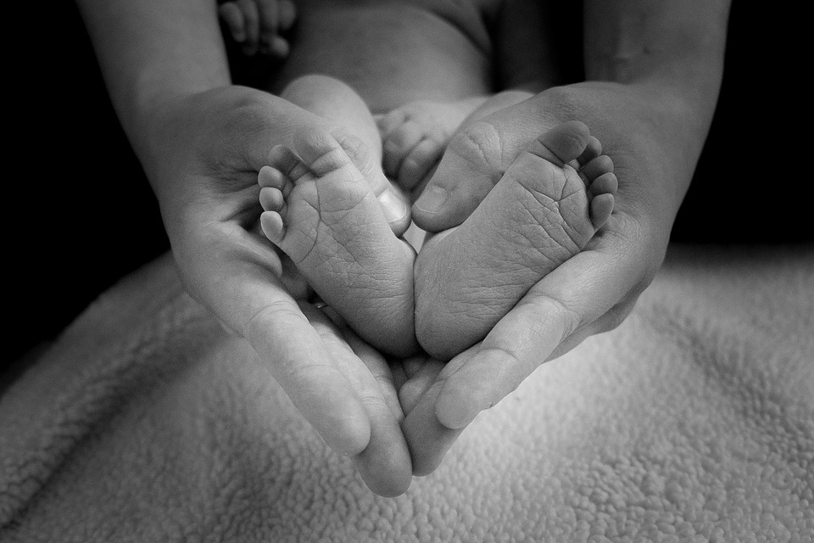
God made every person unique and unrepeatable!
Notes:
What does the word unique mean?
What does the word unrepeatable mean?
What does it mean that God made every person unique and unrepeatable?
From the virtue of respect, Diocesan Virtue Program, page 1
Each person is unique, unrepeatable, and has inherent dignity from God. Further, each person has a unique role in God’s plan. Therefore, each person is to be shown respect, even if the individual is impaired in some way. Having respect toward another person means that we show him/her honor and esteem because he/she is a child of God who deserves consideration and regard.

Slide 6
I Corinthians 3:16
“Do you not realize that you are a temple of God with the Spirit of God living in you?”
Notes:
When we are baptized, we become children of God and a temple of the Holy Spirit. The Holy Spirit comes to dwell in the person’s soul, for the first time.
Each person who is baptized is referred to as a temple of the Holy Spirit because we know that the Holy Spirit dwells within us.

Slide 7
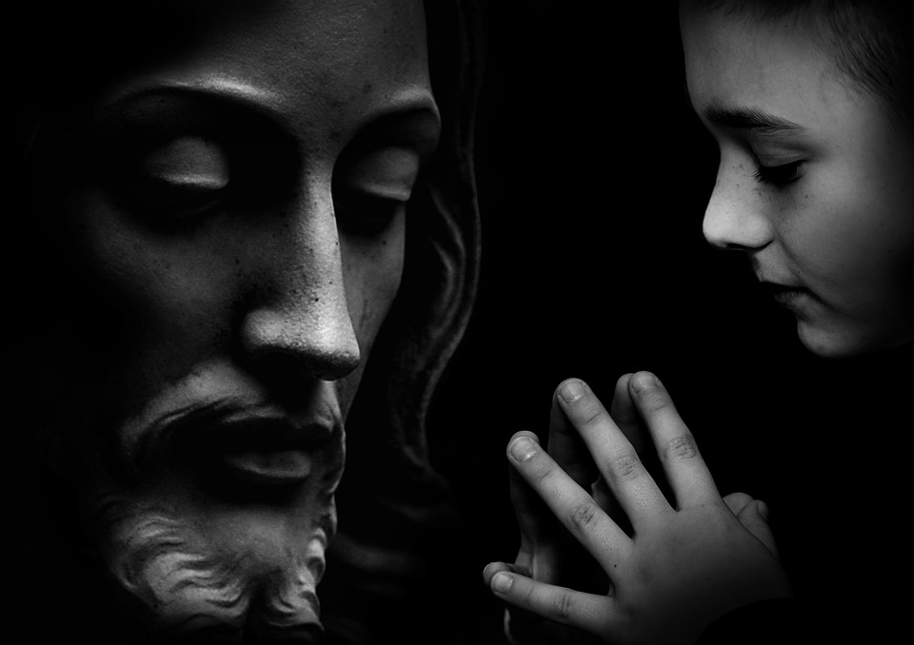
You are a chosen, dearly beloved child of God.
Notes:
God loves us so much that He sent His own Son to die on the Cross for each one of us. Read John 3:16
You are a chosen, dearly beloved child of God.
Because you are so important to God, and every other person is so important to God, you are to love yourself and others.

Slide 8
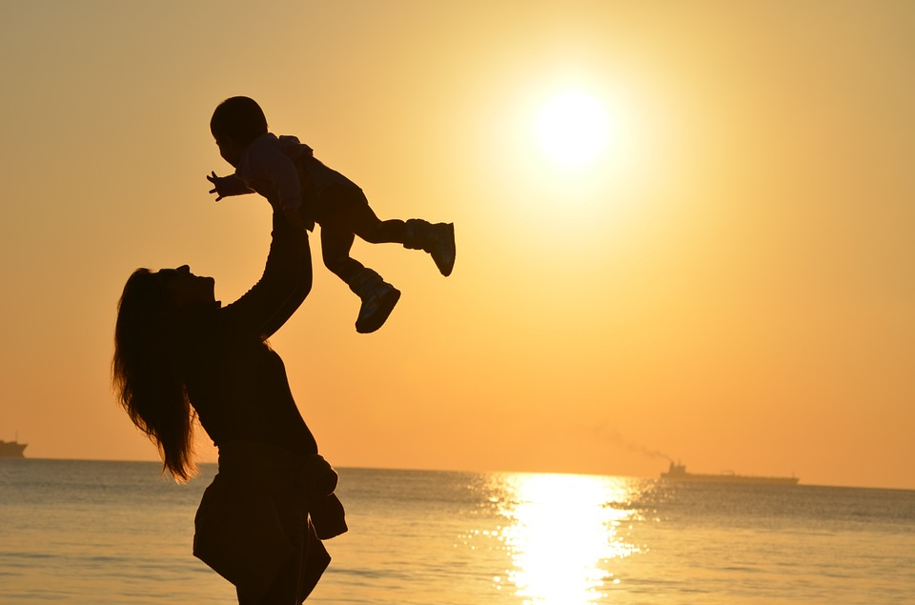
Each Person is a Child of God and Has dignity.
Notes:
What is dignity? Dignity means self-worth; it is the recognition of a person’s incredible importance as a person created by God with an immortal soul - a soul that will live forever and a body that needs to be taken care of, and not abused in any way. The dignity of the human person is rooted in his being created in the image and likeness of God.
God has created each person with the gift of freedom, so that you can choose freely to receive His love and love Him in return and then give His love to others.
God has created you with a desire for happiness placed in your heart in order that you draw closer and closer to Him, because He is the only One who can fulfill this desire for happiness.
God wants you to spend eternity with Him in Heaven.
You should be grateful for God’s incredible love for you and for each person.
God will never stop loving you!
With the students, use an example of a parent, grandparent, aunt or uncle or any trusted adult still loving them even after they did something wrong.

Slide 9
YES!
Every person deserves respect.
Notes:
John 15:12-13 This is my commandment, that you love one another as I have loved you. Greater love has no one than this, that someone lay down his life for his friends. You are my friends if you do what I command you.
Complete respect is to begin in your relationship with God in obeying His commands and responding to His desire that you spend time with Him in prayer each day. You show your love for God by loving others. You love others by showing them respect. Secondly, you are to respect yourself, maintaining a proper balance in all matters.
God has given you your parents and so you are to respect them. This is followed by a special respect for priests, religious, teachers, law enforcement offices, elders, siblings, relatives, neighbors and those in authority.
How do these actions show respect toward another person?
Speak kindly | Don’t speak ill of others
Refrain from idle complaints
Pay attention | Listen
Rediscover silence
Acknowledge and include others | Respect other’s opinions
Choose one from the list that you need to grow in. Pray to Jesus, asking Him to help you to practice and develop the habit of acting or speaking with respect.

Slide 10
Respect includes:
Courtesy
Meekness
Tact
Consideration
Notes:
1. Define the following words: courtesy, meekness, tact, consideration, benevolence. Give an example of a situation for each. (From the virtue of respect, Diocesan Virtue Program and referenced for the fourth grade Safe Environment lesson)
2. How do we show respect toward other people? (See Catechism paragraphs 2196-2200, 2214-2219, 2227)
3. How do we show disrespect toward others and thereby sin against them?
4. Read a book about St. Martin de Porres (for boys) and St. Elizabeth of Hungry (for girls) to discuss how these saints lived out the virtue of respect toward other people.

Slide 11
An important way of showing respect is to keep yourself safe.
Notes:
Due to the effects of Original Sin, we are inclined toward selfishness and pride. Therefore, we have to develop the virtue of respect. If a child is not taught how to respect parents and those in authority, he will neither respect God, himself, nor anyone else. (Diocesan Virtue Program – Respect)
One way of showing respect for yourself is by keeping yourself safe. God loves you very much and wants you to be safe. You are safe when you are not in danger. Some actions like hitting, shoving, grabbing and pushing are not good, kind or safe. These actions do not show respect toward another person(s).
What safety rules do you know that keep you safe? Examples if the students don’t say these:
Look both ways when crossing the street.
Be alert and attentive in all situations.
Wear a seat belt.
Do not play with matches.
Wear a helmet when riding a bike.
Do not smoke as it destroys your lungs.
It is important to know the following rules to keep you from harm & danger. The following seven rules should be discussed and a short phrase for each should be memorized.

Slide 12
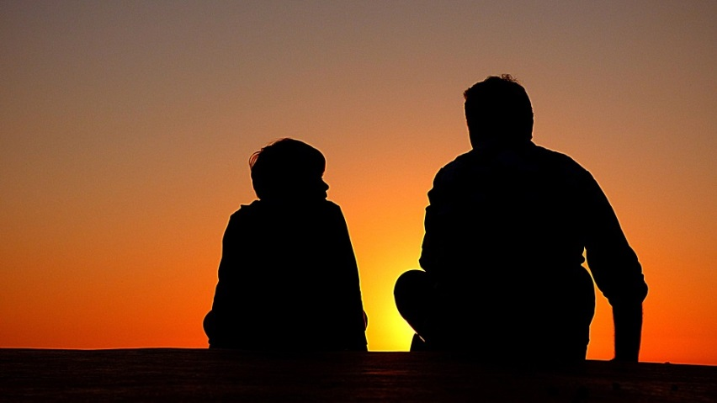
1. Always tell someone.
Always tell someone you trust when someone is making you feel scared or unsafe.
Notes:
After reading the slide: Who could you tell if you feel uncomfortable or afraid in a situation? This is different from being afraid when you are in trouble for doing something wrong.
You should tell someone like your mom, dad, teacher, or grandparents. You should tell them right away when you feel scared and not safe.
What signs of affection are appropriate and inappropriate?
Examples of appropriate signs of affection: a parent’s hug, a friends high-five; shaking hands when meeting someone for the first time; snuggling up with your grandmother when reading a book; hugging a friend who is moving away; hugging someone who is going through a difficult time.
Inappropriate signs of affection: a person that you do not know getting to close to you or wanting to spend time with you; a person that you know who touches you in a way that makes you feel uncomfortable, scared and not safe.
This is different from being scared when you do something that you were told not to and now you will be disciplined.

Slide 13
2. Tell the person who is harming you to STOP!
Notes:
It is o.k. to tell that person, a child or an adult, to STOP. It is o.k. to tell a big person “NO”, I don’t like that – when you feel uncomfortable or scared.
If a person hugs or pats you, and if it makes you feel uncomfortable or scared, tell that person – either a young person or an adult – to STOP. It is also O.K. to run and scream for help.

Slide 14
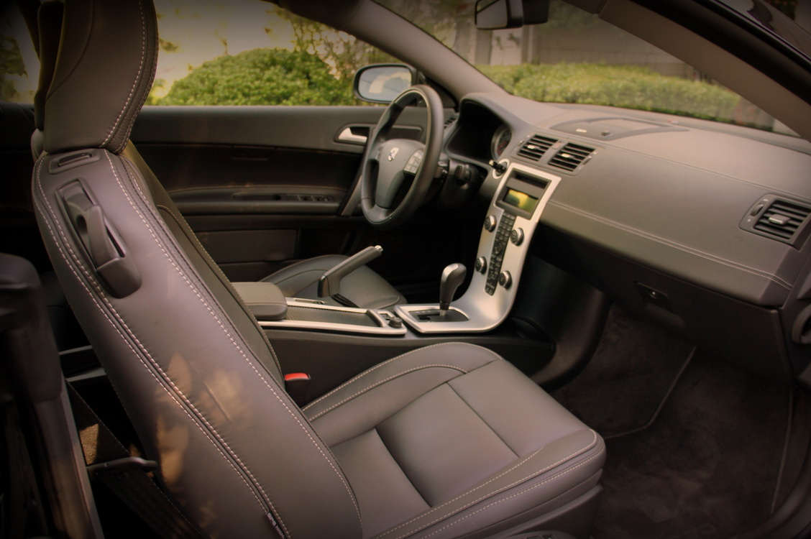
3. Never get in a car with a stranger.
Notes:
Ask students for reasons why they would never want to get in a car with a stranger.
Never get into a car or go with strangers. Never!
If separated from your parents, don’t go looking for them. God to a security officer or lost and found.
Beware of strangers asking for directions, help finding a pet, or saying your parents need help, and they will take you to them.

Slide 15
4. Scream “I don’t know you,” if someone tries to take you.
Notes:
It is helpful to scream in this situation because then other people in the area will know that you need help.
If someone tries to take you yell: “I don’t know you” or They are trying to take me away” or They are not my parents.”

Slide 16
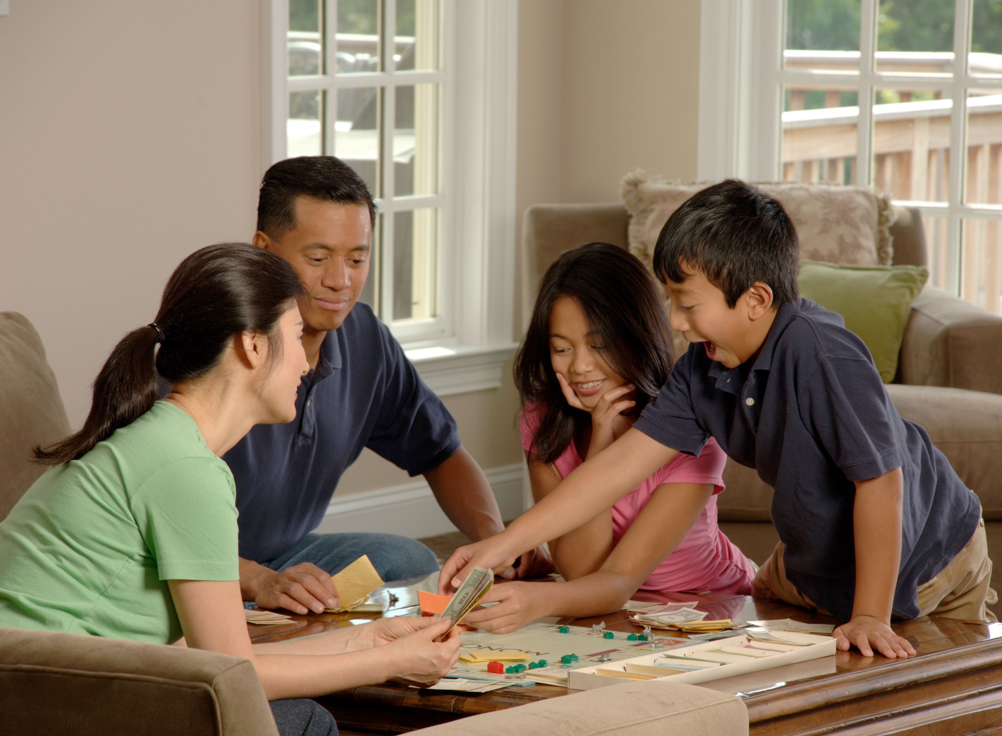
5. Never go to a friend’s house if their parents are not there.
Notes:
Why should you not go to a friend’s house if a parent or another adult is not there?

Slide 17
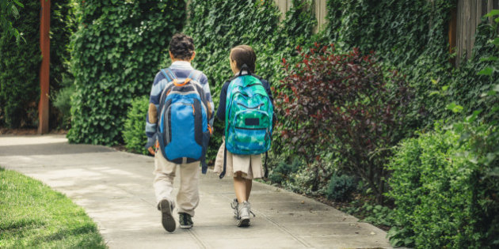
6. Always go with a friend
Notes:
Explain the “Buddy System”
Always go with a friend refers not just to bike rides, but anytime that you are going somewhere.
If you are going for a hike or a bike ride, always go with a friend, and make sure to tell your parents when you leave. And call when you arrive at your friend’s house or the place of destination.

Slide 18
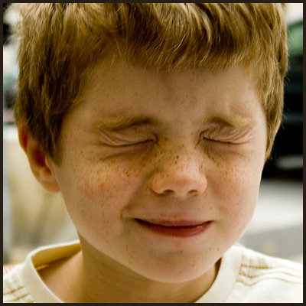
7. Guard your eyes.
Notes:
You do not want to watch things that are violent, or that do not show respect for people. You want to guard your eyes so that you don’t see these things, because your brain is like a computer and it holds what you see in your memory. You will want to watch good things so that you think about good things.
If you feel uncomfortable or scared when watching something on T.V. or a video program, it is a good sign that you don’t want to watch it.
Practice saying “NO” and acting in an assertive way by responding to these situations listed below.
You are walking home from school and a car with a young man /old man pulls up too close and asks you for directions. How can you respond to this situation.
You answer the telephone and you do not recognize the voice on the phone. The person says very unkind words to you. What will you do?
A person that you do not know says: “Your mom told me to come and pick you up and take you home.”
If you are at a friend’s house and a TV program, video or computer program makes you feel uncomfortable, suggest that you would like to watch something different or play a different game. It is ok to say that your parents don’t allow you to watch things that are harmful, violent, use bad words etc.

Slide 19
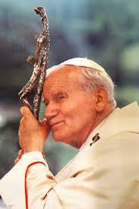
8. Do not be afraid.
Words from the Bible, and often spoken by Pope Saint John Paul II
Notes:
You will want to always abide by these rules to keep you safe, which includes being cautious and not doing things that you should not be doing. But you do not need to be afraid, spending time worrying about something that may never happen. Pope Saint John Paul II told youth, “Do not be afraid.” These same words are in the Bible, 365 times: one time for each day.
Check to see if the students remember the 8 ways to stay safe. Students should memorize the 8 Safety Rules.

Slide 20
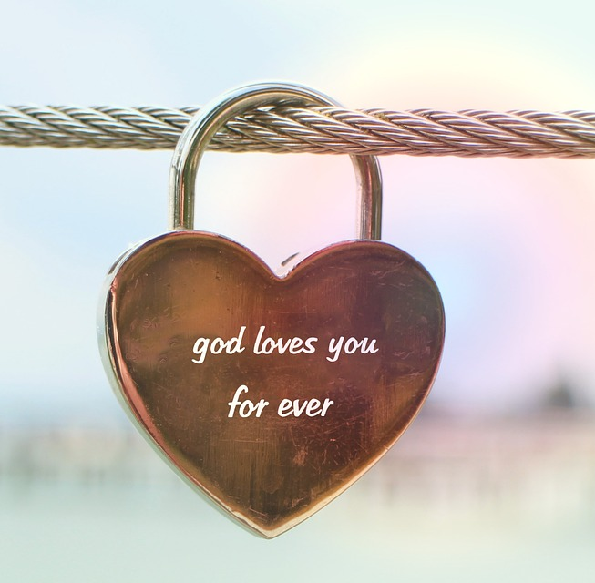
Remember
God loves you very much.
You have incredible worth as a child of God.

Slide 21
Remember
You, and every person, are to be treated with respect.

Slide 22
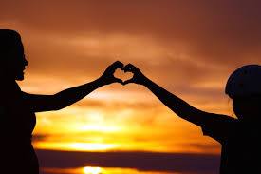
Remember
If you are being harmed, or you feel sad, scared, unsafe, or uncomfortable, tell an adult that you trust right away.
Notes:
Check to see if the students remember the 8 ways to stay safe.

Slide 23
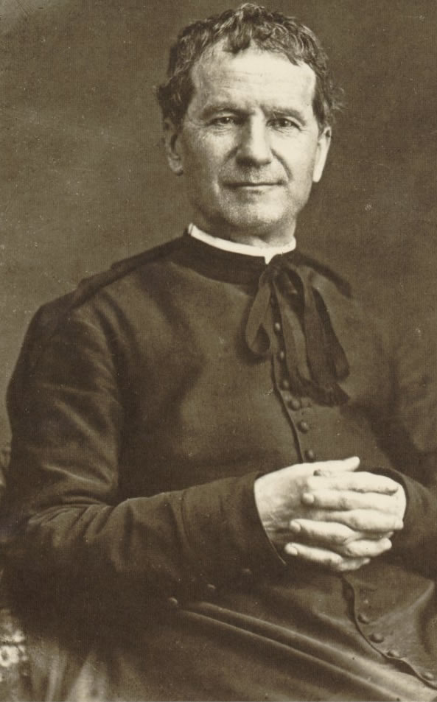
O Saint John Bosco, father & teacher of youth, you labored so much for the salvation of souls.
Help us to respect ourselves & each person as a child of God. Be our guide in seeking the good of our souls & the salvation of our neighbor.
Teach us to love Jesus in the Blessed Sacrament, Mary Mother of Christ & our Mother, & our Holy Father the Pope.
And obtain for us from God, the grace of a happy death, so that we may all be gathered together with you in Heaven. Amen.
Notes:
Tell the story of St. John Bosco and his incredible love and respect for young people in Turin, Italy. A full-page story of his life can be found in the Virtue Program, virtue of respect.
Pray the prayer to St. John Bosco, asking for his intercession to help you grow in the virtue of respect.
The prayer to St. John Bosco, the patron of youth, in the virtue of respect, Diocesan Virtue Program, page 3. http://diolc.org/catechesis/ click on Virtue Program.
Make a copy for each student:
O Saint John Bosco, father and teacher of youth, you labored so much for the salvation of souls.
Help us to respect ourselves and each person as a child of God. Be our guide in seeking the good of our souls and the salvation of our neighbor.
Teach us to love Jesus in the Blessed Sacrament, Mary Mother of Christ and our Mother, and our Holy Father the Pope.
And obtain for us from God, the grace of a happy death, so that we may all be gathered together with you in Heaven. Amen.

