Slide 1
Welcome to
The Heart of the Bridegroom
Formation
Continuing Formation
Companion Workbook Program

Slide 2
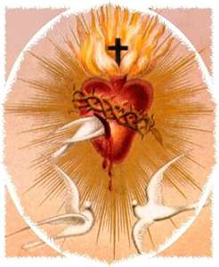
It is an invitation to study not as a scholar ... but as one who loves…

Slide 3
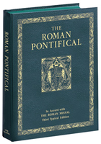
The Church provides the information about this consecration.
Recognized by the Church as an
authentic form of consecrated life
since Apostolic times,
it not only has an official Rite
found in the Roman Pontifical
including a Homily and Prayer of Consecration
(the spirituality and charism of the consecration)

Slide 4
but it is also found in…
The Code of Canon Law
Canon 604 § 1
The Catechism
of the Catholic Church
Numbers
922
923
924

Slide 5
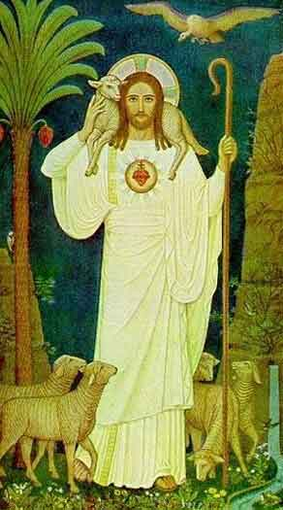
“Learn from me for I am meek and humble of Heart.”
The book
The Heart of the Bridegroom
has been written to establish the necessary foundation and basic understanding of the gift of a life of virginity consecrated to God
for the sake of the Kingdom.
“The life you seek to follow has its home in heaven.
God Himself is the source.
It is He who gives the grace of virginity.”
Roman Pontifical, Rite of Consecration, Homily
This Photo by Unknown Author is licensed under CC BY-NC-ND

Slide 6
What about the program?
The companion workbook formation continuing formation program is based on the book
The Heart of The Bridegroom
Based on the Rite of Consecration the soul is invited to enter into the mystery of the Heart of Jesus.
The companion workbooks are designed with space so to be used not just at initial formation but continuing formation as directed by Pope Saint John PaulII in his exhortation Vita Consecrata.
A simple format for so great a gift.
“The rite for the consecration of virgins belongs to the treasures of Roman Liturgy.
Jesus Christ left holy virginity as a legacy
to His bride, one of His most precious gifts.”
Decree for Promulgation May 31, 1970

Slide 7
17 Companion Workbooks
Background Information Initial Discernment
Heart of the Father, Saint Joseph
Litany of St Joseph
Mysteries of the Rosary & Litany of Saint Joseph
Formal and Informal Introductions
Sacred Scripture, Old Testament
Sacred Scripture, New Testament Gospel of Saint Matthew, Saint Mark Saint Luke, Saint John
Litanies of Love  Sacred Heart Divine Mercy  To The Blessed Host
 Solemnity of the Sacred Heart  Readings for Mass, Liturgy of the Hours
Catechism of the Catholic Church and the Sacred Heart
Vita Consecrata Formation Continuing Formation
Resources & Recommended Reading
The first companion workbook provides a tool for a soul searching for the will of the Father.
Three companion workbooks on the life of Saint Joseph are next.
The 8 chapters of the book provide the material for 8 of the companion workbooks.
The Litanies of Love chapter suggests 3 litanies. Each of the litanies have their own companion workbook.

Slide 8
Companion Workbook Format
The format
of each Companion Workbook provides an actual workbook. The text for that particular chapter/topic for prayer/reflection /study is printed on the left side of the companion workbook.
The right side of the companion workbook and in some workbooks the blank spaces for personal notes, reflections, prayer, begin on the left and continues to the right.
But the right side is free for initial formation and to be used in continuing formation.

Slide 9
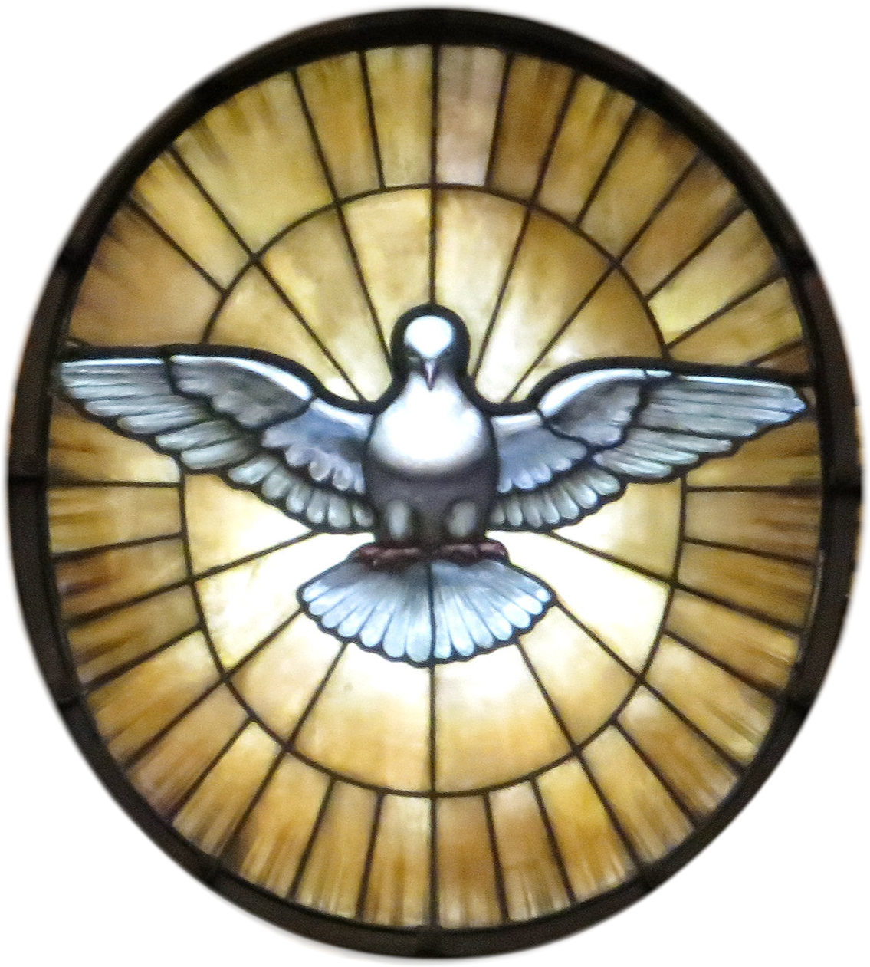
Questions
Humbly understanding the Holy Spirit is the ultimate Formator,
this companion workbook contains suggested questions to assist not only the formator but also the virgin in her understanding the essence of the gift of virginity lived in the world consecrated to God for the sake of the Kingdom,
so that on the day of her consecration she may place her hands into those of the Bishop and say…
“Father receive my resolution to follow Christ in a life of perfect chastity which, with God’s help, I here profess before you and God’s holy people.”
from the renewal of Intention from the Rite of Consecration

Slide 10
Background Information and Initial Discernment
Included in the first “companion workbook” of this formation program,
the Homily and the Prayer of Consecration
of the Rite express the spirituality and the charism of the gift of virginity.
Recognition of the gift is immediate
when the virgin, given the gift of virginity to be lived in the world,
reads this Homily and Prayer of Consecration.
It answers all the questions in her heart and soul.
She knows she is not called to live in a religious community,
but still wants to give her life totally to Jesus.
Her life is Church-centered but lives in the world.
Her devotion to Our Lady and Our Eucharistic Lord are the main stay of her spiritual life.

Slide 11
After the Background Information Initial Discernment … then comes Saint Joseph
The help of Saint Joseph
at the beginning of
The Heart of the Bridegroom Formation Continuing Formation Companion Workbook Program is key in embracing and understanding the grace of receiving a gift from the heavenly Father as did Saint Joseph.

Slide 12
Why Saint Joseph? 3 Companion Workbooks on St Joseph
What does the Church tell us of Saint Joseph?
Litany of Saint Joseph
Mysteries of the Rosary
Liturgy of the Hours
Office of Readings 2nd Reading
Solemnity of Saint Joseph, March 19th
Feast of the Holy Family
Apostolic Letter
With a Father’s Heart
These are two spiritual tools with which you are invited to unwrap the mysteries of Joseph’s life.
Litany gives us the character of Joseph.
The Rosary invites us to look into the shadows to see where Joseph is present in person or spirit.

Slide 13
Liturgy of the Hours Office of Readings 2nd Reading March 19th Solemnity of Saint Joseph The sermon by Saint Bernadine of Siena
“There is a general rule concerning all special graces granted to any human being. Whenever the divine favor chooses someone to receive a special grace, or to accept a lofty vocation, God adorns the person chosen with all the gifts of the Spirit needed to fulfill the task at hand.
This general rule is especially verified in the case of Saint Joseph….

Slide 14
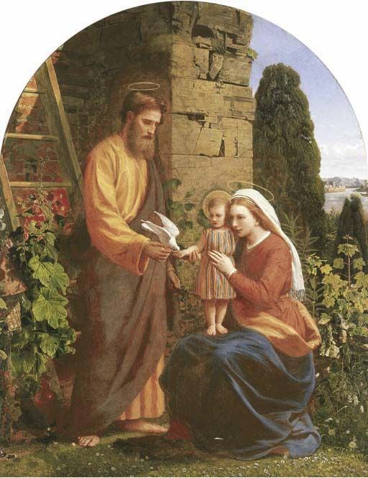
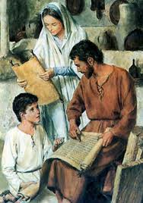
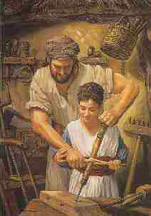
Liturgy of the Hours Office of Readings 2nd Reading Feast of the Holy Family Pope Paul VI , Address on Nazareth
School of Nazareth
Nazareth is a kind of school where we may begin to discover what Christ’s life was like and even to understand his Gospel.
Here we can observe and ponder the simple appeal of the way God’s Son came to be known, profound yet full of hidden meaning. And gradually we may even learn to imitate him.
Nazareth can teach us the value of study and preparation, of meditation, of a well-ordered personal spiritual life, and of silent prayer that is known only to God.

Slide 15
With a Father’s heart: that is how Joseph loved Jesus…
In every situation, Joseph declared his own “fiat”, like those of Mary at the Annunciation and Jesus in the Garden of Gethsemane.
In his role as the head of a family, Joseph taught Jesus to be obedient to his parents (cf. Lk 2:51), in accordance with God’s command (cf. Ex 20:12).
During the hidden years in Nazareth, Jesus learned at the school of Joseph to do the will of the Father.
That will was to be his daily food (cf. Jn 4:34). Even at the most difficult moment of his life, in Gethsemane, Jesus chose to do the Father’s will rather than his own, becoming “obedient unto death, even death on a cross” (Phil 2:8). The author of the Letter to the Hebrews thus concludes that Jesus “learned obedience through what he suffered” (5:8).
All this makes it clear that “Saint Joseph was called by God to serve the person and mission of Jesus directly through the exercise of his fatherhood” and that in this way,
“he cooperated in the fullness of time in the great mystery of salvation and is truly a minister of salvation.”

Slide 16
Litany of Saint Joseph Mysteries of the Rosary & the Litany of Saint Joseph
The Litany of Saint Joseph
and the
Mysteries of the Rosary
prayed in the light of the virtues from the Litany of Saint Joseph
allow us to enter into
the shadow of love which protected the Holy Family.
It was the shadow of Saint Joseph called for by the Father to care for
His two greatest treasures,
Jesus and Mary.
Ponder these virtues and mysteries.

Slide 17
Formal and Informal Introductions Companion Workbook
The first chapter, of The Heart of the Bridegroom, pages 5-7, covering the topic of this companion workbook invites you to read the references listed from not only
The Code of Canon Law
but also
The Catechism of the Catholic Church.
These references will enrich your understanding of the various forms of consecrated life and the uniqueness of the consecration to a life of virginity for women living in the world.

Slide 18
Sacred Scripture Old Testament
This second chapter invites you to see in the Old Testament the lessons Joseph and Mary taught Jesus and teach us today.
“Build up your love of God by the study of Scripture.”
Listed in this companion workbook are Old Testament passages that are considered as fulfillment of the prophecies.

Slide 19
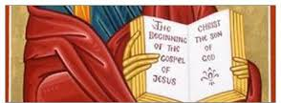
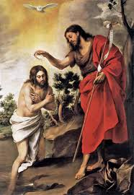
New Testament Gospel s
Saint Matthew
Saint Mark
It is in the Gospel of Saint Matthew we find the
Examples of humility.... “Learn from me
for I am meek and humble of heart.”
Examples of obedience ….
And we find the teaching on the gift of virginity for the sake of the Kingdom. For the virgin called to be the bride of Christ it is important for her to know what is important to Jesus the Bridegroom. Take time now with your Bible to ponder the passages Gospel of Matthew.
Mark never forgot the divine side of Jesus.
He begins his gospel with a declaration of faith,
“The beginning of the gospel of Jesus Christ the Son of God.” Again and again he speaks of the impact Jesus made on the mind and heart of those who heard him.

Slide 20
New Testament Gospels
Saint Luke
Saint John
This brings us to Saint Luke’s Gospel and the view from the heart of Mary.
Here we have the accounts of the mystery of the Annunciation and Incarnation.
These two events in the life of Jesus are foundational in the understanding of this vocation.
This companion workbook has many key elements for pray and interiorizing the beauty of these two mysteries in the life of the consecrated virgin.
We see in the Prologue of the Gospel of St. John the heart of God the Father made visible in the Divine Person of Jesus Christ, Son of God, Son of Mary.

Slide 21
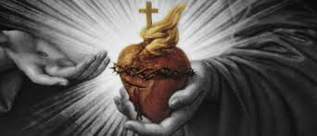
Litanies of Love
The next 3 companion workbooks will focus on litanies which bring out the attributes of the Heart of Jesus and His Eucharistic Presence. As virgins consecrated to Him we are called to be one with His Heart and so must make as our own and live these characteristics.

Slide 22
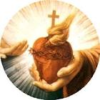
Litany of the Sacred Heart of Jesus
This companion workbook offers a blank page for each invocation.
Pondering the invocations of his Sacred Heart will be key in growing in the likeness of Jesus and his Sacred Heart and to be more fully His bride.
As you grow in your love and understanding of the Sacred Heart of Jesus, the Solemn Blessing used in the Mass of Consecration will be a wellspring of graces.
“May the Lord Jesus, who unites to himself the hearts of sacred virgins in a nuptial covenant, make your hearts fruitful by the word that is God’s seed. ”
Rite of Consecration, Concluding Rite.

Slide 23
“You are apostles in the Church and in the world. In the things of the Spirit and in the things of the world.” Homily, Rite of Consecration Saint Faustina, Apostle of Mercy
Litany of Divine Mercy
Litany to the Blessed Host
In her diary, Saint Faustina, the Apostle of Mercy writes:
“The Love of God is the flower – Mercy the fruit.
Let the doubting soul read these considerations on Divine Mercy and become trusting.
Divine Mercy, gushing forth from the bosom of the Father, I trust in you….”
She continues with 34 more invocations to the Divine Mercy.
It was 1934-1935, during a time of adoration at the end of one year and beginning of a new year she writes invocations to the Blessed Host.
“O Blessed Host, in whom is contained the testament of God’s mercy for us, and especially for us sinners.”
In the thirty invocations that follow we pray with her, find the fullness of God’s presence in the Blessed Host, infinite mercy, hope in the midst of overwhelming trials, fire of purest love, and trust when all seems dark, that confident trust in the “sea of his mercy”.

Slide 24
Solemnity of the Sacred Heart of Jesus
Readings for Mass
Liturgy of the Hours
This next section includes the proper readings for Mass for each of the three-year cycle of the Solemnity of the Sacred Heart of Jesus.
The readings from both the Old and New Testaments will be familiar to you. They echo the mystery of love of the Word made flesh and splendor of the Father.
They echo the sacrifice to which Love is called and to which it continues to call.
As his bride, the virgin makes these readings part of her own way of life.
Integrating the call to fidelity along the way of the cross to the Kingdom of Heaven, who is Jesus.
(Pope Benedict, Jesus of Nazareth page 40)
Along with the liturgical celebrations of the Solemnity of the Sacred Heart for Mass, the Church also provides the rich collection of antiphons, psalms, canticles and readings for this Solemnity for those who are called to pray the Liturgy of the Hours, which includes the consecrated virgin – “Receive the book of the Liturgy of the Hours, the prayer of the Church; may the praise of the heavenly Father be always on your lips; pray without ceasing for the salvation of the whole world.”
(From the Rite, Presentation of the Insignia # 28)

Slide 25
Catechism of the Catholic Church & The Sacred Heart of Jesus
The Church has a beautiful teaching on the Sacred Heart of Jesus rooted in the the Sacred Scriptures.
This companion workbook has included the passages, references and cross references of the Catechism.
478 “…He has loved us with a human heart.
For this reason, the Sacred Heart of Jesus, pierced by our sins and for our salvation, is quite rightly considered the chief sign and symbol of that... love with which the divine Redeemer continually loves the eternal Father and all human beings without exception….”

Slide 26
Vita Consecrata
Formation
Continuing Formation
The back cover of each of the companion workbooks have several quotations from the Apostolic Exhortation of Pope Saint John Paul II
Vita Consecrata
A frequent reminder of essence of formation
and the importance of continuing formation will provide the reminder that formation encompasses ones whole life.
“Make your whole life reflect your vocation and your dignity.”
Rite of Consecration, Homily

Slide 27
Resources and Recommended Reading
This list of works included in the book
The Heart of the Bridegroom
will provide additional material
if clarification or enrichment is needed or desired.

Slide 28
The Diocese of La Crosse Office for Consecrated Life has many resources available for this vocation.
Each priest and deacon from the Diocese of La Crosse has received a copy of the following two publications:
1. Pastoral Guide 2.Background Information Initial Discernment

Slide 29
Pastoral Guide for Priests & Deacons
Basic Information for the vocation of Consecrated Virginity for Women Living in the World
Information from:
*Code of Canon Law Can. 604 §1
*Roman Pontifical
Introduction
Nature & Value of Consecrated Virginity
Those who may be Consecrated
*Catechism of the Catholic Church
nos. 922, 923, 924
*Resources Materials
available from the Diocese of La Crosse
Office for Consecrated Life
The information you are receiving is to help in the understanding of some basics when offering spiritual guidance with discernment a virgin’s desire to give her all to God but not feeling called to religious life in community.
You might call it:
Consecrated Virginity Lived in the World 101
Feel free to make copies of this information as you need it.

Slide 30
Initial Discernment Background Information
The spirituality and charism are expressed in these words given to us
by Holy Mother Church.
Any virgin reading and praying with these will immediately find in them the answer to the deepest longing of her heart.
“The rite for the consecration of virgins
belongs to the treasures of Roman liturgy.
Jesus Christ left holy virginity as a legacy to His bride,
one of His most precious gifts.”
From the Decree for Promulgation of the Rite of Consecration May 31, 1970
This first companion workbook contains the very key to the gift of the vocation.
*Passage from 1970 Document on the Promulgation of the Rite of Consecration
*The Homily
*The Prayer of Consecration
from the Rite of Consecration found in the Roman Pontifical.

Slide 31
Resource Materials
In addition to the basic introduction to the vocation with The Heart of the Bridegroom Program, the Diocese of La Crosse has a set of resource materials all based on the Rite of Consecration to assist the virgin and those accompanying her on her spiritual journey. Here is an image of what is available for purchase by both the virgin and those working with her.

Slide 32
Those able "to receive it"
are those
"to whom it has been given.“
Pope John Paul II
Theology of the Body
Virginity or Celibacy for the sake of the Kingdom #72/ #4

Slide 33
Permissions
Imprimatur for the text The Heart of the Bridegroom
Given at La Crosse the Fifteenth of February
In the Year of Our Lord 2016
+Most Reverend William Patrick Callahan, OFM Conv
Bishop Of La Crosse, Wisconsin
CBS Graphics, La Crosse, Wisconsin
Published by Diocese of La Crosse, Wisconsin
United States of America
Written and compiled by Miss Barbara Swieciak
Consecrated Virgin Diocese of La Crosse
Copyright © January 21, 2016
Memorial of Saint Agnes, Virgin and Martyr
Excerpts from the Lectionary for use in the Diocese of the United States of America, second typical edition Copyright © 1970, 1986, 1992, 1998, 2001 Confraternity of Christian Doctrine, Inc. Washington DC.
International Commission on English in the Liturgy Corporation (ICEL); excerpts from the English translation to a life of virginity ©
Copyright © permission from Libreria Editrice Vaticana:
Sacred Congregation for Divine Worship, Decree promulgating the new rite for the consecration of a virgin, 31 May 1970
Pope John Paul II, The Theology of the Body, On Virginity for the Sake of the Kingdom
John Paul II, Vita Consecrata, March 25, 1996
Joseph Cardinal Ratzinger, Homily, Mass of Consecration 25 March 1988

Slide 34
Thank you for your time!
I pray this presentation has helped you understand the mysteries of this treasure of the Roman liturgy!
God’s choicest blessings!
“The rite for the consecration of virgins belongs to the treasures of Roman Liturgy. Jesus Christ left holy virginity as a legacy to His bride, one of His most precious gifts.”
Decree for Promulgation May 31, 1970

