Slide 1

For the Safety and Protection of Children
Safe Environment
Fifth Grade

Slide 2
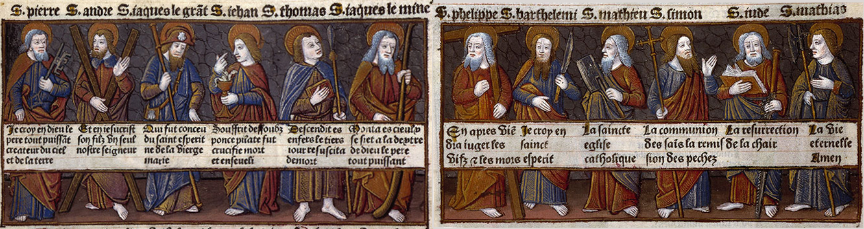
I believe in God, the Father almighty, Creator of heaven and earth, and in Jesus Christ, his only Son, our Lord, who was conceived by the Holy Spirit, born of the Virgin Mary, suffered under Pontius Pilate, was crucified, died and was buried; he descended into hell; on the third day he rose again from the dead;
he ascended into heaven,
and is seated at the right hand of God the Father almighty; from there he will come to judge the living and the dead. I believe in the Holy Spirit, the holy catholic Church, the communion of saints, the forgiveness of sins, the resurrection of the body, and life everlasting. Amen.
Notes:
Open the lesson by praying together the Apostles’ Creed, the prayer that expresses, in a concise way, everything that we believe.
I believe in God,
the Father almighty,
Creator of heaven and earth,
and in Jesus Christ, his only Son, our Lord,
who was conceived by the Holy Spirit,
born of the Virgin Mary,
suffered under Pontius Pilate,
was crucified, died and was buried;
he descended into hell;
on the third day he rose again from the dead;
he ascended into heaven,
and is seated at the right hand of God the Father almighty;
from there he will come to judge the living and the dead.
I believe in the Holy Spirit,
the holy catholic Church,
the communion of saints,
the forgiveness of sins,
the resurrection of the body,
and life everlasting. Amen.

Slide 3
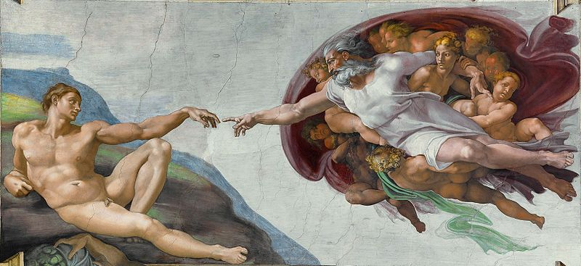
God created you and every person in His image.
Notes:
God is love. God reveals His love through creation. God created us in His image and loves each person completely. We are children of God, and He is our loving Father.
God created you in His image, which means that you can think and you can choose. You can choose to be selfless and think of others first. Or you can choose to act in a way that is unkind and selfish, which will make you unhappy and even miserable and offends God because you are offending another person.
When Adam and Eve chose against God and sinned they separated themselves from God. Out of love, God promised a Savior.
Jesus loves you so much that He wants you to know Him, to develop a deep friendship with Him and to be so close to Him that He is united with you.

Slide 4
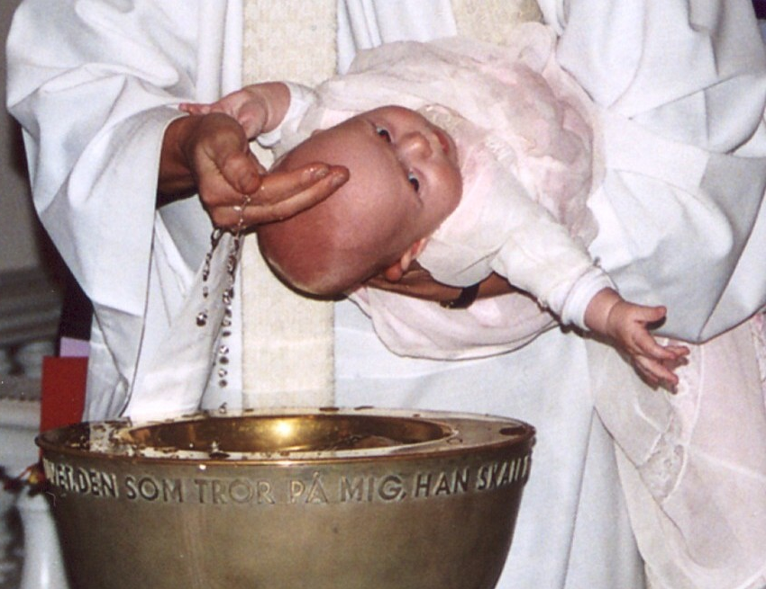
“Before I formed you in the womb I knew you, and before you were born I consecrated you.” (Jeremiah 1:5)
Notes:
“…I will never forget you. See upon the palms of My hands I have written your name…” God (Isaiah 49:15b, 16a)
God is our creator. All that God made is good.
God created you and He knows you. He knows everything about you. And He loves you!
You need to be grateful to God for His incredible love.
Since you are created in the image of God and He loves you, He wills that you love yourself. You show love for your soul by striving for holiness by loving God and every other person. You show love for your body by eating healthy food, sleeping over 8 hours, proper hygiene, by protecting your body from harm and through modesty. Modesty is decency in dress, thoughts, words and deeds.

Slide 5

God made every person unique
& unrepeatable!
Notes:
What does the word unique mean?
What does the word unrepeatable mean?
What does it mean that God made every person unique and unrepeatable?
Each person is unique, unrepeatable, and has inherent dignity from God. Further, each person has a unique role in God’s plan. Therefore, each person is to be shown respect, even if the individual has different interests and abilities than you or is impaired in some way. Having respect toward another person means that we show him/her honor and esteem because he/she is a child of God who deserves consideration and regard. See Diocesan Virtue Program, Respect for more teaching. diolc.org/catechesis/understanding-and-living-the-virtues/respect/
A good book or movie that the students are familiar with may help the children to understand the meaning of unique and unrepeatable. [Example: Wonder]

Slide 6
O Lord, You have searched me and know me!
You know when I sit down and when I rise up;
You discern my thoughts from afar.
You search out my path and my lying down and are acquainted with all my ways.
Even before a word is on my tongue, behold,
O Lord, You know it altogether.
(Psalm 139:1-4)
Notes:
“Truly You have formed my inmost being; You knit me in my mother’s womb.
I give You thanks that I am fearfully, wonderfully made; wonderful are Your works.
My soul also knew full well; nor was my frame unknown to You
When I was made in secret, when I was fashioned in the depths of the earth.
Your eyes have seen my actions; in Your book they are all written.” (Psalm 139:13-16a)

Slide 7
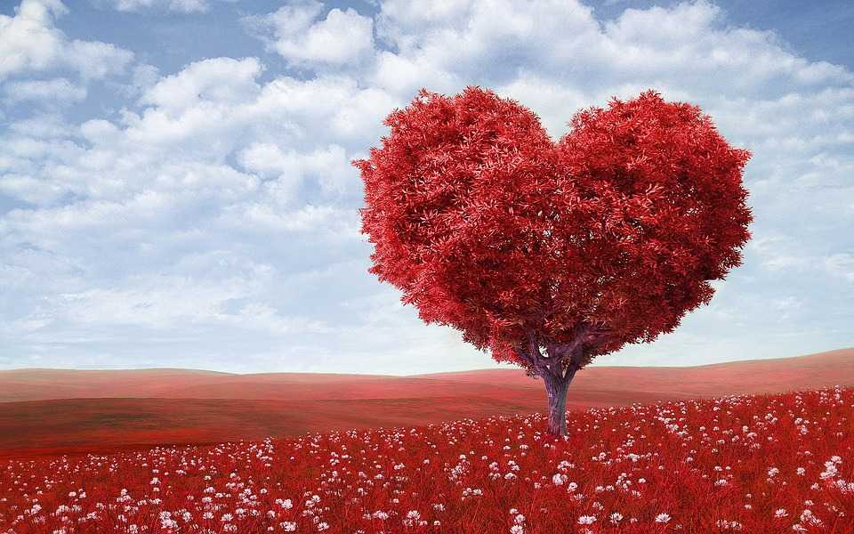
You are a chosen, dearly beloved child of God.
Notes:
God loves you so much that He sent His own Son to die on the Cross for you and for every person. Read John 3:16
You are a chosen, dearly beloved child of God.
Because you are so important to God, and every other person is so important to God, you are to love yourself and others.
Since all people are created in the image of God and He loves each person, He wills that you love all people (no matter how good they are at sports, or a musical instrument, or reading or if they can’t walk etc.). To love means to will and act for the good of another person. Willing and acting for the good of another person means to think and act in a way that is selfless (turning outward) and not selfish (turning inward). A person is to be loved not a thing to be used – in any way. Jesus wants you to treat others with kindness.

Slide 8
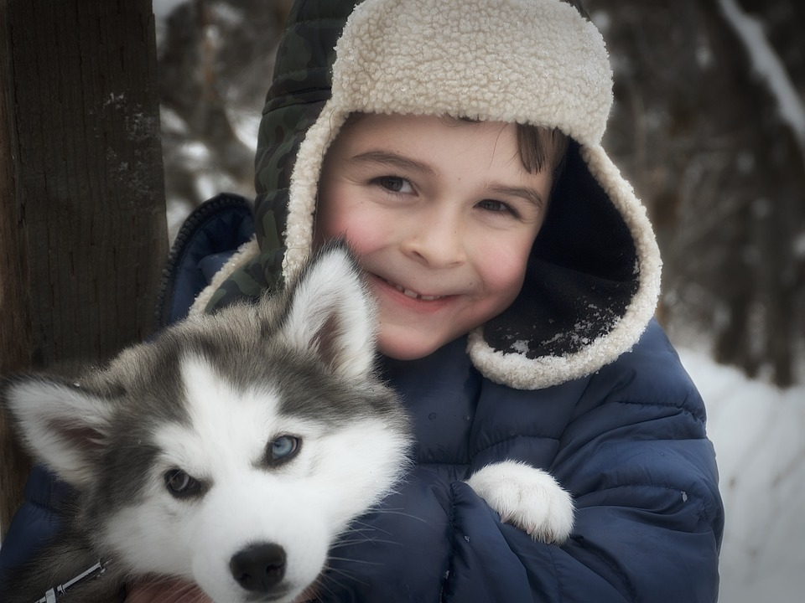
Each Person is a Child of God and has dignity.
Notes:
What is dignity? Dignity means self-worth; it is the recognition of a person’s incredible importance as a person created by God with an immortal soul - a soul that will live forever and a body that needs to be taken care of, and not abused in any way. The dignity of the human person is rooted in his being created in the image and likeness of God.
God has created each person with the gift of freedom, so that you can choose freely to receive His love and love Him in return and then give His love to others.
God has created you with a desire for happiness placed in your heart in order that you draw closer and closer to Him, because He is the only One who can fulfill this desire for happiness.
God wants you to spend eternity with Him in Heaven.
You should be grateful for God’s incredible love for you and for each person.
God will never stop loving you!
With the students, use an example of a parent, grandparent, aunt or uncle or any trusted adult still loving them even after they did something wrong.

Slide 9
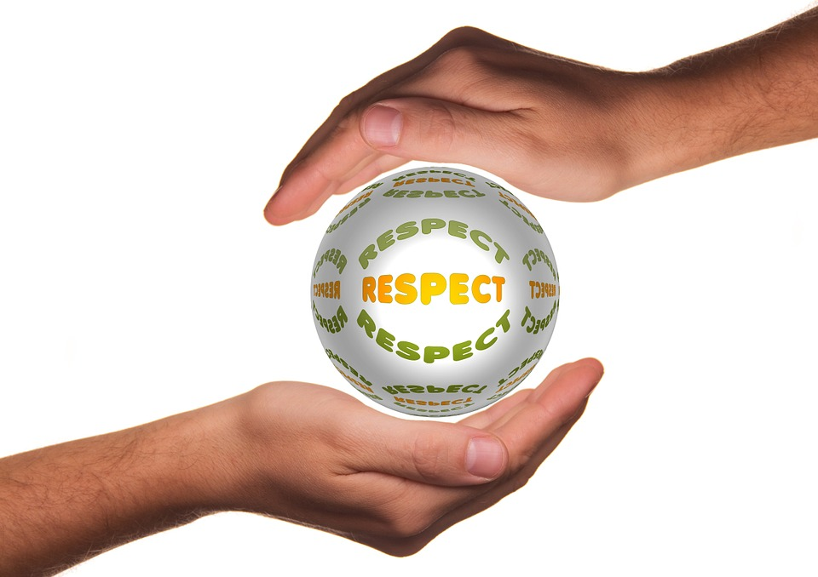
Each Person Deserves Respect!
It’s not just a word.
Notes:
John 15:12-13 This is my commandment, that you love one another as I have loved you. Greater love has no one than this, that someone lay down his life for his friends. You are my friends if you do what I command you.
Complete respect is to begin in your relationship with God in obeying His commands and responding to His desire that you spend time with Him in prayer each day. You show your love for God by loving others. You love others by showing them respect. Secondly, you are to respect yourself, maintaining a proper balance in all matters.
God has given you your parents and so you are to respect them. This is followed by a special respect for priests, religious, teachers, law enforcement offices, elders, siblings, relatives, neighbors and those in authority.
How do these actions show respect toward another person?
Speak kindly | Don’t speak ill of others
Refrain from idle complaints
Pay attention | Listen
Rediscover silence
Acknowledge and include others | Respect other’s opinions
Choose one from the list that you need to grow in. Pray to Jesus, asking Him to help you to practice and develop the habit of acting or speaking with respect.

Slide 10
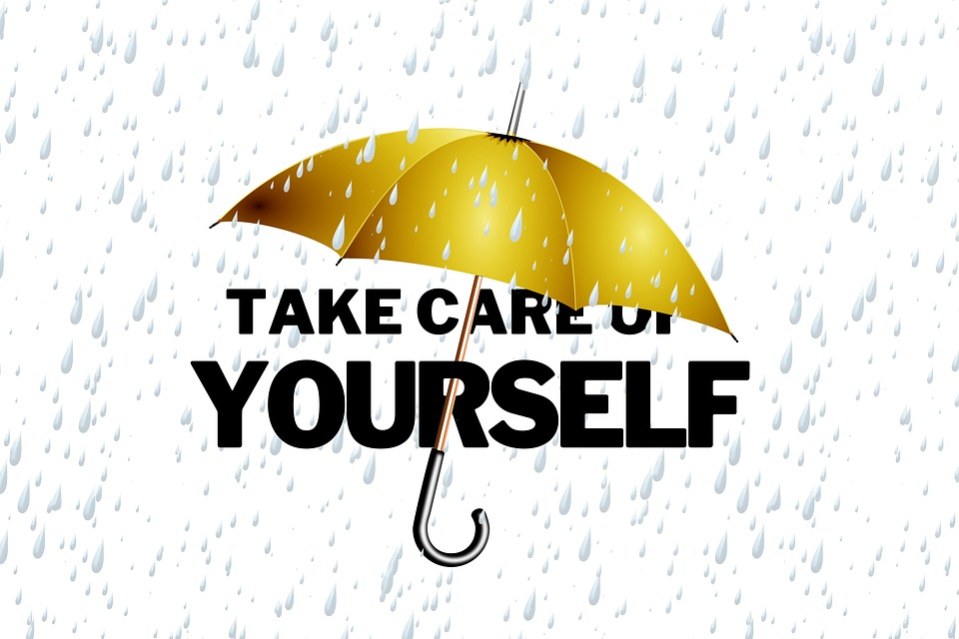
An important way of showing respect
Keep Yourself Safe.
Notes:
Due to the effects of Original Sin, we are inclined toward selfishness and pride. Therefore, we have to develop the virtue of respect. If a child is not taught how to respect parents and those in authority, he will neither respect God, himself, nor anyone else. (Diocesan Virtue Program – Respect)
One way of showing respect for yourself is by keeping yourself safe. God loves you very much and wants you to be safe. You are safe when you are not in danger. Some actions like hitting, shoving, grabbing and pushing are not good, kind or safe. These actions do not show respect toward another person(s).
What safety rules do you know that keep you safe? Examples if the students don’t say these:
Look both ways when crossing the street.
Be alert and attentive in all situations.
Wear a seat belt.
Do not play with matches.
Wear a helmet when riding a bike.
Do not smoke as it destroys your lungs.
It is important to know the following rules to keep you from harm & danger. The following seven rules should be discussed and a short phrase for each should be memorized.

Slide 11
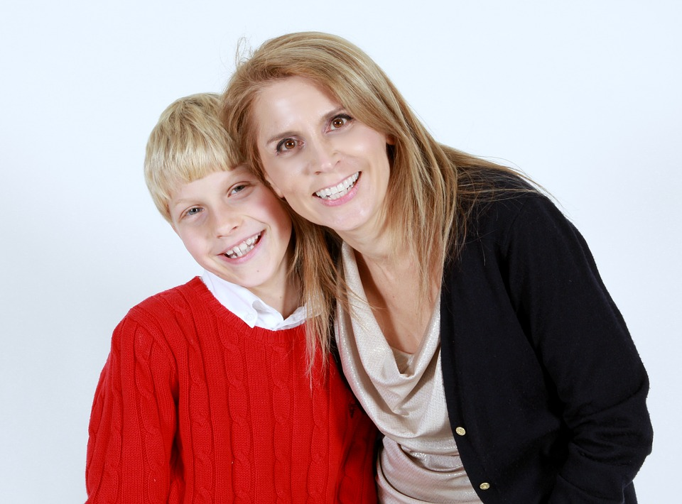
#1
Always tell someone
No person should ever treat you or touch you in a way that makes you feel uncomfortable or afraid. Always tell someone that you trust right away when you feel scared and not safe.
Notes:
After reading the slide: Who could you tell if you feel uncomfortable or afraid in a situation? This is different from being afraid when you are in trouble for doing something wrong.
You should tell someone like your mom, dad, teacher, or grandparents. You should tell them right away when you feel scared and not safe.
What signs of affection are appropriate and inappropriate?
Examples of appropriate signs of affection: a parent’s hug, a friends high-five; shaking hands when meeting someone for the first time; snuggling up with your grandmother when reading a book; hugging a friend who is moving away; hugging someone who is going through a difficult time.
Inappropriate signs of affection: a person that you do not know getting to close to you or wanting to spend time with you; a person that you know who touches you in a way that makes you feel uncomfortable, scared and not safe.
This is different from being scared when you do something that you were told not to and now you will be disciplined.
Even though you need to respect all people, some people might want to hurt you. If someone is hurting you, you MUST tell an adult you can trust. Tell them right away!

Slide 12

#2
Tell an offender to
If a person hugs or pats you, & if it makes you feel uncomfortable or scared, tell that person to STOP.
It is also O.K. to run and scream for help.
Notes:
It is o.k. to tell that person, a child or an adult, to STOP. It is o.k. to tell a big person “NO”, I don’t like that – when you feel uncomfortable or scared.

Slide 13

#3
Never get in a car with a
stranger!

Slide 14

#4
Scream
Scream “Help! I don’t know you”, if someone tries to take you.
Notes:
It is helpful to scream in this situation because then other people in the area will know that you need help.

Slide 15

#5
Parents need to be present
Never go to a friend’s house if their parents are not there.
Notes:
Why is this necessary and important?

Slide 16
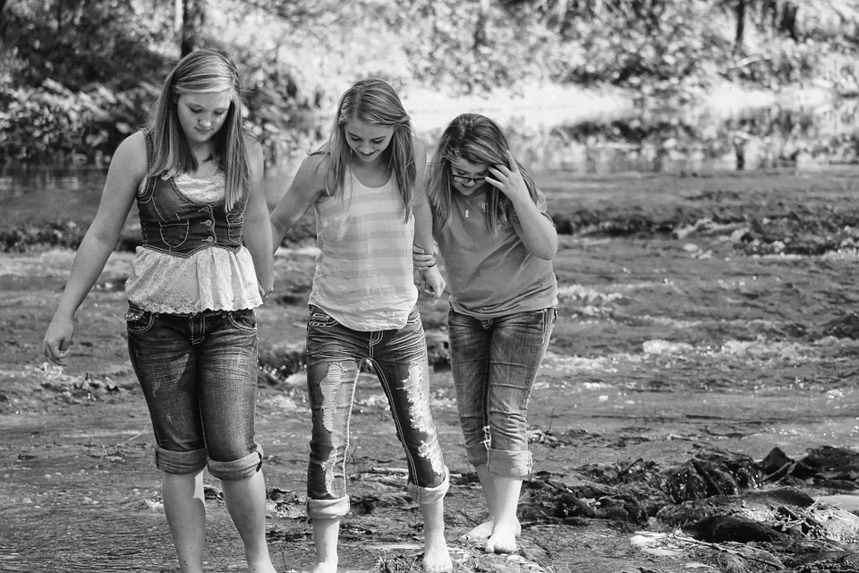
#6
Always go with a friend
If you are going somewhere, always go with a friend, & be sure to tell your parents when you leave. Always call your parents when you arrive at your place of destination.
Notes:
Explain the “Buddy System”
Always go with a friend refers not just to bike rides, but anytime that you are going somewhere.

Slide 17
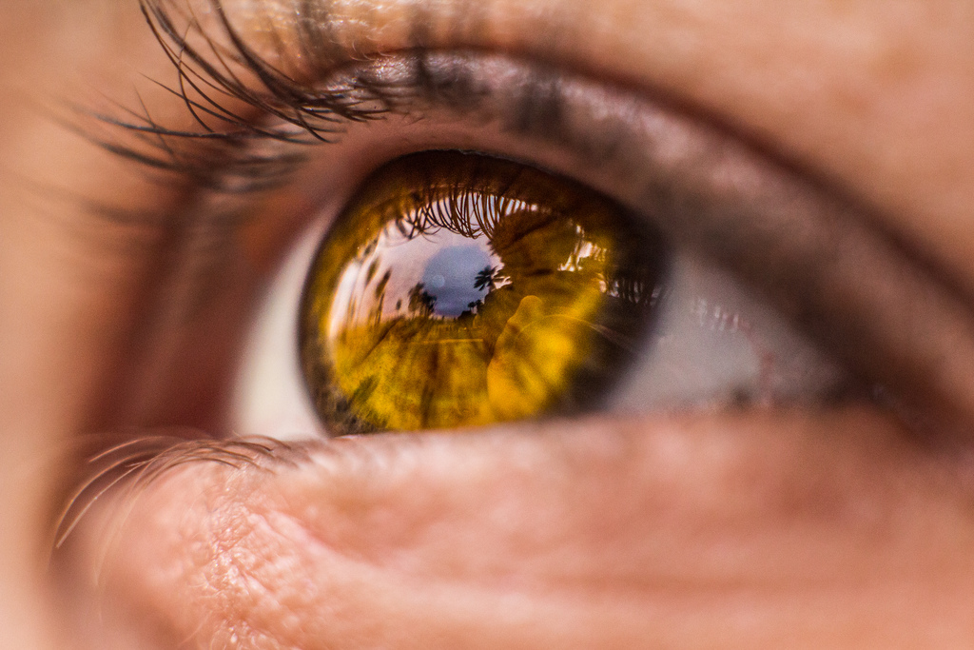
#7
Guard your eyes
It is ok to say that your parents don’t allow you to watch certain programs. Always know that you can call your parents.
Notes:
You do not want to watch things that are violent, or that do not show respect for people. You want to guard your eyes so that you don’t see these things, because your brain is like a computer and it holds what you see in your memory. You will want to watch good things so that you think about good things.
If you feel uncomfortable or scared when watching something on T.V. or a video program, it is a good sign that you don’t want to watch it.
Practice saying “NO” and acting in an assertive way by responding to these situations listed below.
You are walking home from school and a car with a young man /old man pulls up too close and asks you for directions. How can you respond to this situation.
You answer the telephone and you do not recognize the voice on the phone. The person says very unkind words to you. What will you do?
A person that you do not know says: “Your mom told me to come and pick you up and take you home.”

Slide 18

#8
Do not be afraid
You are loved by God and He wants you to live with peace and joy.
Notes:
You do not need to be afraid. You do want to follow these rules, to protect yourself from harm.

Slide 19
Remember
God loves you very much!
You have incredible worth as a child of God.
You, and every person, are to be treated with respect.

Slide 20
If you are being harmed, or if you feel sad, scared, unsafe, or uncomfortable…
Tell an adult that you trust right away!

Slide 21



How do we respect every person?
Notes:
1. See Catechism of the Catholic Church, respect for:
Every person: paragraphs 2055; Matthew 22:36-40
A person’s name: paragraphs 2158
Health: paragraphs 2288-2291
Read a book about Pope Saint John Paul II and /or St. Gianna Beretta Molla and report about how this person lived out the virtue of respect.
Memorize the following Scriptures over a time period:
Proverbs 13:1 “A wise son hears his father’s instruction, but a scoffer does not listen to rebuke.”
Sirach 3:2-6 “Whoever honors his father atones for sins…” (respect for parents)
4. “Respect for parents (filial piety) derives from gratitude toward those who, by the gift of life, their love and their work have brought their children into the world and enabled them to grow in stature, wisdom and grace… Filial respect is shown by true docility (following parent’s guidance) and obedience.” Catechism, paragraphs 2215-2216.

Slide 22
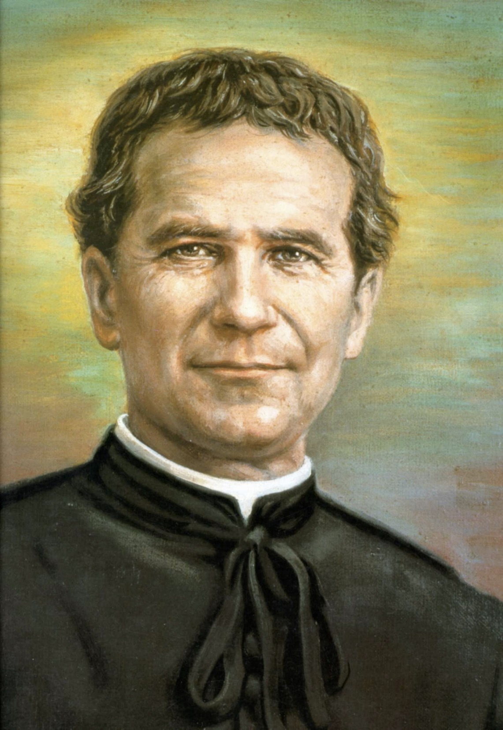
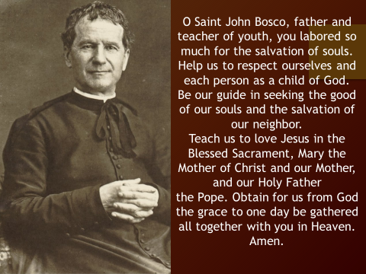
Notes:
The prayer to St. John Bosco, the patron of youth from the virtue of respect, Diocesan Virtue Program, page 3. diolc.org/catechesis/ click on Virtue Program.
Make a copy for each student:
O Saint John Bosco, father and teacher of youth, you labored so much for the salvation of souls.
Help us to respect ourselves and each person as a child of God. Be our guide in seeking the good of our souls and the salvation of our neighbor.
Teach us to love Jesus in the Blessed Sacrament, Mary the Mother of Christ and our Mother, and our Holy Father
the Pope. Obtain for us from God the grace to one day be gathered all together with you in Heaven. Amen.
2. Discuss the page entitled “Our Personal Dignity” that is part of the virtue of respect, Diocesan Virtue Program. Go to diolc.org/files/catechesis/Dignity.pdf
Make a list of the word from page one that describes the virtue of respect: diolc.org/files/catechesis/Respect_Teacher.pdf

