Slide 1
For the Safety and Protection of Children Safe Environment Sixth Grade

Slide 2
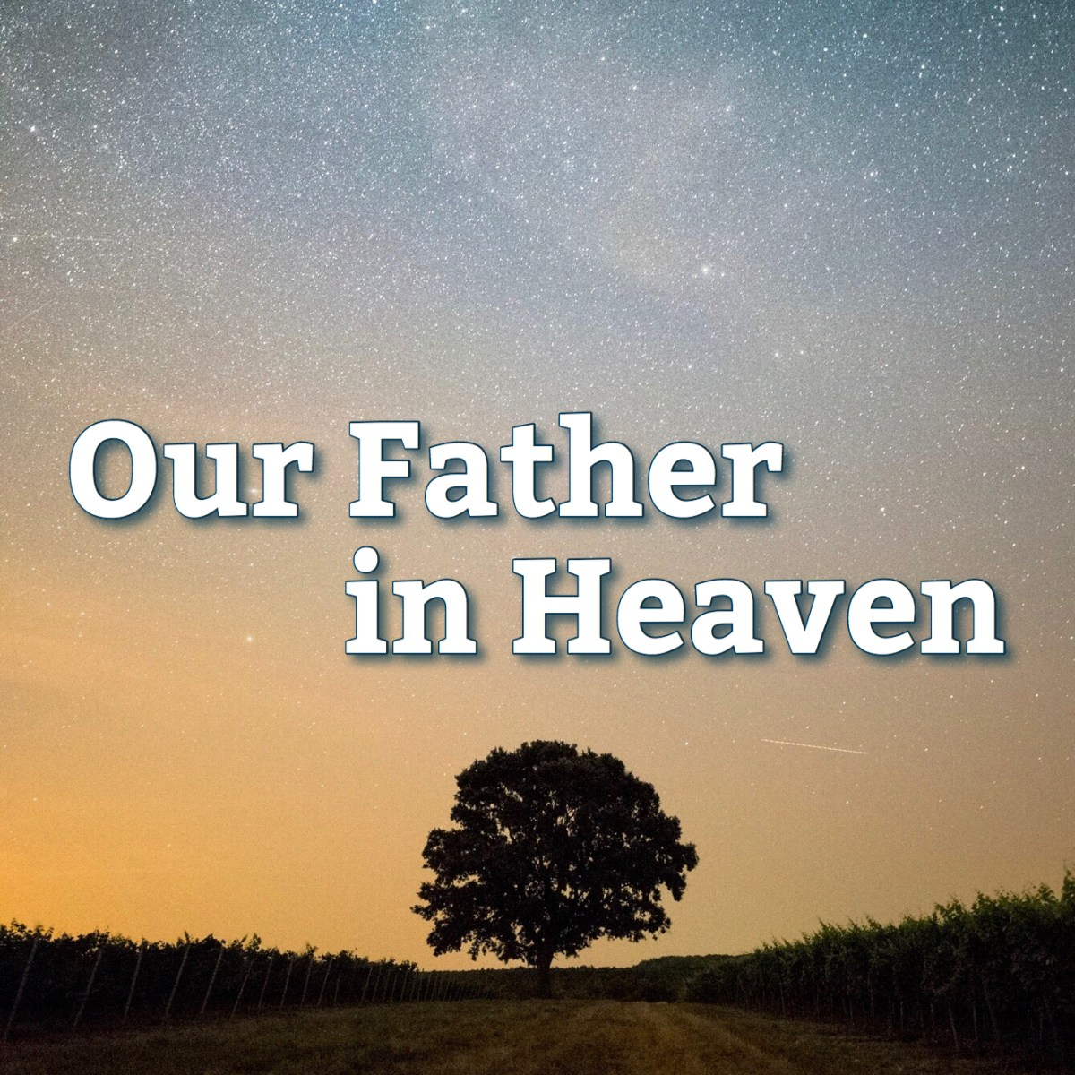
Our Father who art in Heaven, hallowed be Thy name.
Thy Kingdom come, Thy will be done on earth as it is in Heaven.
Give us this day our daily bread and
forgive us our trespasses as we forgive those who trespass against us and lead us not in to temptation but deliver us from evil. Amen
Notes:
Open the lesson by praying together the Our Father, the prayer that Jesus taught us and asks Our Heavenly Father for everything that we need.
Please lead the students to pray the words of the Our Father at a reverent pace, to remember that they are speaking with Our Heavenly Father.

Slide 3
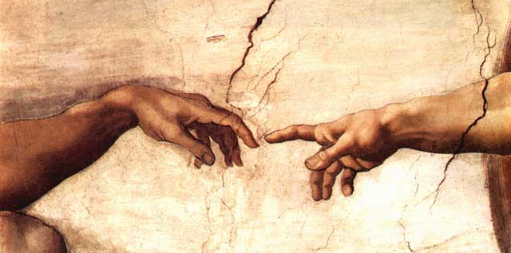
God created you and every person in His image
Notes:
God is love. God reveals His love through creation. God created each person in His image and loves each person completely. You are child of God, and He is our loving Father.
God created you in His image, which means that you can think and you can choose. You can choose to be selfless and think of others first. Or you can choose to act in a way that is unkind and selfish, which will make you unhappy and even miserable and offends God because you are offending another person.
When Adam and Eve chose against God and sinned they separated themselves from God. Out of love, God promised a Savior.
Jesus loves you so much that He wants you to know Him, to develop a deep friendship with Him and to be so close to Him that He is united with you.

Slide 4
God made every person unique!
Notes:
What does the word unique mean?
What does the word unrepeatable mean?
What does it mean that God made every person unique and unrepeatable?
Each person is unique, unrepeatable, and has inherent dignity from God. Further, each person has a unique role in God’s plan. Therefore, each person is to be shown respect, even if the individual has different interests and abilities than you or is impaired in some way. Having respect toward another person means that we show him/her honor and esteem because he/she is a child of God who deserves consideration and a loving regard.
Therefore, you have incredible dignity, value and identity in Jesus, and, every other person has incredible dignity, value and identity in Jesus. Things like popularity, looks, sports, clothes do not change this fundamental truth.
(From the virtue of respect, Diocesan Virtue Program, page 1, diolc.org/catechesis/understanding-and-living-the-virtues/respect)
A book or movie, such as Wonder, that the students are familiar with may help the children to understand the meaning of unique and unrepeatable.

Slide 5
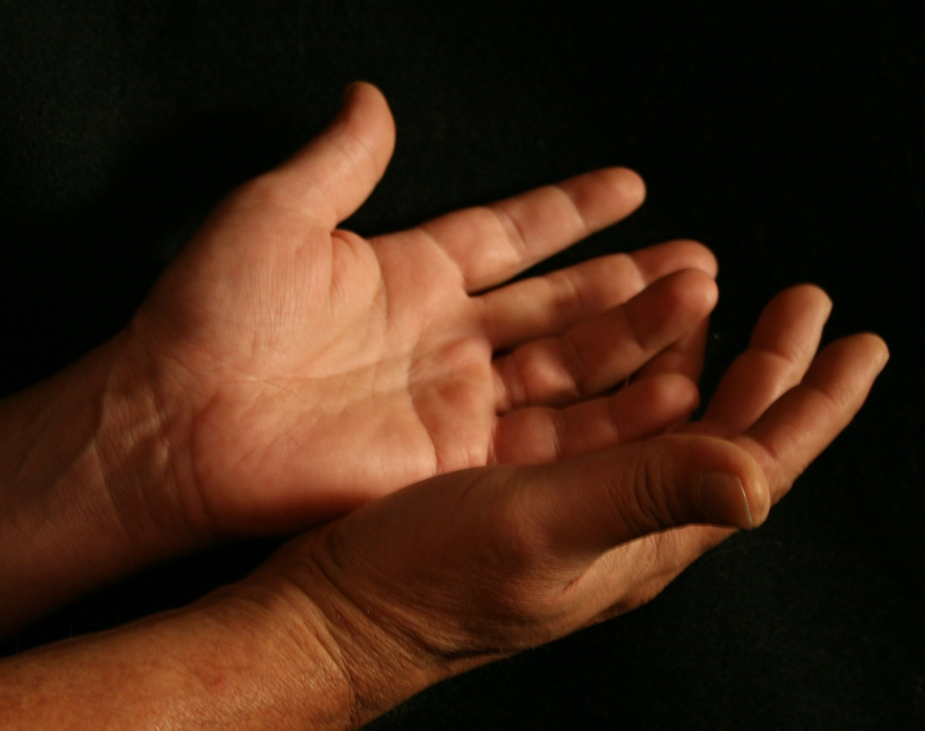
“I will never forget you. See upon the palms of My hands I have written your name”
(Isaiah 49:15b, 16a)
Notes:
“…I will never forget you. See upon the palms of My hands I have written your name…” God (Isaiah 49:15b, 16a)
God is our Creator. All that God made is good.
God created you and He knows you. He knows everything about you. And He loves you!
You need to be grateful to God for His incredible love.
Since you are created in the image of God and He loves you, He wills that you love yourself. You show respect for your soul by loving God through developing a friendship with Him in daily prayer, being His committed follower, and loving every other person. You show love for your body eating healthy food, sleeping 10 hours every night, practicing proper hygiene and by protecting your body from harm and through modesty. Modesty is decency in dress, thoughts, words and deeds.

Slide 6
Notes:
God is love and He made you for love. Each person is intimately, uniquely designed by God. You were created in love by God and loved by Him since before you were born. You are made for love and Heaven – your goal.
Holiness consists in following the will of God, and the will of God is that you walk the path of love, for God is love. To love means to seek the good of another person, thinking of the other person first. This is referred to as self-giving love and this is the complete opposite of selfishness. Selfishness is thinking of yourself, and only yourself, always first. Yes, we do need to take care of ourselves, but selfishness is about turning inward and has no regard for another person.
Therefore, there is deep meaning in each of our choices, in the way that you treat other people. With the help of God’s grace, you need to see yourself, and every other person, as a child of God, which will enable you to make proper choices throughout your life. Ask God to help you love every person, and to see each person as a child of God.
“My command is this: Love each other as I have loved you.” John 15:12

Slide 7
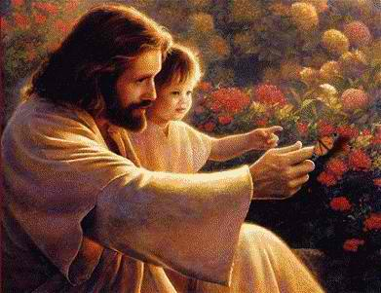
Each person is a child of God and has dignity.
Notes:
What is dignity? Dignity means self-worth; it is the recognition of a person’s incredible importance as a person created by God, who is able to know and love his Creator. Each person is created with an immortal soul - a soul that will live forever and a body. Both the soul and the body need to be taken care of, and not abused in any way.
The dignity of the human person is rooted in his being created in the image of God.
God has created each person with the gift of freedom, so that you can choose freely to receive His love and love Him in return and then give His love to others.
God has created you with a desire for happiness placed in your heart in order that you draw closer and closer to Him, because He is the only One who can fulfill this desire for happiness.
God wants you to spend eternity with Him in Heaven.
You need to be grateful for God’s incredible love for you and every person. God can never stop loving you!
With the students, use an example of a parent, grandparent, aunt or uncle or any trusted adult still loving them even after they did something wrong.

Slide 8
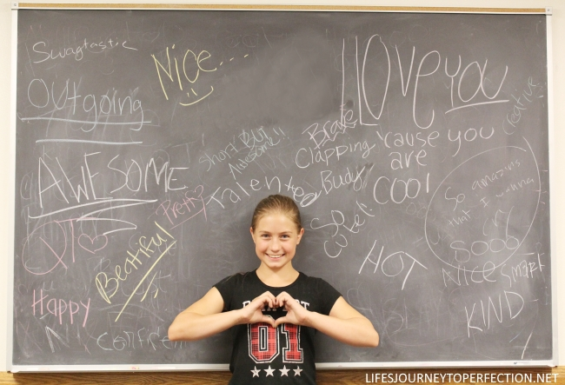
Notes:
We tend to equate dignity with surface values such as, popularity, looks, our ability in sports, a natural talent that we have etc. Some people use these surface values as a guide for their own self-worth, as well as the worth they place on others. The danger is that you can start to think that this is how God sees you. You need to move beyond these surface values and see God’s unending love for you and every other person and your relationship with Him as what reveals your true human identity.

Slide 9
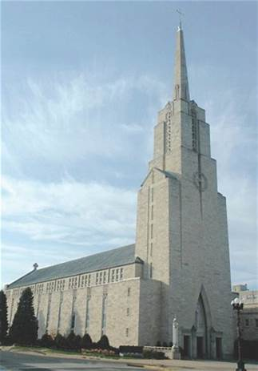
“Your body is a temple of the Holy Spirit.” God dwells within you.
(1 Corinthians 6:19-20)
Notes:
You know that you are a child of God and you have dignity because God reveals this truth to you: “Your body is a temple of the Holy Spirit.” This means that God dwells within you. We can think of an analogy in each Catholic Church. Jesus dwells within in the tabernacle. The Holy Eucharist is Jesus Himself and the Holy Eucharist – Holy Communion – is reserved in the tabernacle. There is always a red sanctuary light burning to signify this truth.
The Lord wants you to enjoy good things. You are to listen to, read and watch things that are good and pure, things that do not make you uncomfortable or that you know are wrong. You can consider the questions:
“Would Jesus think this program is good for you to watch?”
“Is it something that has to be whispered about?”
If the answers to these questions is “Yes,” then you should stay away from it. Fill your mind with everything that is good and pure.

Slide 10
The voice of conscience calls us “to love and do what is good and avoid what is evil.”
Notes:
God created you with an internal guide to help you determine which actions are good for you and which actions are bad for you; actions that are harmful to yourself and others. This is known as your conscience. The voice of conscience calls you “to love and do what is good and avoid what is evil.” Your conscience must be properly formed or taught. To form your conscience you must look to the Bible – the Word of God, to the Catechism of the Catholic Church which is explained in our Religion textbooks, and to the knowledge and practice of the Ten Commandments.

Slide 11
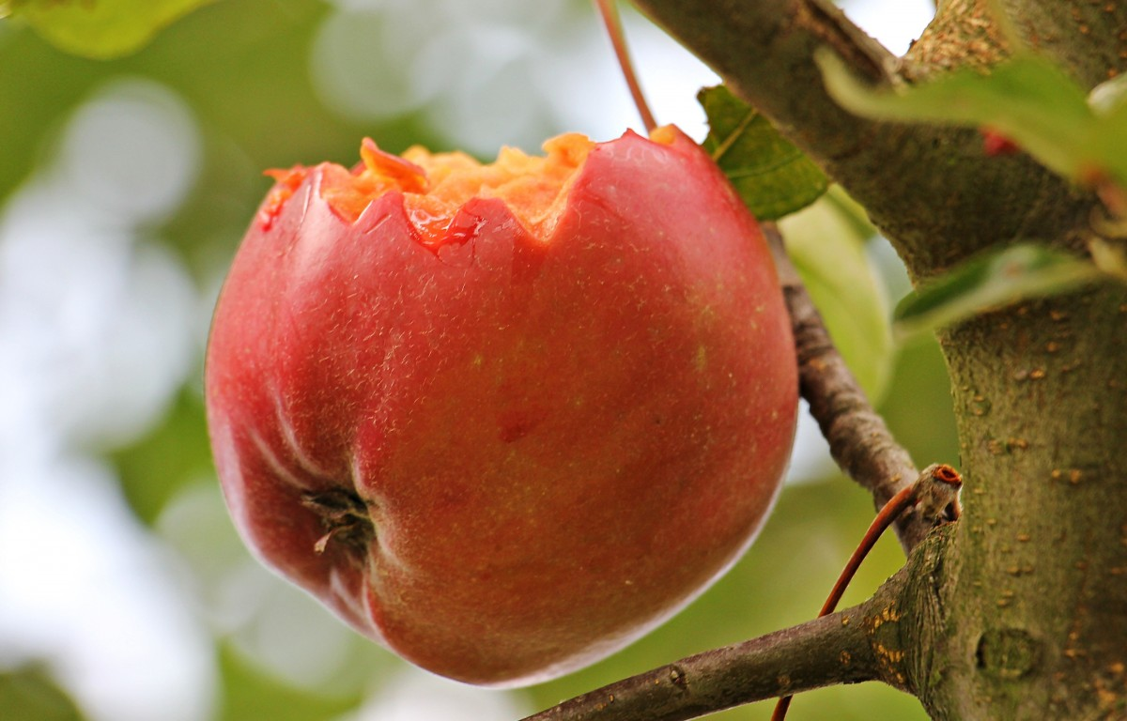
Notes:
God created you and knows everything about you. Why would you stray from His love?
Why did Adam and Eve sin? Our first parents choose against God, by eating from the tree that God told them not to because they did not trust God’s love for them. They thought that they were responsible for their own happiness. They were deceived by Satan to think that God was holding back on giving them good things. They did not understand that their friendship with God is the root of all true happiness. They doubted God’s love. They began to see Him as a tyrant who wanted to deprive them of good things, rather than a loving Father who wanted to give them “every good gift” (see James 1:17).
We sin for the same reasons as Adam and Eve. We tend to question God’s love for us and try and create our own happiness rather than accepting the gift of God’s love and friendship which is the foundation for true happiness.

Slide 12
Notes:
To make good decisions and avoid sin, you must develop good habits.
In order to live a life of joy, peace and fulfillment, you need to develop good habits. These good habits, also referred to as virtues, strengthen you to withstand temptations from outside influences, as well as from within your own heart, that would otherwise lead you into sin, and possibly dangerous situations. This growth in the virtues comes about especially as you cooperate with the power (grace) of the Holy Spirit, to develop good habits, leading you to become a person of integrity. A person of integrity lives in such a way that their thoughts, words and actions are all virtuously aligned with each other. In other words, you treat another person with respect not just because the teacher is watching, but because this person is a child of God, even if he/she is not good at Math, or sports, or a musical instrument or art, does not like the same things that you do.
We also refer to this as developing character and maturity.

Slide 13
Virtues
Patience
Honesty
Fortitude
Prudence
Notes:
Rules and structure support us to develop good habits. An analogy can be made between a virtue and a young plant that needs stakes and ties until it is strong enough to hold itself up. We need to develop these virtues in order to make good choices in the way that we treat other people. With those supports, we are better able to withstand temptations. A temptation is an attraction to act contrary to right reason and the commandments of God. We can be tempted to reject another person, or call them names, or make something up about them etc.
Patience, honesty, fortitude (courage), and prudence will strengthen you in your life to love yourself, and each person the way that God does.
Prudence means making good decisions. Prudence is a good habit that you develop through learning about it and practicing it in everyday life. Prudence helps you to know and choose what is good for yourself in every circumstance. It also helps you to foresee and avoid dangerous and harmful situations. It is wise to formulate a plan to avoid dangerous situations. It is also prudent to rely on a network of people you trust to help you know how to keep yourself safe. God gave you your parents, friends, and teachers to help you know when and how to avoid dangers, and to turn to them when you are in danger.
The following slides are some safety tips that will help you to make good decisions, thereby helping you to be safe.

Slide 14
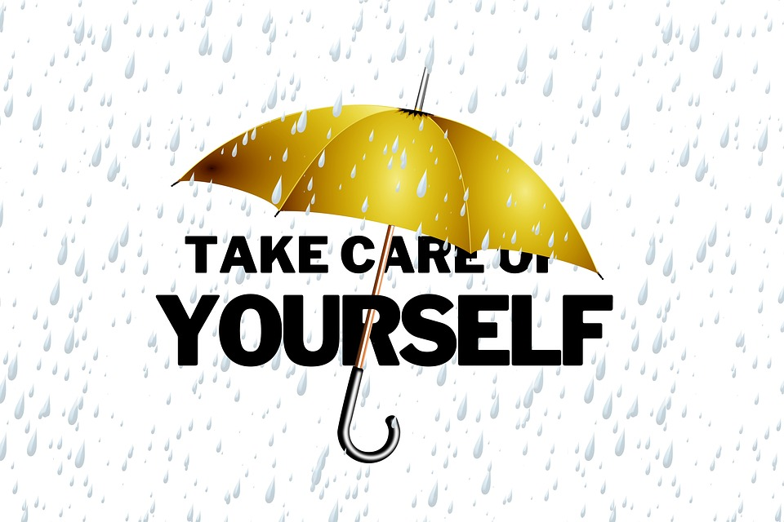
An important way of showing respect is
Notes:
In summary: God loves you and every other person with perfect love. You need to love yourself and every other person, which includes showing respect for yourself and others.
(See more information on respect here: diolc.org/catechesis/understanding-and-living-the-virtues/respect)
One way of showing respect for yourself is by keeping yourself safe. God loves you very much and wants you to be safe. You are safe when you are not in danger. Some actions like hitting, shoving, grabbing and pushing are not good, kind or safe. These actions do not show respect toward another person(s).
What safety rules do you already know that keep you safe? Examples:
Be alert and attentive in all situations.
Wear a seat belt | Wear a helmet when riding a bike.
A new safety rule that is a matter a life and death:
Do not smoke or vape as it destroys your lungs, and causes cancer which can lead to death.
The following nine slides should be discussed and a short phrase for each should be memorized.

Slide 15
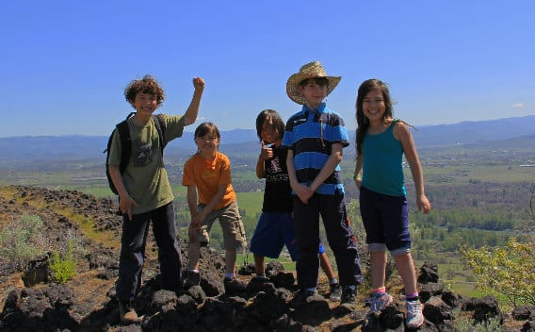
#1 Always be with a group when outdoors.
Notes:
Never go anywhere alone. Always have a “buddy” with you. Always go with a friend refers not just to bike rides, but anytime that you are going somewhere.
Discuss the “Buddy System” and why it is important.
Another important point: Be aware of your surroundings.

Slide 16
#2 Never Get in a Car with a Stranger
Notes:
Never get in a car with a stranger!
You should never hitchhike because you would be riding with someone that you know nothing about. This person could specifically be picking you up in order to seriously harm you.

Slide 17
#3 Don’t use shortcuts.
Notes:
You also want to obey warning signs that are placed there for your protection.
Do not use shortcuts, such as going down an unknown alley, or cutting through someone’s field that you do not know, because something could happen. There might be no one else around to see what took place, and to help you.
Keep in mind: Use well lit streets, walkways, and playgrounds.

Slide 18
#4 Have emergency numbers when you are home alone.
Notes:
Why is this safety rule important? What emergency numbers should you have available?
One answer:
The number of a neighbor or a near-by friend.

Slide 19
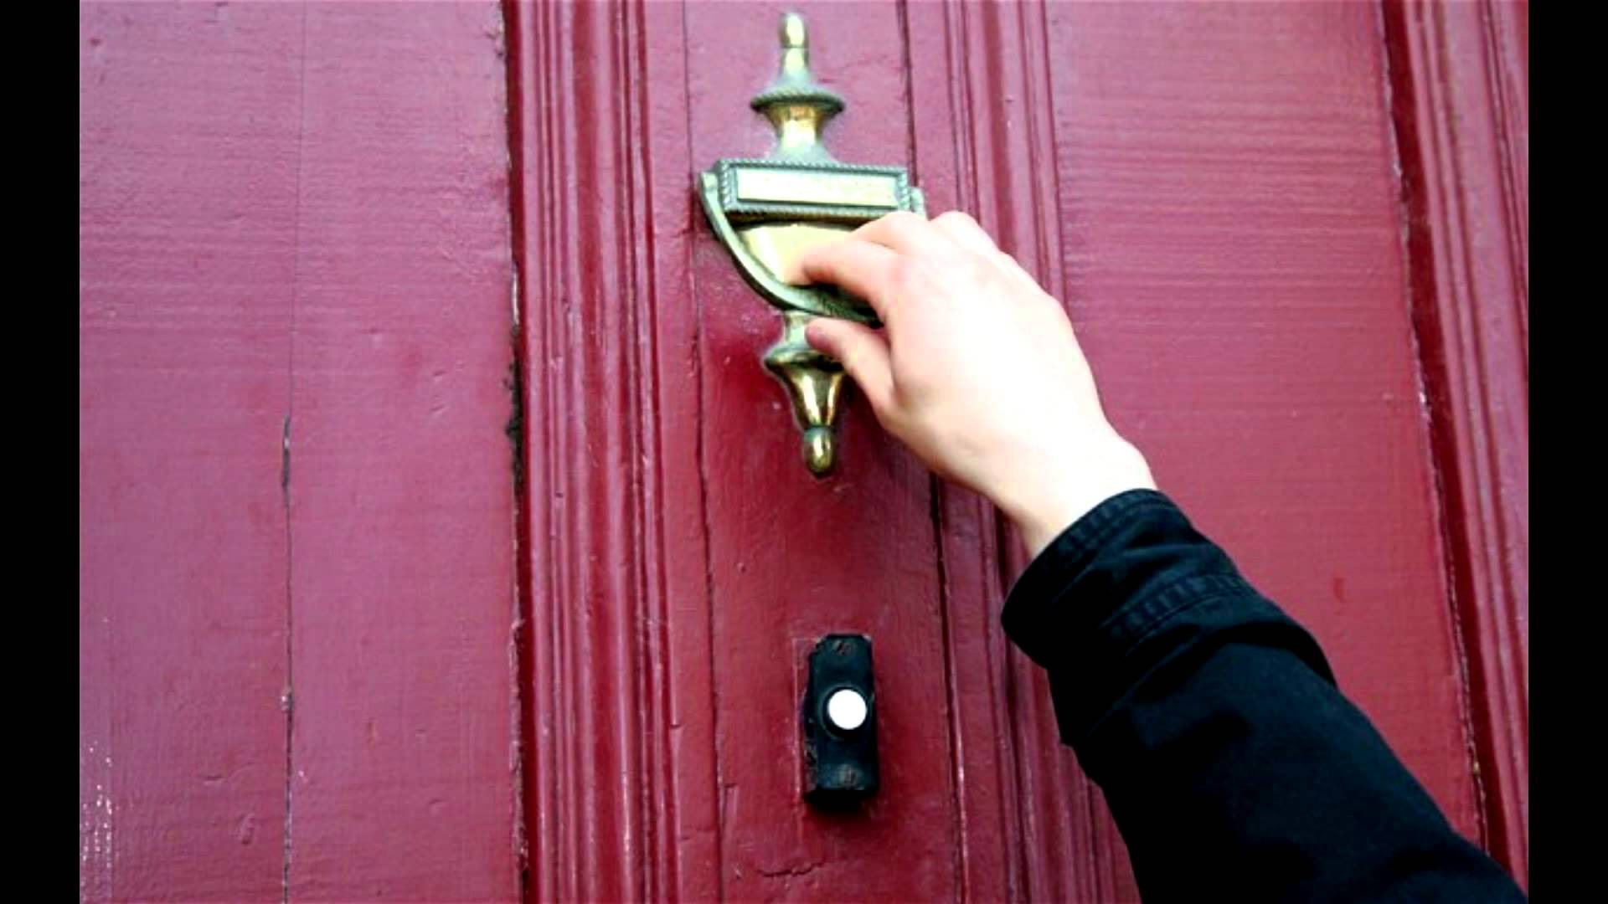
#5 Never answer the door unless you know the person.
Notes:
Why is this safety rule important? What could you say to a stranger if you answer the door and think it is going to be your friend who is coming to your house to meet you?
Practice saying “NO” and acting in an assertive way by responding to these situations listed below.
You are walking home from school and a car with a young man /old man pulls up too close and asks you for directions. How can you respond to this situation.
You answer the telephone and you do not recognize the voice on the phone. The person says very unkind words to you. What will you do?
A person that you do not know says: “Your mom told me to come and pick you up and take you home.”
You are babysitting for your younger sister and brother and the doorbell rings. What would you do?
You and your friend are shopping at the mall and a stranger is following you, asking you questions. How would you respond to this situation?
You are walking home with a friend. A young person that you do not know offers you a ride. How would you respond to this situation?

Slide 20
#6 If you are being treated inappropriately, or in a harmful way, it is ok to say, “STOP!”
Notes:
What person could you tell if you feel uncomfortable or afraid in a situation? You should tell this adult right away when you feel scared and not safe. This is different from being afraid when you are in trouble for doing something wrong.
What signs of affection are appropriate and inappropriate?
Examples of appropriate signs of affection: a parent’s hug, a friends high-five; shaking hands when meeting someone for the first time; hugging a friend who is moving away; hugging someone who is going through a difficult time.
Inappropriate signs of affection: a person that you do not know getting to close to you or wanting to spend time with you; a person that you know who touches you in a way that makes you feel uncomfortable, scared and not safe. It is o.k. to tell that person, a child or an adult, to STOP. It is o.k. to tell a big person “NO”, I don’t like that – when you feel uncomfortable or scared. It is helpful to scream in this situation because then other people in the area will know that you need help.
You need to understand appropriate actions and how these actions correspond to the truth about various relationships and settings.
Even though you need to respect all people, some people might want to hurt you.
If someone is hurting you, you MUST tell an adult you can trust. Tell them right away!

Slide 21
#7 Do not engage in inappropriate behavior.
Notes:
You do not want to watch things that are violent, or that do not show respect for people. You want to guard your eyes so that you don’t see these things, because your brain is like a computer and it holds what you see in your memory, for the rest of your life. You will want to watch good things so that as you think about good and beautiful and truthful things, you will experience peace and interior joy.
If you feel uncomfortable or scared when watching something on T.V. or a video program, it is a good sign that you don’t want to watch it.

Slide 22
#8 Don’t stay overnight at a friend’s house if their parents aren’t home.
Notes:
Never go to a friend’s house if their parents are not there. Discuss why this is a good rule to follow.
Provide the following if the students do not give these answers:
If someone gets hurt, there would not be an adult present to make mature decisions on what to do.
If a difficult circumstances arose, who would be in charge to stop the situation from getting worse?

Slide 23
#9 When at a friend’s house and are watching something that makes you feel uncomfortable, suggest watching something different.
Notes:
Why is this a good safety rule? How does this protect you?
God gives these words in the Bible, to help you to know that you need to guard your eyes, your thoughts and your imagination.
Finally, brothers and sister, what is true, whatever is honorable, whatever is right, whatever is pure, whatever is lovely, whatever is admirable, if anything is excellent, if there is anything worthy of praise, think about these things” (Philippians 4:8)
Trash in trash out (violence, disrespectful language to another person, etc.) Good things in, good things out.

Slide 24
Remember
God loves you very much!
You have incredible worth as a child of God.
You, and every person, are to be treated with respect.

Slide 25
If you are being harmed, or if you feel sad, scared, unsafe, or uncomfortable…
tell an adult that you trust right away!
Notes:
Discuss your safety plans with your parents and ask for their guidance when you are planning an outing. “What should I do if…” Always tell your parents where you are going, with whom you are going, and the time that you will return so that they can find you if needed.

Slide 26
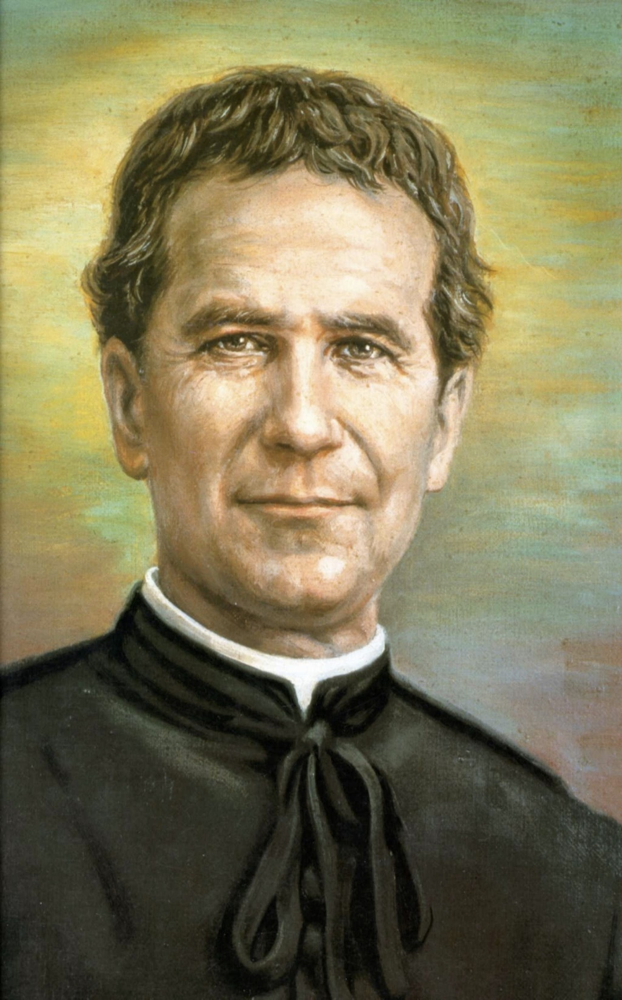
Notes:
The prayer to St. John Bosco, the patron of youth, in the virtue of respect, Diocesan Virtue Program, page 3. diolc.org/catechesis/understanding-and-living-the-virtues/respect.
Make a copy for each student:
O Saint John Bosco, father and teacher of youth, you labored so much for the salvation of souls.
Help us to respect ourselves and each person as a child of God. Be our guide in seeking the good of our souls and the salvation of our neighbor.
Teach us to love Jesus in the Blessed Sacrament, Mary the Mother of Christ and our Mother, and our Holy Father
the Pope. Obtain for us from God the grace to one day be gathered all together with you in Heaven. Amen.

