Slide 1
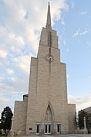
Diocese of La Crosse
Priest Unity Days
&
Consecrated Life

Slide 2
Refresher Course
Pastoral Guide
to
Consecrated Virginity
101

Slide 3
It is Virginity
for the sake of the Kingdom

Slide 4
It is a gift from God the Father…
As Jesus tells us in the Gospel… “For those to whom it is given”

…It is He
who
gives the grace
of virginity…”
Homily, Rite of Consecration

Slide 5
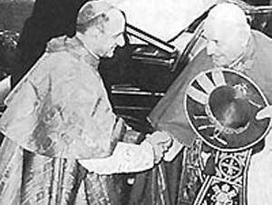
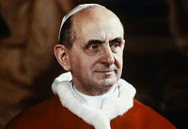
During the II Vatican Council it was Cardinal Montini who had promoted the restoration of the rite of consecration for virgins living in the world.
It is through his perseverance and intercession we have the
restored Rite
and the
‘Ordo Virginum’.

Slide 6
The Second Vatican council decreed that the rite for the consecration of virgins should be revised (cf. Constitution on the Sacred Liturgy, Sacrosanctum Concilium, no. 80).

Slide 7
Pope Paul VI Decree for Promulgation May 31, 1970
“The rite for the consecration of virgins is one of the most treasured in the Roman Liturgy. Consecrated virginity is among the most excellent gifts bequeathed by Our Lord to his Bride, the Church.”

Slide 8
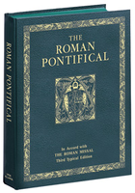
The Church provides the information about this consecration.
Recognized by the Church as an
authentic form of consecrated life
since Apostolic times,
it not only has an official Rite
found in the Roman Pontifical
including a Homily and Prayer of Consecration
(the spirituality and charism of the consecration)

Slide 9
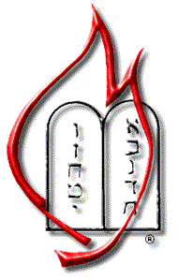
but also has it’s own Canon
Canon 604 § 1
§1 The order of virgins is also to be added to these forms of consecrated life.
Through their pledge to follow Christ more closely, virgins are consecrated to God,
mystically espoused to Christ
and dedicated to the service of the Church,
when the diocesan Bishop consecrates them according to the approved liturgical rite.

Slide 10
“The day of the Annunciation… is the origin of Christian Virginity: ...born of the “Yes” of the Virgin to the divine maternity.” Joseph Cardinal Ratzinger Homily March 25, 1988

Slide 11
Pope John Paul II Vita Consecrata #7
It is a source of joy and hope
to witness in our time
a new flowering of the ancient Order of Virgins,
known in Christian communities ever since
Apostolic times.

Slide 12
As with all vocations, formation and continuing formation is essential
Formation is a path of
gradual identification
with the attitude of Christ
towards the Father.
Pope John Paul II Vita Consecrata

Slide 13
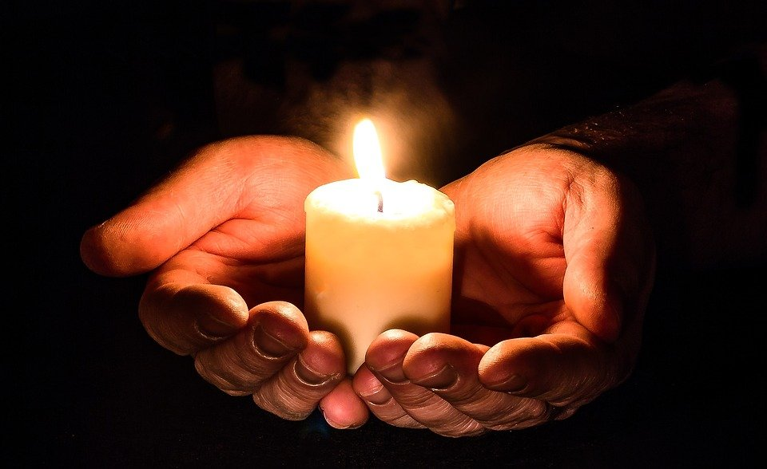
Vita Consecrata
Since the very purpose of consecrated life
is conformity to
the Lord Jesus in his total self-giving,
this must also be the
principal objective of formation.

Slide 14
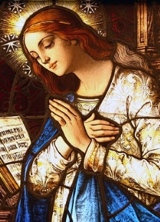
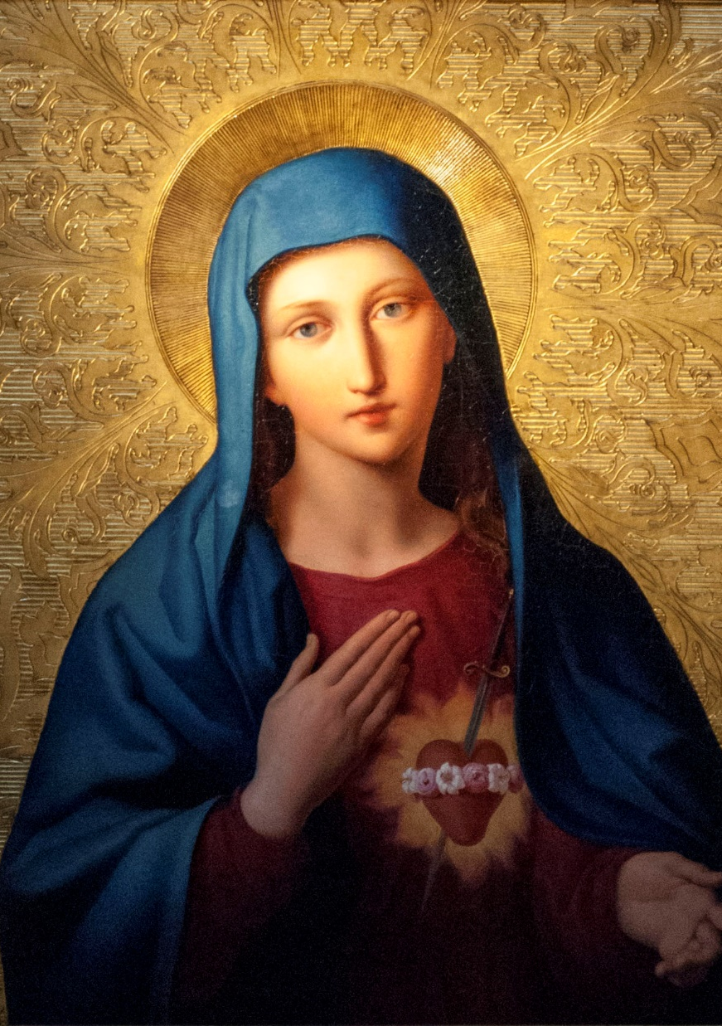
Following the example of the Virgin Mary
Mary, the handmaid of the Lord,
who did not make vows
but simply lived in purity of heart
doing the Father’s will

Slide 15
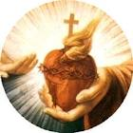
Jesus says… ”Learn from Me for I am meek and humble of heart” Responding to the gift the virgin enters into …
God the Father
The School of Mary The School of Nazareth The School of Hope
“Imitate the Mother of God” an example of humility and obedience The Our Father
Homily, Rite of Consecration Office of Readings, Pope Paul VI Words of Jesus

Slide 16
She enters into the Mystery of Love

Slide 17
She knows she is not called to live in a religious community,
but still wants to give her life totally to Jesus.
Her life is Church-centered but lives in the world.
Her devotion to Our Lady and Our Eucharistic Lord are the main stay of her spiritual life.

Slide 18
The Homily and the Prayer of Consecration
of the Rite express the spirituality and the charism of the gift of virginity.
Recognition of the gift is immediate
when the virgin, given the gift of virginity to be lived in the world,
reads this Homily and Prayer of Consecration.
It answers all the questions in her heart and soul.

Slide 19
Even from earliest times, as the Fathers of the Church bear witness, Mother Church in her wisdom set her seal on this high vocation by her practice of consecrating those who follow it by a solemn prayer.
Virgins living in the world
present themselves to the Church,
the Bishop…
they receive
a solemn consecration

Slide 20
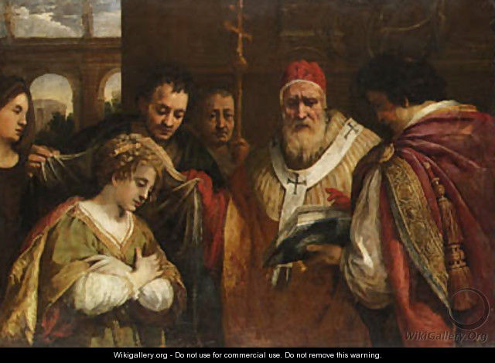
Those able "to receive it"
are those
"to whom it has been given.“
Pope John Paul II
Theology of the Body
Virginity or Celibacy
for the sake of the Kingdom
#72/ #4

Slide 21
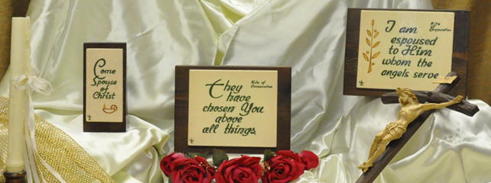
Consecrated virginity lived in the world…
is not a form of Religious Life

Slide 22
Consecrated Virgins living in the world …
do not make vows
of poverty,
chastity,
obedience, etc.

Slide 23
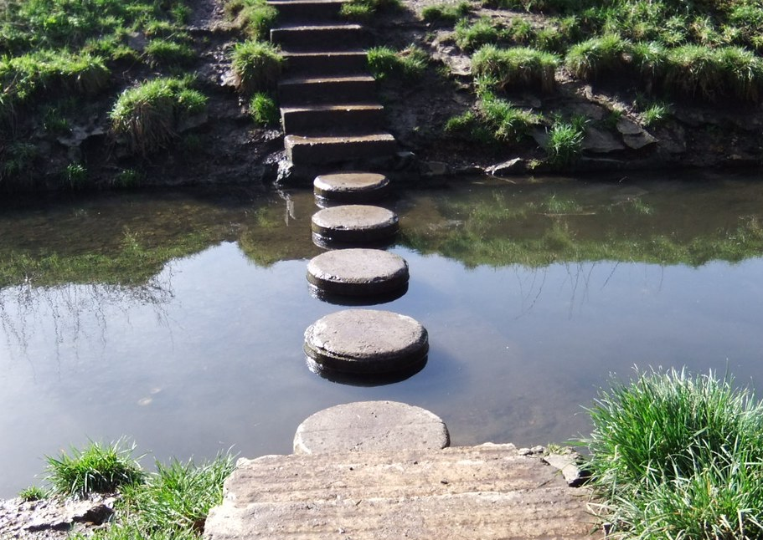
Consecrated virginity lived in the world
Is not
a stepping stone
to enter Religious life, become a nun or a hermit

Slide 24
Consecrated virginity lived in the world
Is not…
a Secular Institute,
or an Association of the Faithful

Slide 25
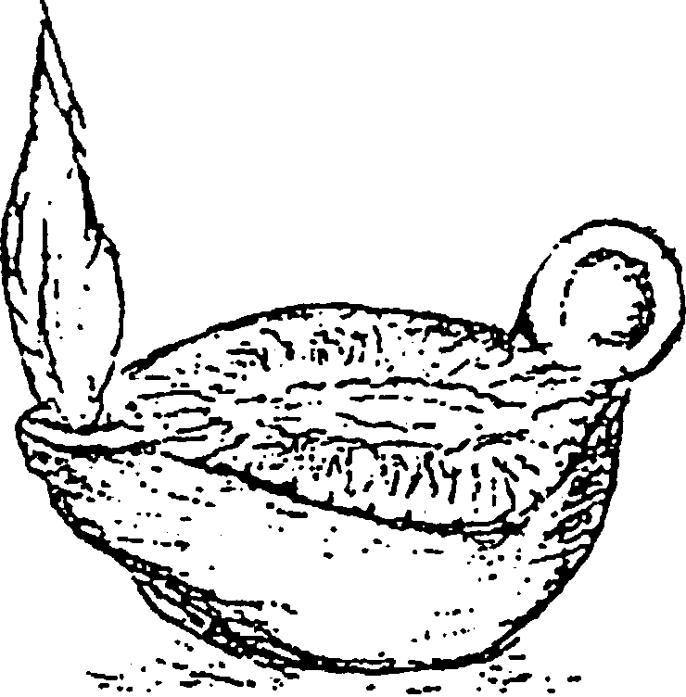
Consecrated virgins living in the world…
do not…
wear a habit
change their name
live in religious community
Virginity for the sake of the Kingdom

Slide 26
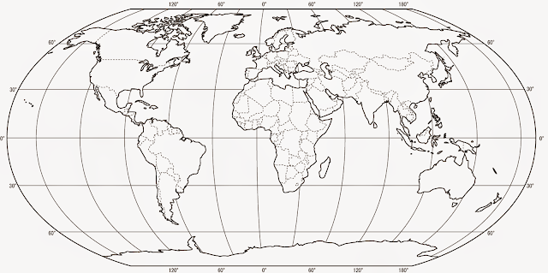
They remain in the world, living with family or alone.
They are responsible for their own livelihood, including housing, job, insurance, etc.

Slide 27
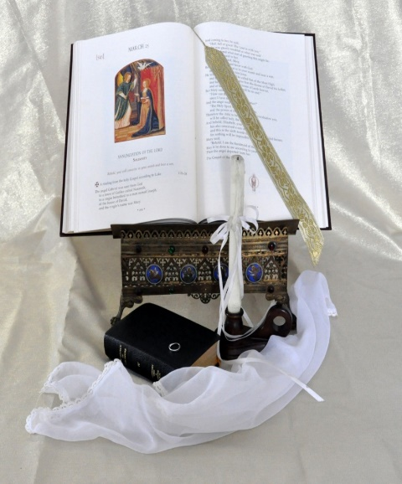
The Diocese offers many tools for information formation and continuing formation
found on the Diocesan Consecrated Life/consecrated virginity resources webpage

Slide 28
The next short presentation is on the Liturgy of the Hours
the “work” of the consecrated virgin…

Slide 29
Ponderings…. Some insight into praying the Liturgy of the Hours
Welcome to

Slide 30
Ponderings…
An avenue to discover the depths of the treasures of the Church,
the gift of the life of prayer,
the gift of the Heart of Jesus, Mary and Joseph

Slide 31
“Receive the Liturgy of the Hours, the prayer of the Church…”
These words spoken by the Bishop at your consecration is the invitation into the mystery of prayer, one of the greatest treasures of the Church
The Divine Office!

Slide 32
Our responsibility of prayer
As part of the gift of receiving the consecration to a life of virginity for women living in the world,
we are given a responsibility of prayer
for the praise of God
and for needs of the Church.

Slide 33
The liturgical prayer of the Church, the Liturgy of the Hours, was hopefully part of your preparation/formation.
And with that preparation I hope you discovered the gift it truly is to the Church and to you as a consecrated virgin.

Slide 34
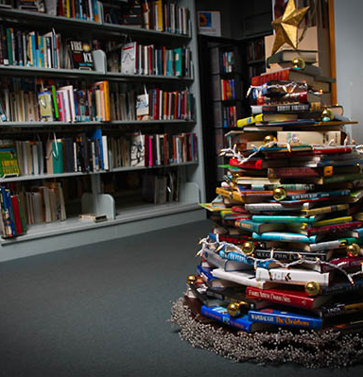
The gift…
As a
Christmas tree
brings joy to those
who gaze upon it and
under its branches hold treasures
galore so too with the Divine Office,
the Liturgy of the Hours. The books themselves
are gifts
to us from
Holy Mother Church.
This Photo by Unknown Author is licensed under CC BY-SA-NC

Slide 35
your copies
Purchased them yourself?
Received them from a friend?
Someone loaned you a copy?
No matter how you obtained a copy of the Divine Office, to begin or to continue using them as part of your prayer, it is and always will be a great gift to both you and the Mystical Body of Christ.

Slide 36
These 4 volumes are indeed a treasure!
Volume I Advent Season
Christmas Season
Volume II Lenten Season
Easter Season
Volume III Ordinary Time
Weeks 1 -17
Volume IV Ordinary Time
Weeks 18 - 34
This Photo by Unknown Author is licensed under CC BY-NC

Slide 37
Each liturgical season brings with it a wellspring of writings found within these volumes.
The new Ponderings web site
offers some simple thoughts
and reflections on the many parts of the Divine Office,
the Liturgy of the Hours

Slide 38
We offer to God a sacrifice of Praise!

Slide 39
Might seem to you like just a little offering….
But…..

Slide 40
when Christ enters into our prayer…
Our heart
shines forth
His love
for all to see.

Slide 41
With God’s grace

Slide 42
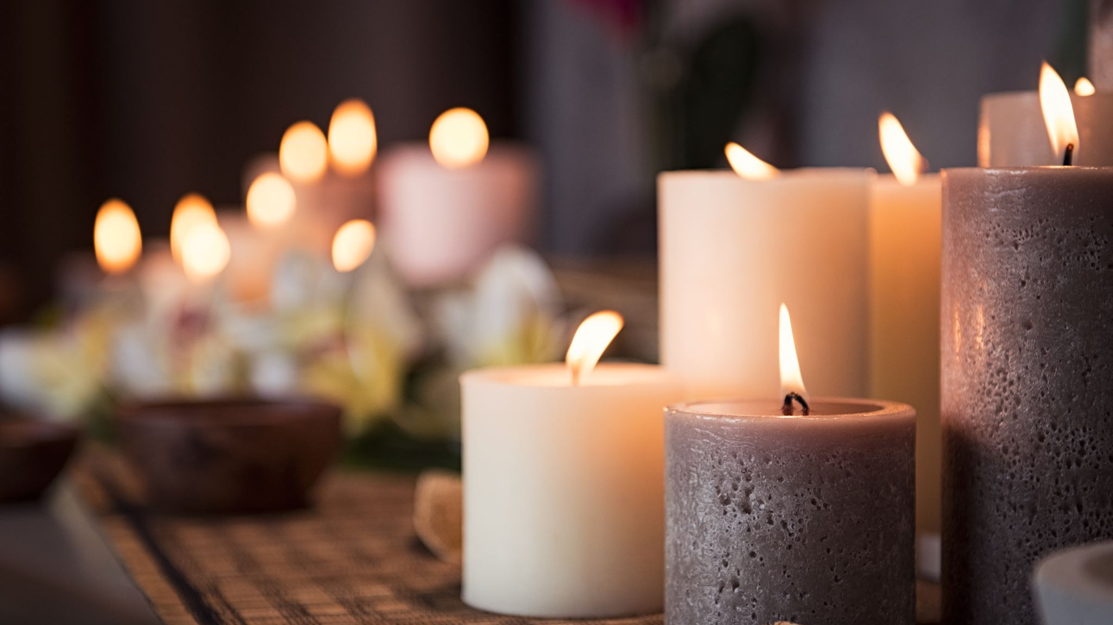
The Mystical Body of Christ
is enriched when we pray with the mind and heart of Holy Mother Church.

Slide 43
As you use the Ponderings
You will find quotations from
The Roman Pontifical

Slide 44
The “Ponderings” are available to be ‘downloaded’ for your convenience.
Each Pondering has both
a cover and a text
saved in a PDF format
Printable on 8.5 x 11 paper
“landscape”
Print back-to-back
The cover could be copied on heavier card stock in color.

Slide 45
There are nine Ponderings
1. Invitatory
2. Morning Prayer
3. Evening Prayer
4. The Gospel Canticle
5. Our Father
6. Intercessions
these 3 are part of both Morning & Evening Prayer
7. Office of Readings
8. The “Little Hours”
9. Night Prayer
These Hours are prayed by those responsible for praying all seven “hours”.
For the consecrated virgin they are ‘extra’ and enriching when she has time to pray them.

Slide 46
Ponderings
With this introduction to each one of them..
my prayer is they will help you grow in the Love of Christ and His holy Church through our uniting in prayer with the Mystical Body of Christ…..

Slide 47
The Invitatory
“Lord open my lips. And my mouth will proclaim your praise.”
Thus begins the opening prayer of the Liturgy of the Hours,
the Divine Office for each day.

Slide 48
Each part of the Office is designed to sanctify the day.

Slide 49
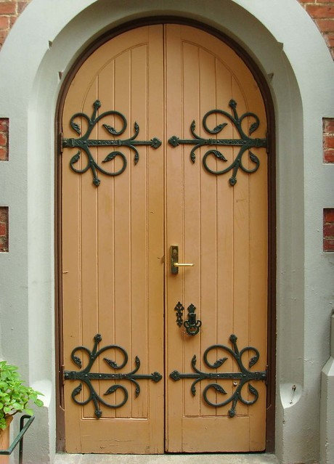
Morning Prayer and Evening Prayer
hinges of the Liturgy of the Hours
They open the doors of grace for the moment of prayer

Slide 50
Three keys
Both Morning
and Evening Prayers
have these three key parts.
They unlock the music of the heart.
Gospel Canticle
Our Father
Intercessions

Slide 51
Gospel Canticle
The Canticle of Zachariah and the Canticle of Mary enrich the hour.
The Mystery of the Incarnation before our mind & heart
intertwines the lives of Zachariah, Elizabeth, Mary, Joseph
John and Jesus and our lives today.

Slide 52
Our Father
The "school of hope”

Slide 53
Intercessions
We pray for the Church, our true Mother on earth…
Our “job” as consecrated virgins is to pray

Slide 54
Office of Readings
Holy Mother Church does not require the
consecrated virgin to pray
this “hour”.
However,
in doing so the readings
will enrich your spiritual life …

Slide 55
Little Hours
These three “little hours” of the Divine Office offer additional prayer opportunities for retreat days or days of recollection.
They are not required.

Slide 56
Night Prayer
Protect us, Lord….
watch over us as we sleep…..
Lord, now you let your servant
go in peace…

Slide 57
Ponderings …
So completes the reflection on
the Liturgy of the Hours

Slide 58
My prayer for you…
that your commitment
to praying the Liturgy of the Hours
may enrich your life
and the life of the Mystical Body of Christ

