Slide 1
Renewal of Intention
This is a “retreat/reflection” on the Renewal of Intention
from the Rite of Consecration
to a Life of Virginity for Women

Slide 2
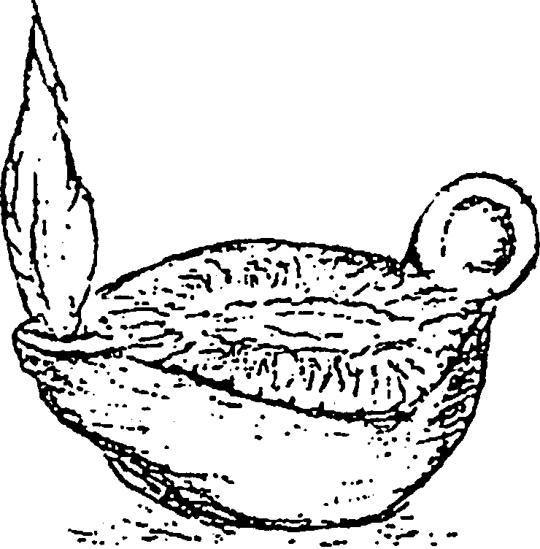
Welcome
to the journey
through
the Rite of Consecration
to the
Renewal of Intention…
This is the Cathedral where I received my Consecration…
Remember yours?

Slide 3
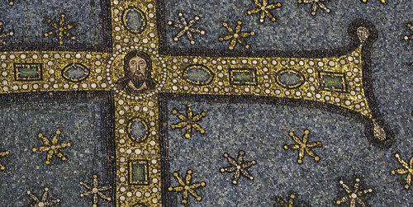
You have found this pearl of great price….
Jesus…. In the quiet of your heart, He calls your name…..

Slide 4
You have been given a gift….
Virginity
consecrated to God
for the sake of the Kingdom.
Now the day comes….
Doubt….
Maybe this is not my gift,
Maybe….
Temptations…
Even right before the day of
consecration…. Lord… then….

Slide 6
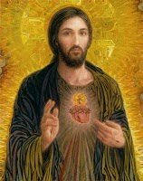
…then He comes… His love breaks through the fear…

Slide 7
You come with the love that inspired the virgins from of old…..
Remember…
Macrina
and her brother ….
His writings inspired you
then….

Slide 8
It is basic
It is gift….
To those to whom it is given….
Let it be received…..

Slide 9
So this gift…
Is yours!

Slide 10
Receive it
With confidence!

Slide 11
Then….
To my Heavenly
Father
Return it
to the Heavenly Father

Slide 12
….and He

Slide 13
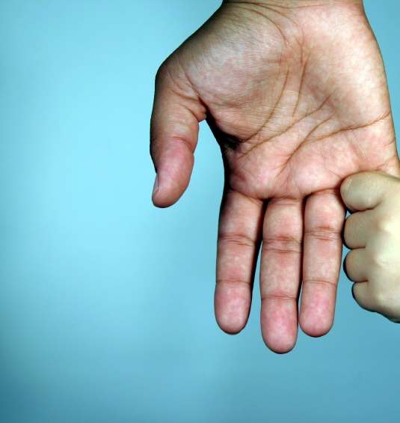
Responds with love…

Slide 14
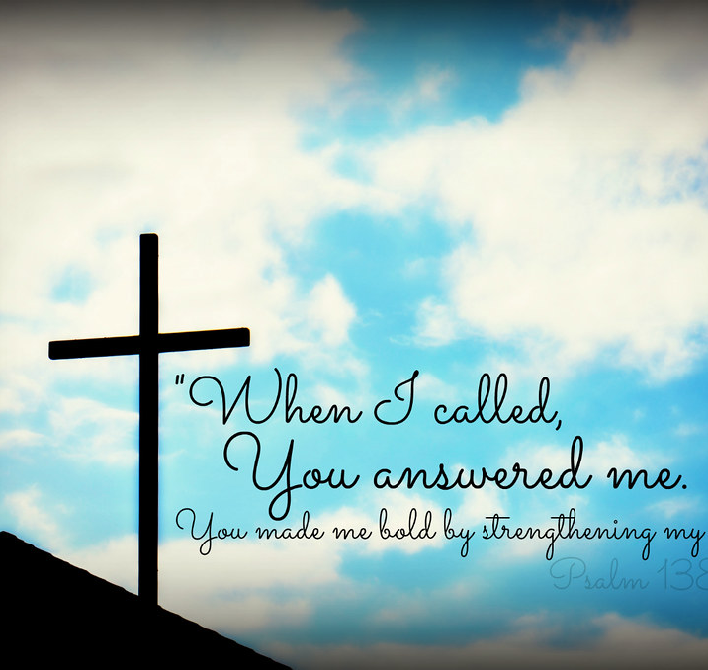
We turn to Holy Mother Church….
She gives us the Rite….
It gives us direction….

Slide 15
The Rite of Consecration
to a life of Virginity
for women Living in the world
has many parts
before we arrive at
the Renewal of Intention….

Slide 16
Here is a quick look at the parts of the rite, this treasure before
before the …
The Renewal of Intention
Renewal of Intention

Slide 17
First
The Praenotanda
or the preliminary notes….
Essential for prayer and study as you well know…
The list…..

Slide 18
CONSECRATION TO A LIFE OF VIRGINITY INTRODUCTION
NATURE AND VALUE OF CONSECRATION TO VIRGINITY
II. PRINCIPAL DUTIES OF THOSE CONSECRATED
THOSE WHO MAY BE CONSECRATED
MINISTER OF THE RITE
FORM OF THE RITE
MASS FOR THE CONSECRATION TO A LIFE OF VIRIGINITY

Slide 19
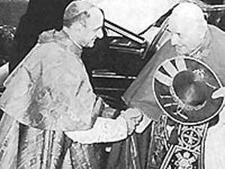
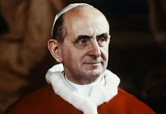
Then we have the Rite itself
If you remember it is
Cardinal Montini,
Pope Paul VI
to whom we owe a debt of gratitude.
It is through his perseverance and intercession we have the
restored Rite
and the ‘Ordo Virginum’.

Slide 20
CHAPTER I CONSECRATION TO A LIFE OF VIRGINITY FOR WOMEN LIVING IN THE WORLD INTRODUCTION
1-8 Rubrics
The Introductory Rites
(throughout the entire Rite we find this ‘red print’, the rubrics, to guide the proper celebration)
The Liturgy of the Word
Consecration
CALLING OF THE CANDIDATE
HOMILY OR ADDRESS
EXAMINATION
LITANY OF SUPPLICATION

Slide 21
Liturgy of the Word
Do you remember the readings for your Mass of Consecration?
Special feast day?
Or …..are you…
preparing to receive the consecration?
The selections of Readings
are available in
the Roman Pontifical.

Slide 22
“Be wise make: ready your lamps. Behold the bridegroom comes; go out to meet him.”
then… the candle or lamp is lit

Slide 23
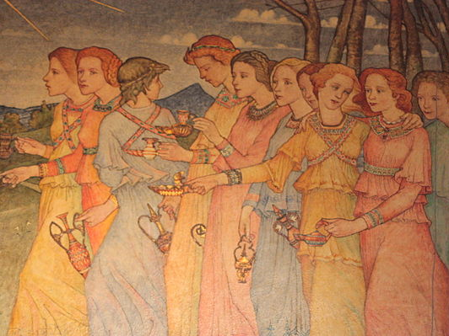

Slide 24
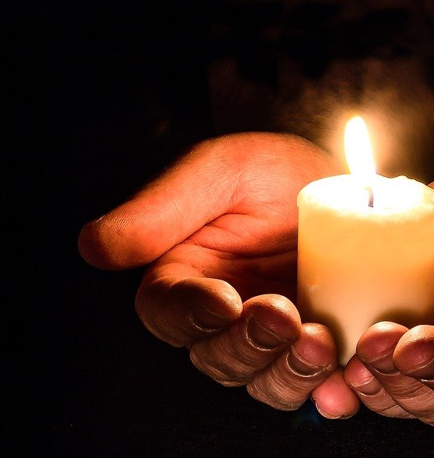
The Calling of the Candidate
The virgin responds…

Slide 25
Now with all my heart
I follow you,
I reverence you and seek your presence.
Lord fulfill my hope: show me your loving kindness, the greatness of your mercy.

Slide 26
In humility I remember…

Slide 27
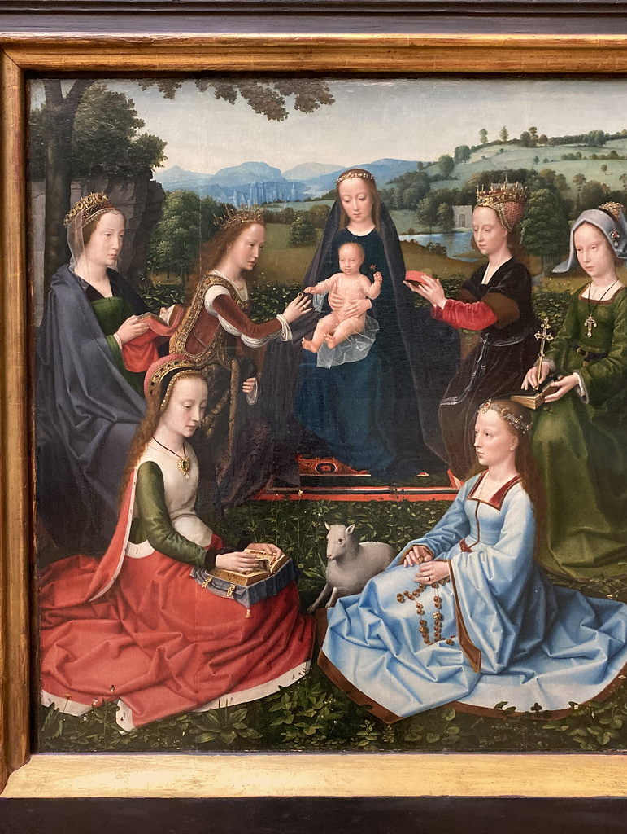
I join the multitudes of virgins who listen to words of instruction…

Slide 28
Homily or Address
16 the Bishop then gives a short Homily to the candidates and the people on the gift of virginity and its role in the sanctification of those called to virginity and the welfare of the whole Church.

Slide 29
Then comes the Examination
Three questions are asked…
Ready to follow Jesus?

Slide 30
Litany of Supplication
(Litany of the Saints)
…through the intercession of the
Blessed Virgin Mary and all the saints,

Slide 31
He may pour out the Holy Spirit of His love….

Slide 32
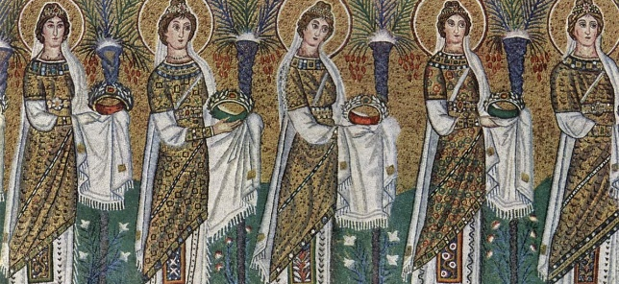
As the deacon invites all to kneel for the Litany, the virgin herself kneels and spiritually prepares to receive from these saints the gifts and graces they want to share with her.
Litany of Supplication

Slide 33
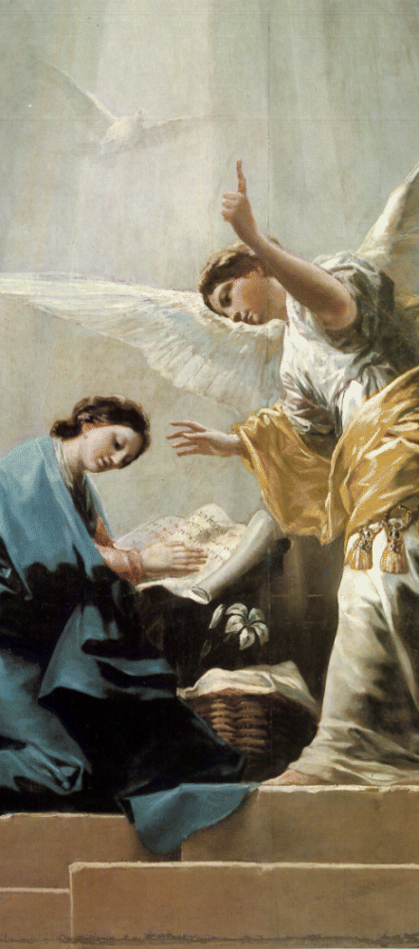
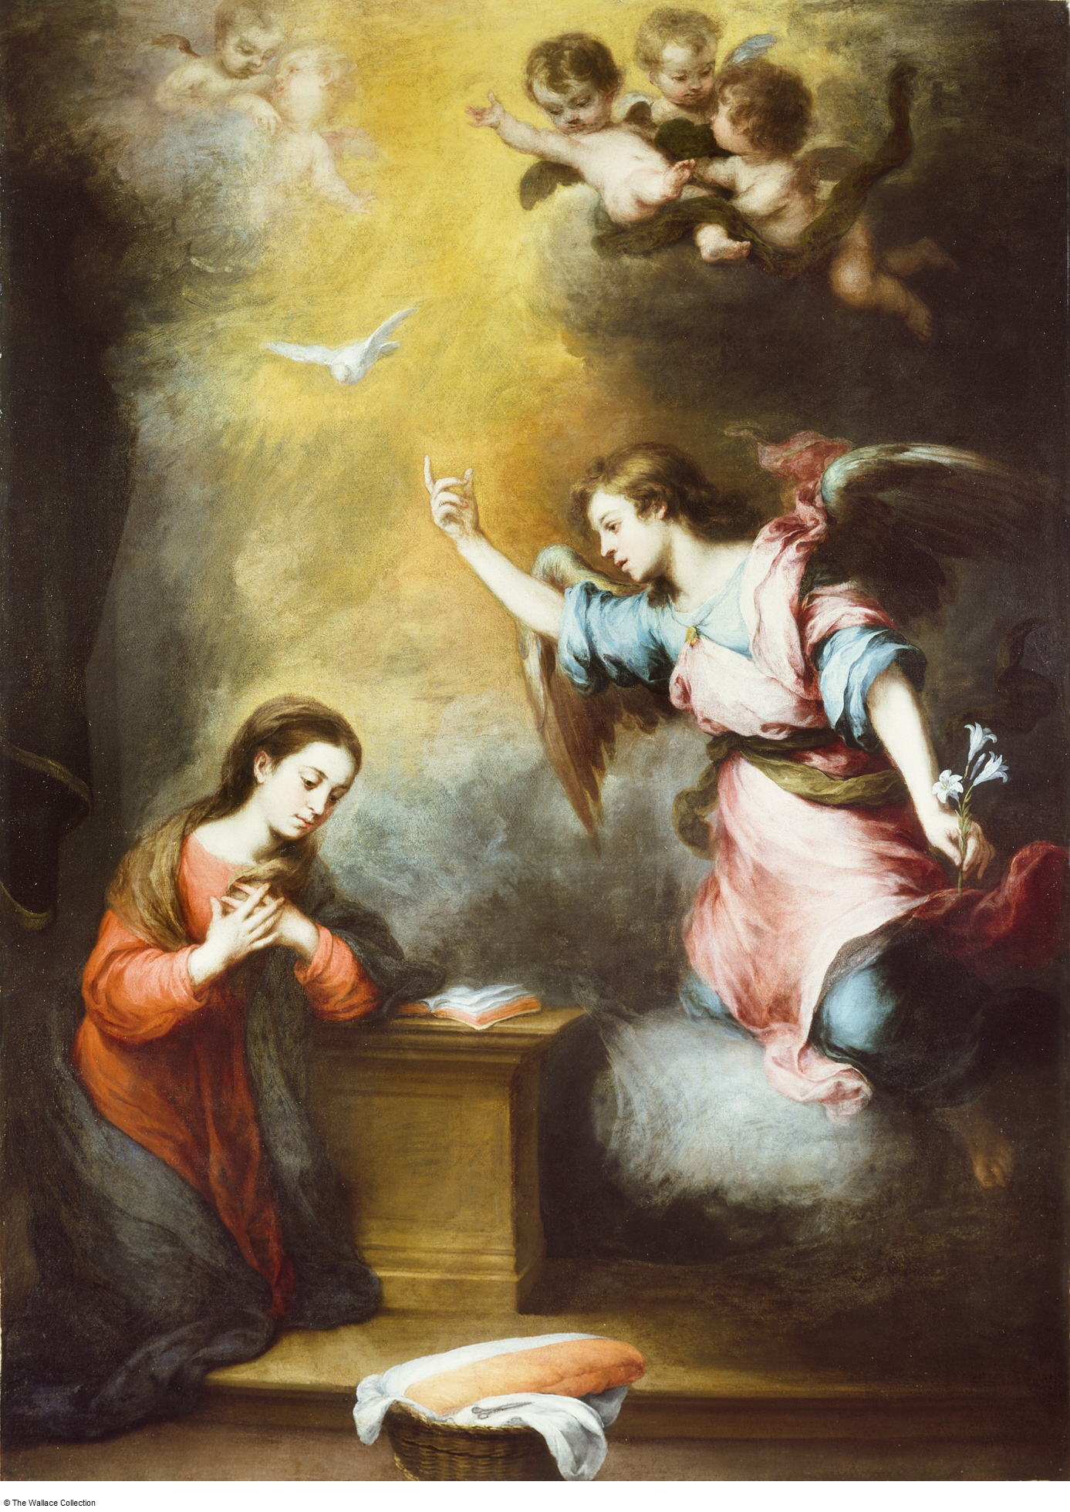
Kneeling during the Litany …Humility…
But for the consecration of a virgin, it is the image of humility we seek. The consecrated virgin is called to imitate the Mother of God. Historically, the kneeling position is a symbol of humility. An image we see Our Lady in at the Annunciation where she accepts the Word Made Flesh into her womb as Mother of God. Kneeling, symbol of the nothingness of the person before the greatness of God, has been practiced in Christian worship from the beginning as an expression of urgent supplication.

Slide 34
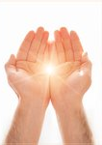
The Litany is sung….
The Saints
come forward
with
gifts…..

Slide 35
Their gift
is the fruit of their lives now brought to fulfillment in the Kingdom of Heaven.
These saints
whose lives you have studied
and pondered
and taken inspiration

Slide 36
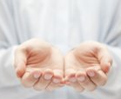
…these Saints come forward in love and in humility…
Come forward to place
in your open heart
symbolized by
your open hands
the graces of their lives.

Slide 37
Now… The fullness of time….
The Renewal of Intention…

Slide 38
“Father…”
You call to mind
some
examples
of faith

Slide 39
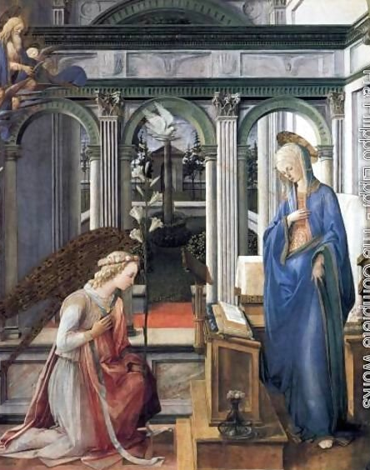
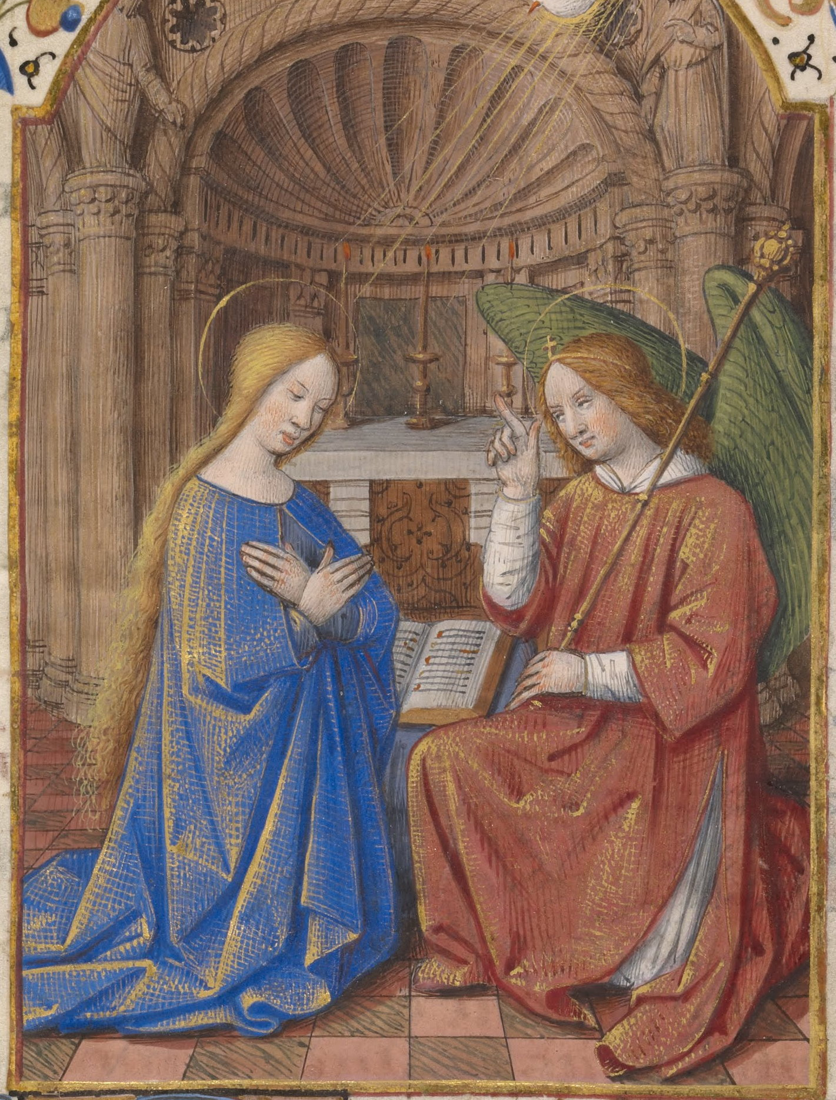
“Father…”
Behold
I am the Handmaid of the Lord…

Slide 40
Father
Receive my resolution

Slide 41
“Father…”
Joseph….

Slide 42
Father…

Slide 43
Father…

Slide 44
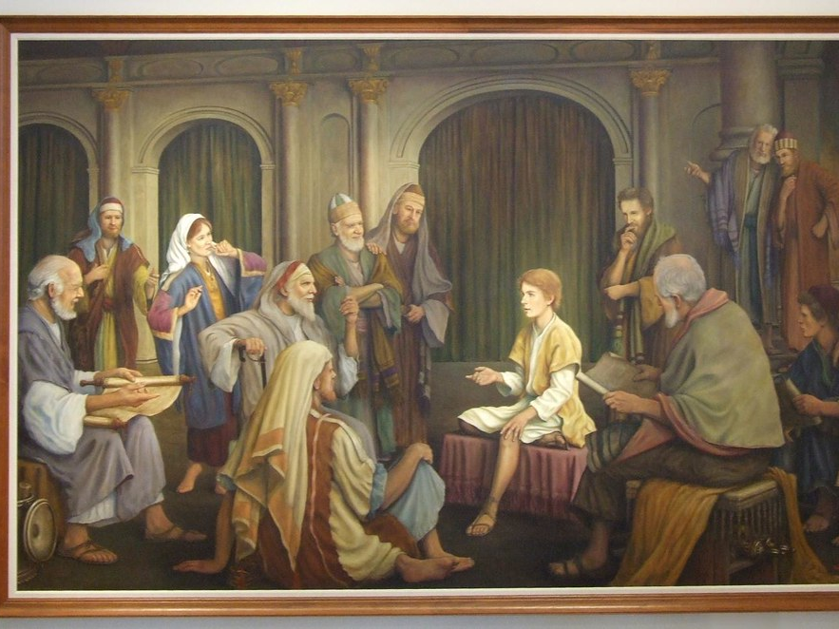
Father…

Slide 45
Father…

Slide 46
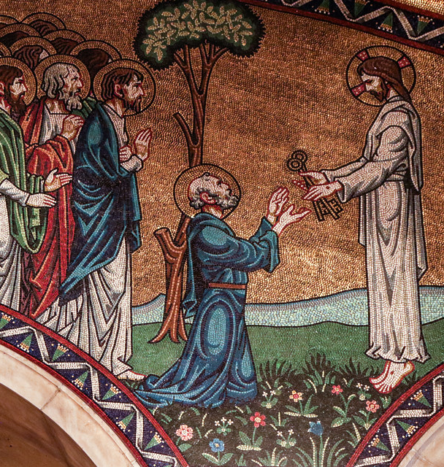
St Peter
He trembled
at his gift/responsibility…
Fear is useless
what is needed is trust….

Slide 47
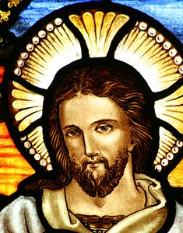
Father..
I have chosen them….

Slide 48
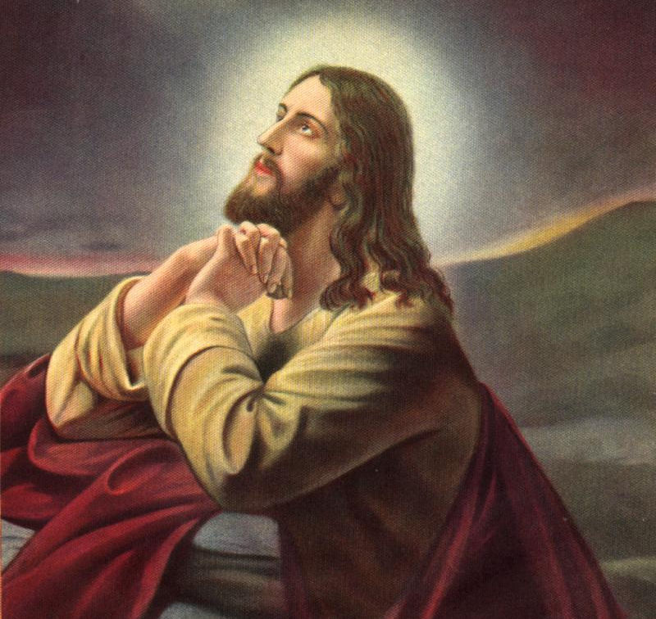
Father….
Into your hands
I commend My spirit

Slide 49
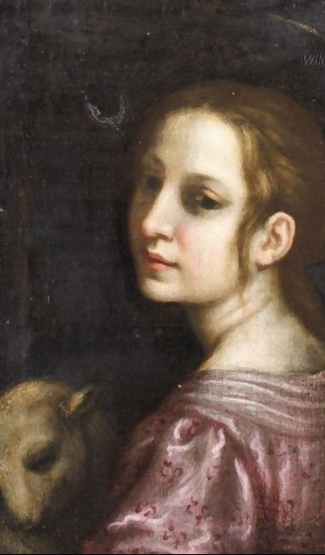
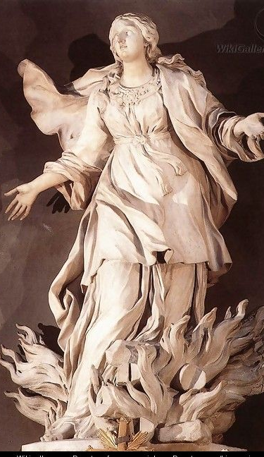
Father…
his Photo by

Slide 50
Father …
Receive my resolution to follow Christ

Slide 51
As a sign of my total surrender of my will to the will of the Heavenly Father
“Father, receive my resolution to follow Christ in a life of perfect chastity which with God’s help I here profess before you and God’s holy people.”
With humility and obedience….
The action of placing one’s hands into the hands of the Bishop
is an image of total self giving… two handed giving holding nothing back for oneself
Giving all back
to the Heavenly Father.

Slide 52
Father, receive…

Slide 53
He takes our life and makes it fruitful…

Slide 54
Father,
receive my resolution to follow Christ…

Slide 55
In a life of perfect chastity

Slide 56
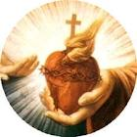
which with God’s help….

Slide 57
For those to whom it is given…

Slide 58
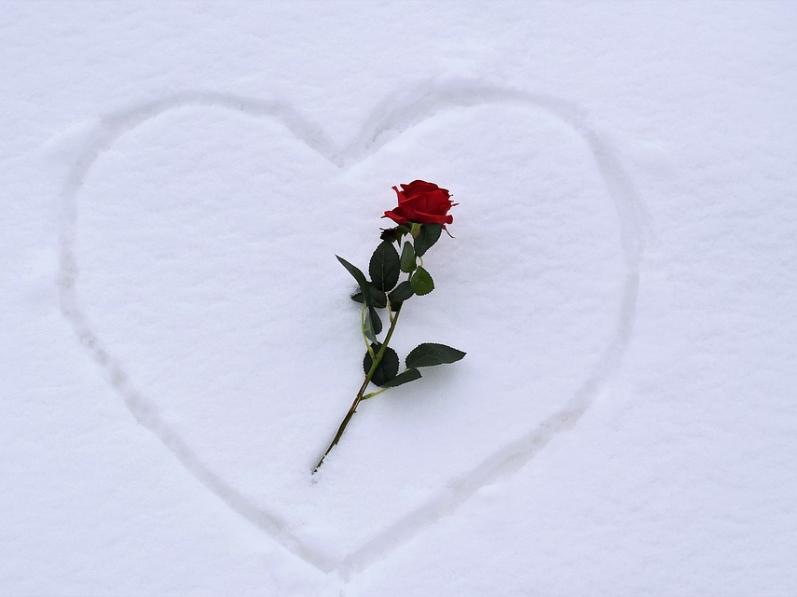
Consecrated virginity… a white martyrdom

Slide 59
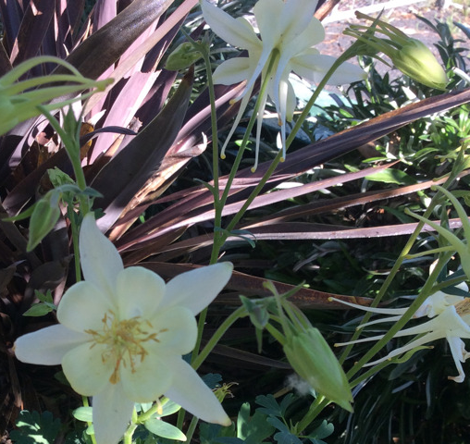
For the glory of God
and
the salvation
of the whole world

Slide 60
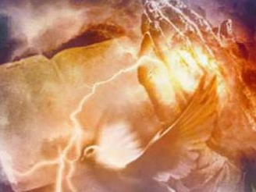
I here profess before you
and
God’s holy people.

Slide 61
Diocese of La Crosse
Office for Consecrated Life
Consecrated Virginity Lived in the World
September 2023

