Slide 1
The Litany of the Saints
A school of love
Introduction

Slide 2
This an Introduction to the Series on the Litany of Supplication the Litany of the Saints
Where we encounter the listing of or mentioning of ‘Saints’

Slide 3
Baptism

Slide 4
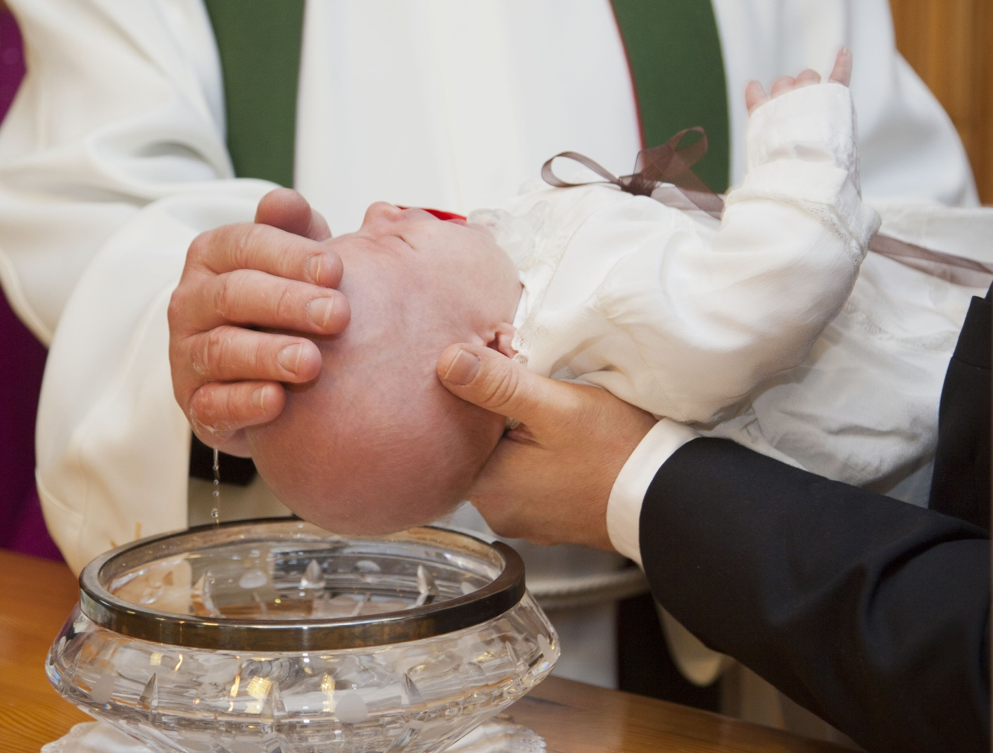
“I baptize you in the name of the Father, the Son and the Holy Spirit…”
Our Baptism

Slide 5
Here is our first encounter with the communion of Saints becoming a child of God given the name of a saint.
What name have you been given? Who is you patron Saint?

Slide 6
With this Sacrament
you now have a Guide through
the changing waters of life

Slide 7
We have our LINK between Heaven and Earth
in the puzzle of life…

Slide 8
Joining with
the
Communion of Saints
and
following
their examples,
our participation
in the Sacraments,
the holy Mass
teaches us
to die to ourselves
and be filled
with God’s Life,
His very Presence

Slide 9
The Holy Mass
There are several places where “saints”
are mentioned
in the text/prayers
of the Mass.
“I confess…
and I ask Blessed Mary
ever Virgin, all the
angels and saints…”
“I believe…
in the communion
of saints...”
Eucharistic Prayer I
The Roman Canon
“…Agatha, Lucy, Agnes…”

Slide 10
New Life…

Slide 11
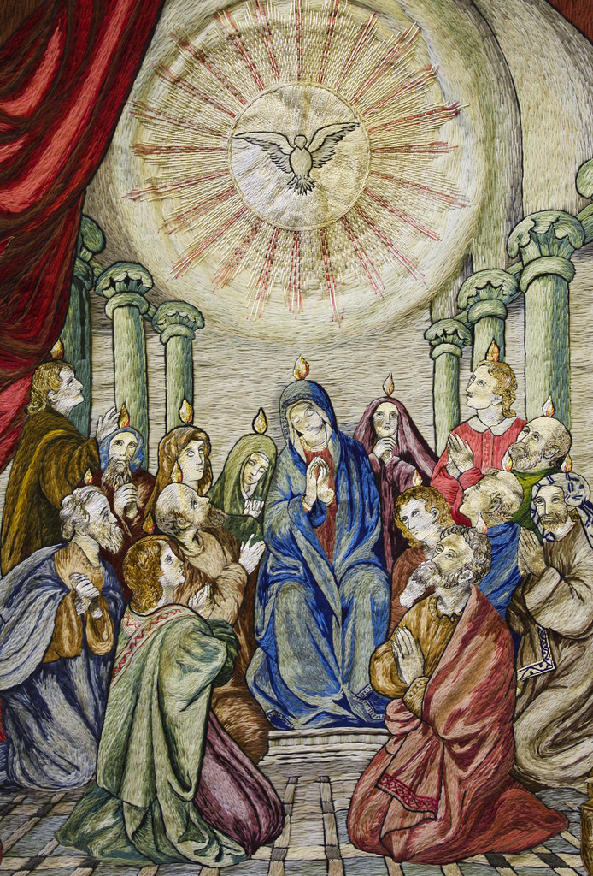
Remembering that day in the Upper Room… then our Confirmation …
united us
with these Apostles
boldly proclaiming God’s great love…
with Mary
and the Apostles,
we too
put on the armor of God…

Slide 12
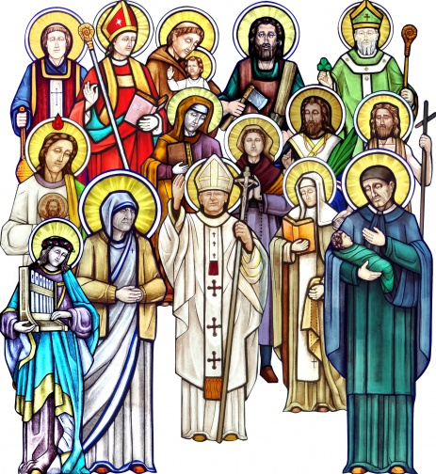
At your confirmation….
What saint did you select for your confirmation name?

Slide 13
Lives of the Saints
Adventures in the Love of God and neighbor

Slide 14
This brings us to more new life
The mystery of God’s love and gifts given

Slide 15
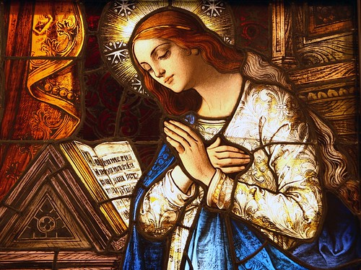
The gift of virginity for the sake of the Kingdom.
If this is a gift you have been given….

Slide 16
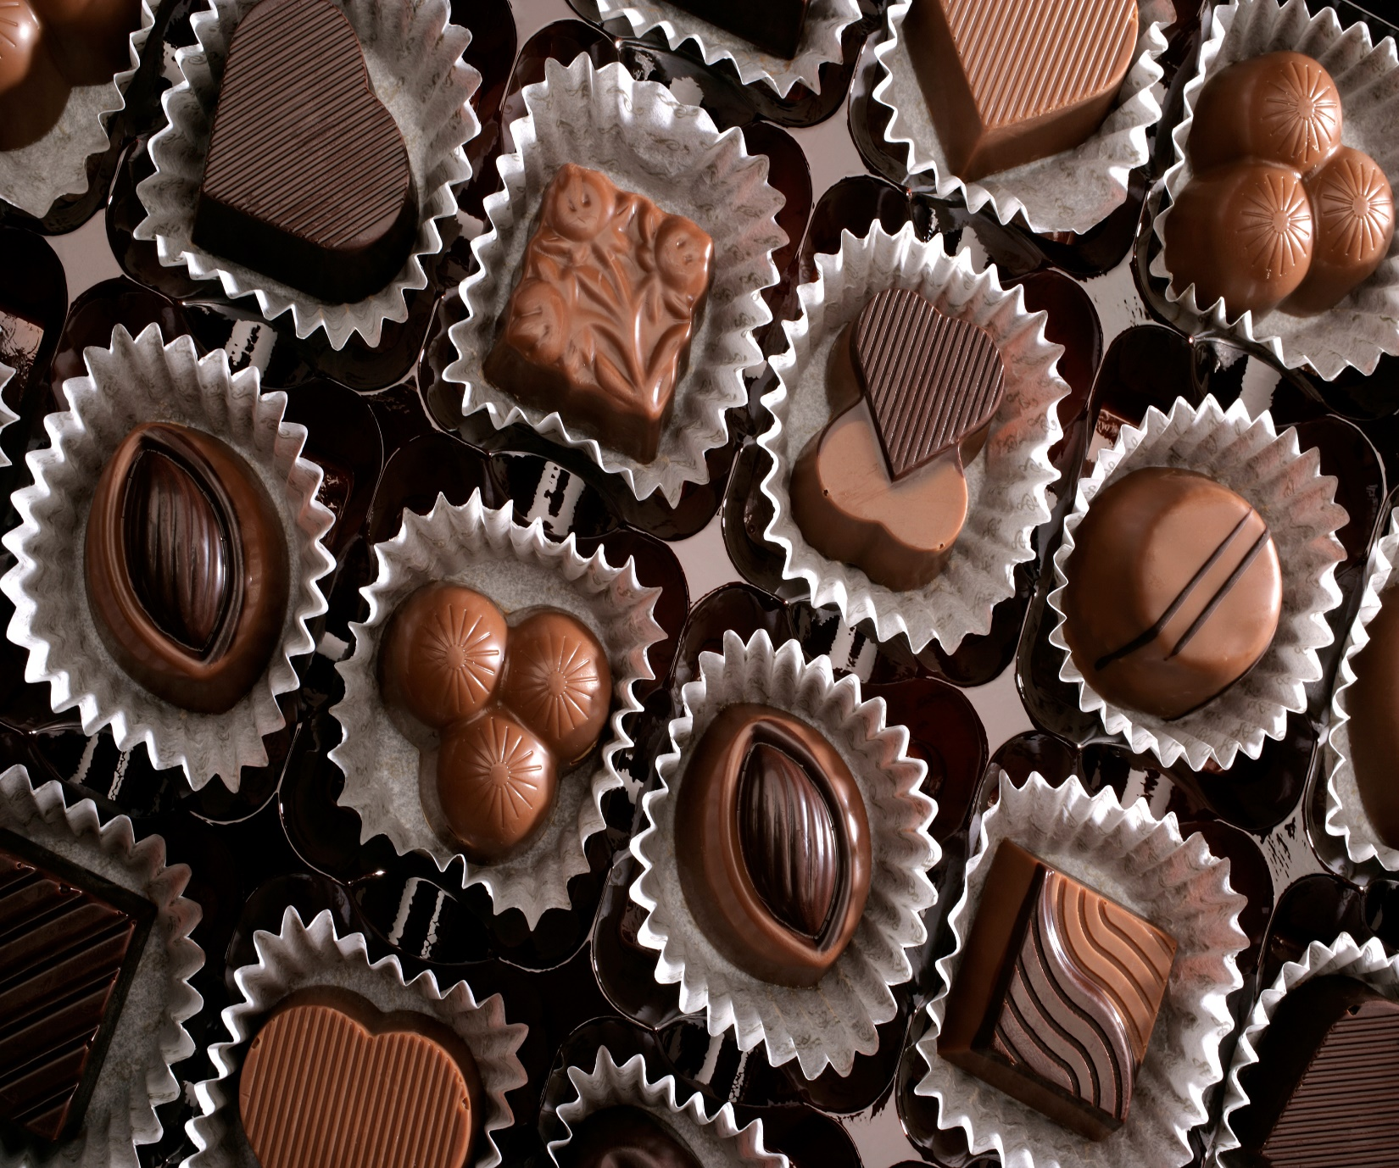
yOur Joy
And delight!

Slide 17
Then enter into the mystery…

Slide 18
Accept and live the purity of life
As a bride of Christ…

Slide 19
Where
nothing is impossible
with God…

Slide 20
And find in
the Litany of Supplication,
the Litany of the Saints
in the Rite
of Consecration…
Gifts beyond measure!

