Slide 1
The Litany of the Saints
A school of love
Part 1

Slide 2
This is the first in the series on The Litany of Supplication The Litany of the Saints
In the Rite of Consecration
to a Life of Virginity
for Women Living in the World
found in the
Roman Pontifical

Slide 3
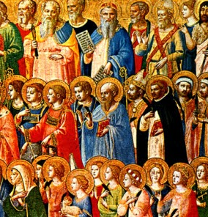
Ponderings This litany is ‘proper’ for this Mass of Consecration.
The saints have been selected for a reason
Holy Mother Church offers direction in this Litany
This Photo by Unknown Author is licensed under CC BY-NC-ND

Slide 4
From the Rite Roman Pontifical LITANY OF SUPPLICATION 18. Then all stand, and the Bishop, without his miter, invites the people to pray:

Slide 5
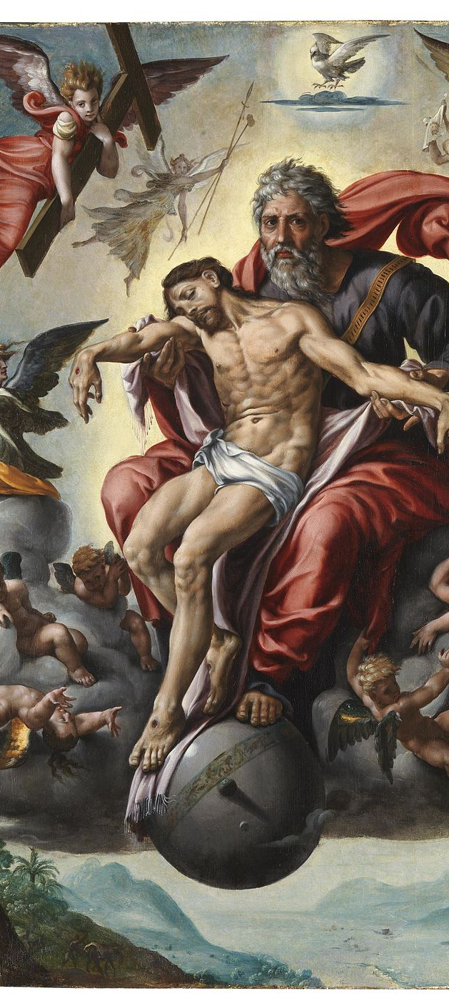
From the Rite Roman Pontifical LITANY OF SUPPLICATION
Dearly beloved,
let us pray
to God
the almighty Father
through his Son,
our Lord Jesus Christ,

Slide 6
From the Rite Roman Pontifical LITANY OF SUPPLICATION
that by the intercession
of the Blessed Virgin Mary
This Photo by Unknown Author is licensed under CC BY

Slide 7
From the Rite Roman Pontifical LITANY OF SUPPLICATION and all the saints,
This Photo by Unknown Author is licensed under CC BY-SA

Slide 8
From the Rite Roman Pontifical LITANY OF SUPPLICATION “…he will pour out the Holy Spirit of his love on these servants of his whom he has chosen to be consecrated to his service.”
This Photo by Unknown Author is licensed under CC BY-SA-NC

Slide 9
Do you remember… this rite is for both for nuns and women living in the world
From the Rite of Consecration
in the Roman Pontifical
Introduction
III. THOSE WHO MAY BE CONSECRATED
3. This consecration may be received by nuns or by women living in the world.

Slide 10
Let us take a closer look at the ‘rubrics’ (the red print) the guidelines, the directives from Holy Mother Church for this Litany…
From the Rite of Consecration in the Roman Pontifical
19. Deacon (except during the Easter season):
Let us kneel.
Then the Bishop, the ministers, the candidates, and the people kneel (except during the Easter season, when all stand).
Where it is customary for the candidates to prostrate themselves, this may be done.

Slide 11
There has been much discussion about ‘kneeling’ during the Litany of Supplication, the Litany of the Saints…

Slide 12
Please note the “rubrics,” the directives and guidelines from Holy Mother Church make a distinction between the case of nuns and the case of women living in the world. A religious community has established customs proper to their founder and spirituality

Slide 13
There is a difference in the text...
Let us look at the “rubrics” found in the Roman Pontifical, for Rite of Consecration to a life of Virginity for women living in the world
Introduction III Those Who May be Consecrated

Slide 14
From the Rite of Consecration in the Roman Pontifical Introduction III. THOSE WHO MAY BE CONSECRATED
4 In the case of nuns it is required: a)…
b)…
c) that their religious family uses this rite either by an
established custom or by new permission of the competent authority.
5 In the case of women living in the world it is required:
a)…
b)…
c) that they be admitted to this consecration by the Diocesan Bishop who is Ordinary of the place.
The point in question…
What is the
“established custom”?
It is the use of
this Rite of consecration…
This Photo by Unknown Author is licensed under CC BY-ND

Slide 15
From the Rite of Consecration in the Roman Pontifical Consecration 19. Deacon (except during the Easter season): Let us kneel. Then the Bishop, the ministers, the candidates, and the people kneel…
As the deacon invites
all to kneel
for the Litany,
the virgin herself kneels
and
spiritually prepares to receive
from these saints
the gifts and graces
they want to share
with her.

Slide 16
From the Rite of Consecration in the Roman Pontifical Introduction III. THOSE WHO MAY BE CONSECRATED 19. Deacon (except during the Easter season): Let us kneel… …Where it is customary for the candidates to prostrate themselves, this may be done.
These candidates,
who also made
profession as a nun
is part of a religious community
where
the prostration
is an “established custom.”
They do not kneel.

Slide 17
Religious Life
When a woman becomes a member
of a particular religious family,
she accepts
the “established customs,”
The Rule of Life and Constitutions.
These women who choose to follow,
to enter a particular
religious community,
founder, spirituality, charism,
leave their old life behind …
and enter into community life.
they die to themselves….
…the grain of wheat…
symbolized by the prostration……
and put on a new way of life
They look different on the outside

Slide 18
Why does the
candidate who is a virgin living in the world
kneel
during the
Litany of Supplication,
the Litany of the Saints?

Slide 19
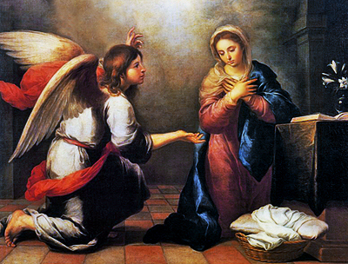
Historically, the kneeling position is a symbol of humility.
Kneeling,
symbol of the nothingness of the person
before the greatness of God,
has been practiced in Christian worship
from the beginning
as an expression of urgent supplication.

Slide 20
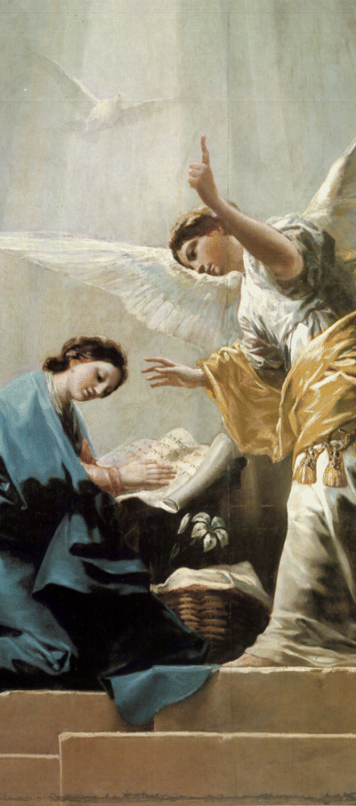
Ponder….. the spiritual reality of kneeling during the Litany of Supplication, the Litany of the Saints…

Slide 21
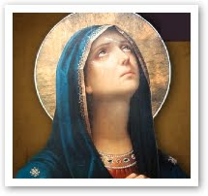
For the consecration of a virgin, it is the expression of humility we seek to follow…
The consecrated virgin is called to imitate the Mother of God.
An image we see Our Lady in at the Annunciation where she accepts the Word Made Flesh into her womb as Mother of God.

Slide 22
“Those to whom it is given” Matthew 19:11-12
These words of Our Lord express the “gift” from the Heavenly Father to a soul…
Virginity
for the sake of the Kingdom

Slide 23
Receiving the consecration the virgin’s life does not change
She continues
with her
days activities
and living situation…
but
has been enriched, sanctified by and through
the Holy Spirit…
the gift of receiving the Consecration
as a bride of Christ…

Slide 24
She follows the directive of Holy Mother Church… the invitation to “imitate the Mother of God ” Homily, Rite of Consecration
Like Our Blessed Lady,
the virgin continues
to live in the world.

Slide 25
Virgin Saints Living in the World
Take
as your example
the virgin saints
who
have enriched
the church’s life in every age
Pope Saint John Paul II
Consecrated Virgins
International Congress Rome,1995

Slide 26
From the Rite of Consecration in the Roman Pontifical 20. The cantors then sing the Litany….

Slide 27
From the Rite of Consecration in the Roman Pontifical
…At the proper place they may add the names of other saints who are specially venerated by the people,
or petitions suitable to the occasion.
This Photo by Unknown Author is licensed under CC BY-SA

Slide 28
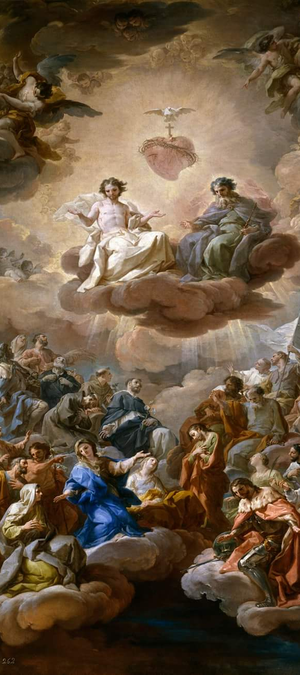
From the Rite of Consecration in the Roman Pontifical The Litany begins…
Lord have mercy
Lord, have mercy.
Christ, have mercy
Christ, have mercy.
Lord, have mercy
Lord, have mercy.
This Photo by Unknown Author is licensed under CC BY-NC-ND

