Slide 1
The Litany of the Saints
A school of love
Part 3 Intercessions

Slide 2
This is the third of the series on The Litany of Supplication The Litany of the Saints
In the Rite of Consecration
to a Life of Virginity
for Women Living in the World
found in the
Roman Pontifical

Slide 3
Intercessions
In the Roman Pontifical
the Rites
of Ordination of a
Bishop
Priest
Deacon

Rite of Blessing of
an Abbott an Abbess

each has their own set
of favors, “intercessions,”
we wish to obtain.

Slide 4
The following “Intercessions” are written for this Rite of Consecration to a Life of Virginity for Women Living in the World found in the Roman Pontifical

Slide 5
Cantors
Continue
with
the Intercessions

Slide 6
Lord, be merciful,
Lord, deliver us, we pray.
From all evil,
Lord, deliver us, we pray.
From every sin,
Lord, deliver us, we pray.
From everlasting death,
Lord, deliver us, we pray.

Slide 7
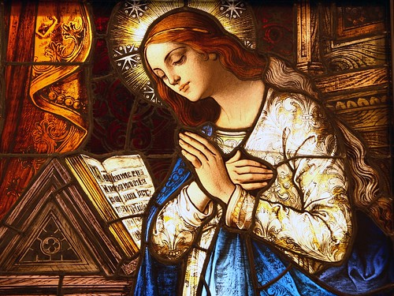
By your Incarnation,
Lord, deliver us, we pray.

Slide 8
By your Death and Resurrection, Lord, deliver us, we pray.

Slide 9
By the outpouring of the Holy Spirit, Lord, deliver us, we pray.
This Photo by Unknown Author is licensed under CC BY-SA-NC

Slide 10
Be merciful to us sinners Lord, we ask you, hear our prayer.

Slide 11
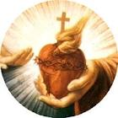
Give to your servant Pope N., and to all the other Bishops, the grace of growing daily in the likeness of Christ, Bridegroom of the Church,
Lord, we ask you,
hear our prayer.

Slide 12
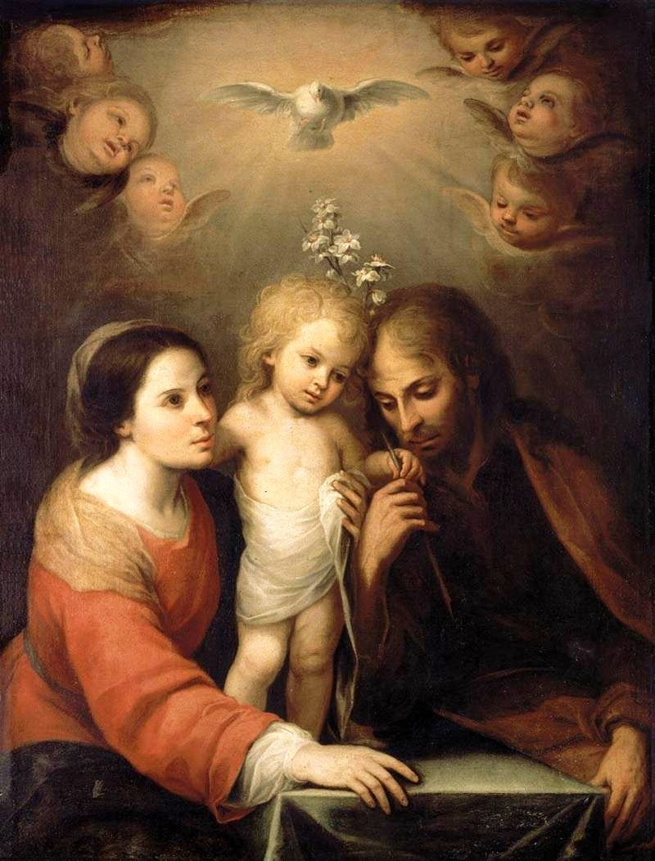
Maintain and foster in your Church love for holy virginity, Lord, we ask you, hear our prayer.
This Photo by Unknown Author is licensed under CC BY-SA

Slide 13
Strengthen in Christ’s faithful people hope of a glorious resurrection and of the life of the world to come, Lord, we ask you, hear our prayer.

Slide 14
Bring all peoples together
in peace and true harmony,
Lord, we ask you, hear our prayer.

Slide 15
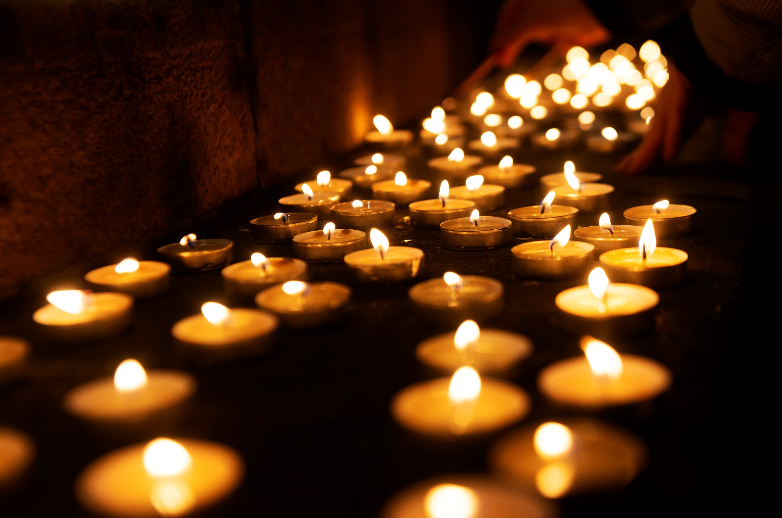
Increase in holiness and in number those who follow the counsels of the Gospel, Lord, we ask you, hear our prayer.

Slide 16
Reward a hundredfold the parents of your handmaids for the sacrifice they have made, Lord, we ask you, hear our prayer.

Slide 17
Bless these handmaids, make them holy, and consecrate them to your service, Lord, we ask you, hear our prayer.

Slide 18
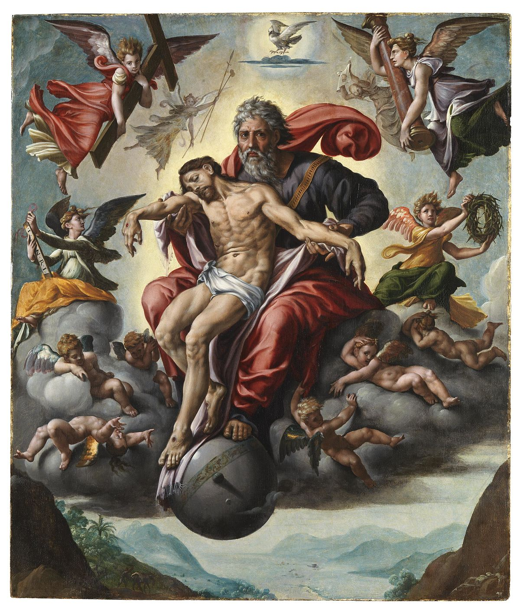
Jesus,
Son of the living God
Lord, we ask you,
hear our prayer.

Slide 19
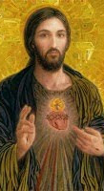
Christ, hear us. Christ, hear us.

Slide 20
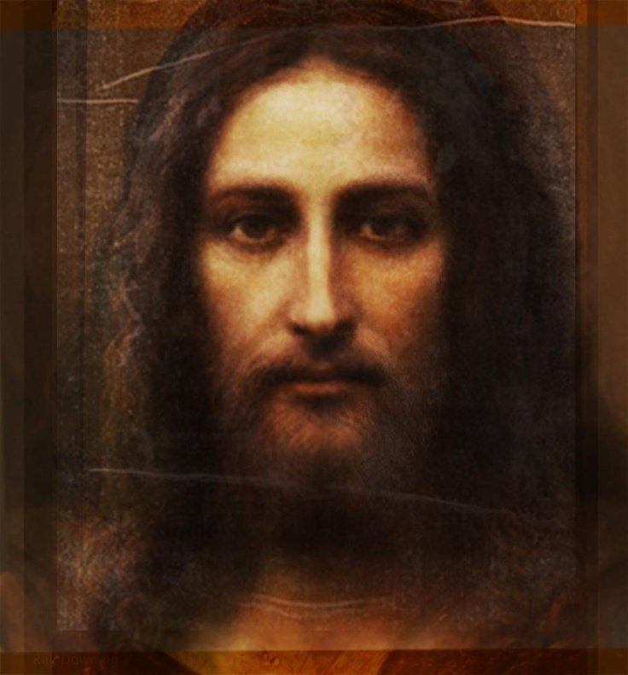
Christ, graciously hear us. Christ, graciously hear us.

Slide 21
21 Then the Bishop alone rises and, with hands joined, sings or says:
Lord,
hear the prayers of your Church.
Look with favor on your handmaids
whom you have called in your love.
Set them on the way
of eternal salvation;
may they seek
only what is pleasing to you,
and fulfill it
with watchful care.
Through Christ our Lord.
All:
Amen.
Deacon:
Let us stand.

Slide 22
This completes the Litany of Supplication, the Litany of the Saints.
The Rite of Consecration
continues with
the
Renewal of Intention

Slide 23
A side note… Each flower in God’s creation has a special meaning to enhance its beauty.
The simple tulip,
a flower of springtime.
“The most known meaning of tulips is perfect and deep love.
As tulips are a classic flower that has been loved by many for centuries they have been attached with the meaning of love.
They're ideal to give to someone who you have a deep, unconditional love for, whether it's your partner, children, parents or siblings.” info from the Internet

