Slide 1
Litany of Saints
School of Love
Part 2

Slide 2
This is the second of the series on The Litany of Supplication The Litany of the Saints
In the Rite of Consecration
to a Life of Virginity
for Women Living in the World
found in the
Roman Pontifical

Slide 3
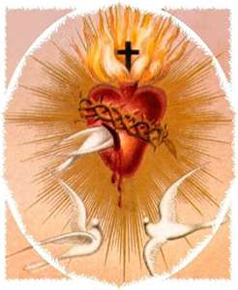
God allows us to enter into His Divine Mercy
as experienced by the saints that have gone before us…

Slide 4
…these Saints come forward in love and in humility…
Come forward to place
in your open heart
symbolized by
your open hands
the graces of their lives.

Slide 5
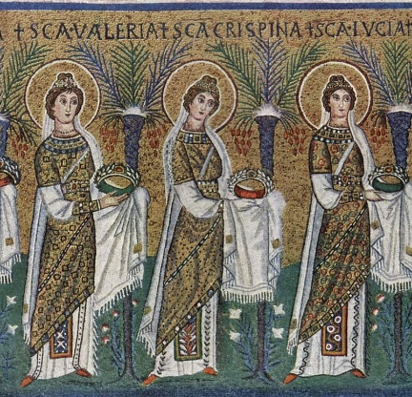
Their gift for you
is the fruit of their lives now brought to fulfillment in the Kingdom of Heaven.

Slide 6
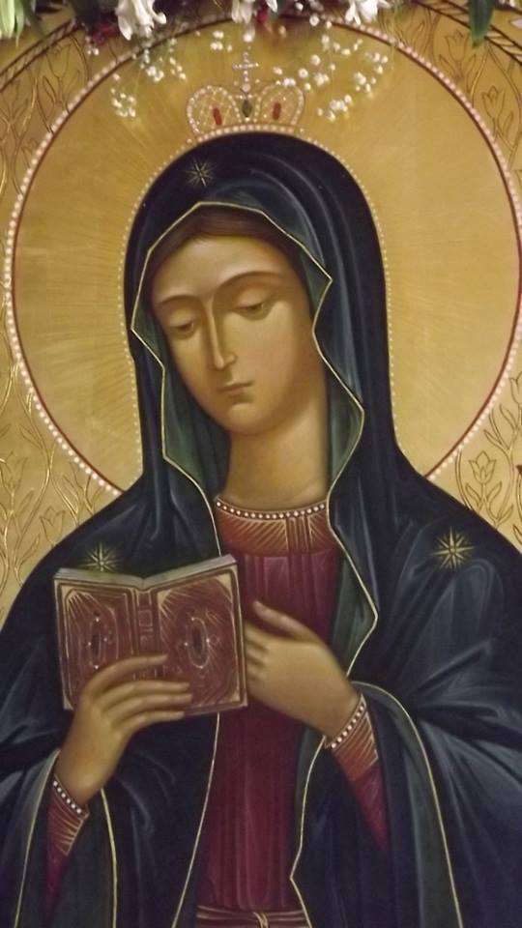
Our Lady begins the list…

Slide 7
Holy Mary, pray for us.
What do I receive from Holy Mary?
This Photo by Unknown Author is licensed under CC BY-SA-NC

Slide 8
Holy Mother of God, pray for us
What does the Mother of God want to give me?
This Photo by Unknown Author is licensed under CC BY-SA-NC

Slide 9
Most honored of all virgins, pray for us. What does the most honored of all virgins want to give me?
This Photo by Unknown Author is licensed under CC BY-SA

Slide 10
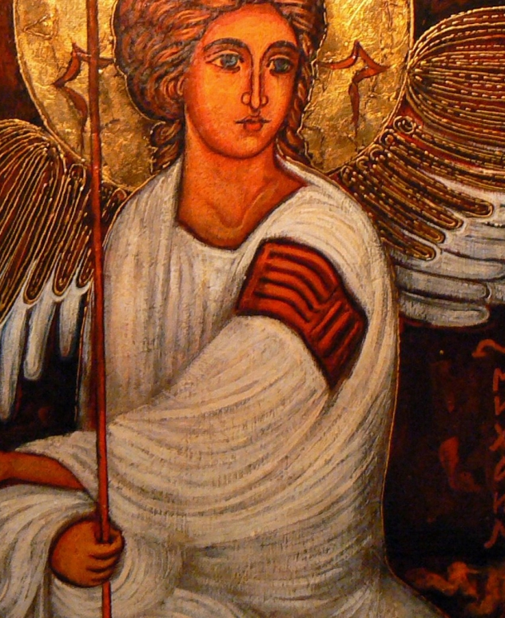
Saint Michael, pray for us.
This Photo by Unknown Author is licensed under CC BY-SA-NC
What gift does Saint Michael want to give me?

Slide 11
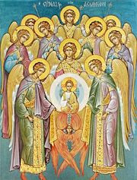
Holy Angels of God, pray for us.
What do these
Holy Angels of God
want to give me?

Slide 12
Saint John the Baptist , pray for us.
What does St John the Baptist want to give me?
This Photo by Unknown Author is licensed under CC BY-SA

Slide 13
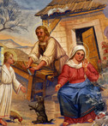
Saint Joseph, pray for us.
As we ponder the
School of Nazareth
What does Saint Joseph want to give me?
This Photo by Unknown Author is licensed under CC BY-NC-ND

Slide 14
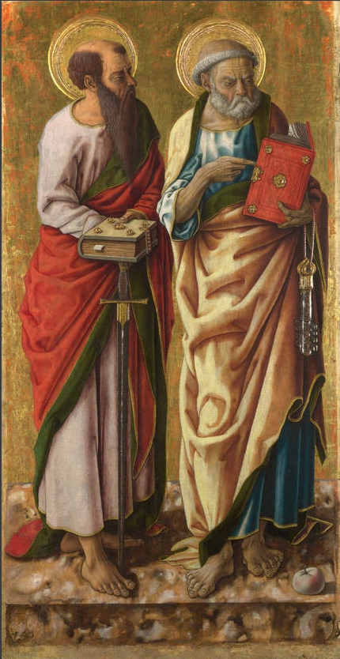
Saint Peter & Saint Paul, pray for us
What gifts do Saint Peter and Saint Paul
want to give to me?
This Photo by Unknown Author is licensed under CC BY-SA

Slide 15
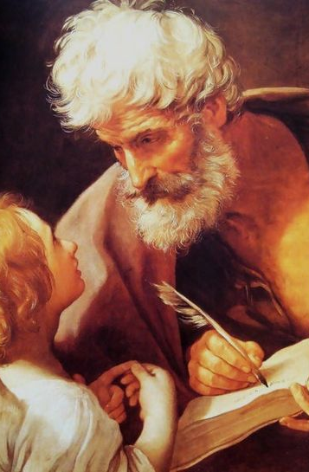
Saint Matthew, pray for us
What gift does Saint Matthew want to give me?
This Photo by Unknown Author is licensed under CC BY-SA

Slide 16
Saint John, pray for us.
What gift does Saint John want to give to me?
This Photo by Unknown Author is licensed under CC BY-NC-ND

Slide 17
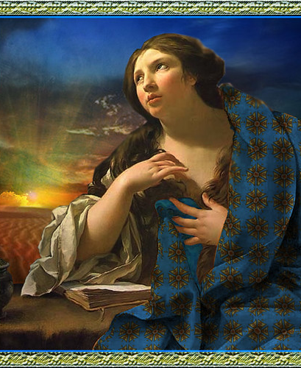
Saint Mary Magdalene, pray for us.
This Photo by Unknown Author is licensed under CC BY-SA-NC
What gift does Saint Mary Magdalene want to give to me?

Slide 18
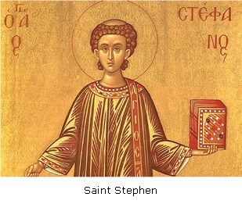
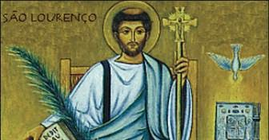
Saint Stephen & Saint Lawrence, pray for us.
What gift
does Saint Stephen wan to give to me?
What gift does
Saint Lawrence want to give to me?

Slide 19
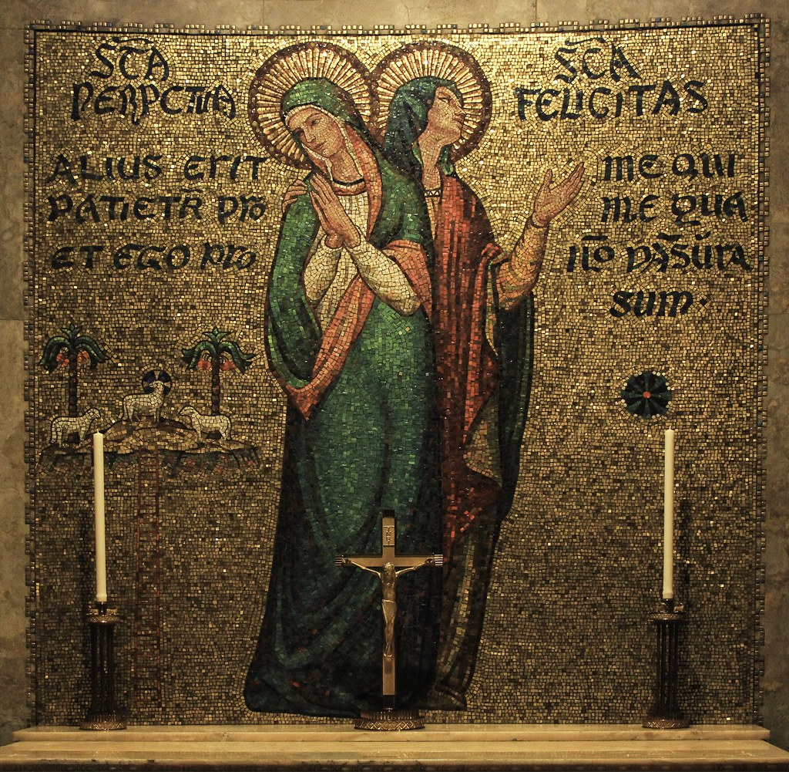
Saint Perpetua & Saint Felicity, pray for us.
What gift
does Saint Perpetua want to give to me?
What gift
does Saint Felicity want to give to me?
This Photo by Unknown Author is licensed under CC BY-SA-NC

Slide 20
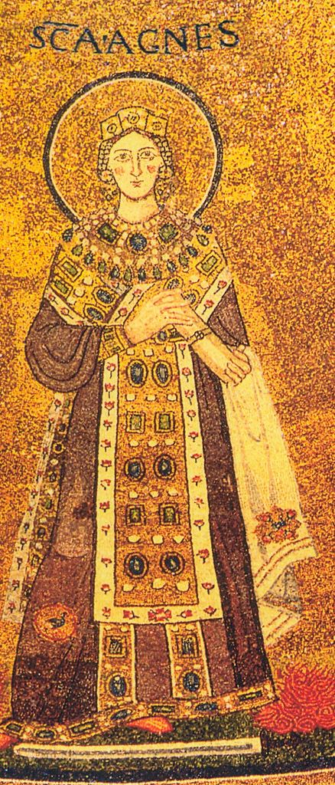
Saint Agnes, pray for us.
What gift does Saint Agnes want to give to me?
This Photo by Unknown Author is licensed under CC BY-NC-ND

Slide 21
Saint Agatha, pray for us.
What does Saint Agatha want to give to me?
This Photo by Unknown Author is licensed under CC BY-NC-ND

Slide 22
Saint Lucy, pray for us.
What gift does Saint Lucy
Want to give to me?
This Photo by Unknown Author is licensed under CC BY-NC-ND

Slide 23
Saint Maria Goretti, pray for us.
What gift does
Saint Maria Goretti
want to give to me?
This Photo by Unknown Author is licensed under CC BY-SA

Slide 24
Saint Athanasius, pray for us
What gift does Saint Athanasius want to give me?
This Photo by Unknown Author is licensed under CC BY-SA

Slide 25
Saint Ambrose, pray for us.
What gift does Saint Ambrose
Want to give to me?
This Photo by Unknown Author is licensed under CC BY-SA

Slide 26
Saint Methodius of Olympus, pray for us.
What gift does Saint Methodius of Olympus
want to give to me?
This Photo by Unknown Author is licensed under CC BY

Slide 27
Saint Augustine, pray for us.
This Photo by Unknown Author is licensed under CC BY-NC-ND
What gift does Saint Augustine
want to give to me?

Slide 28
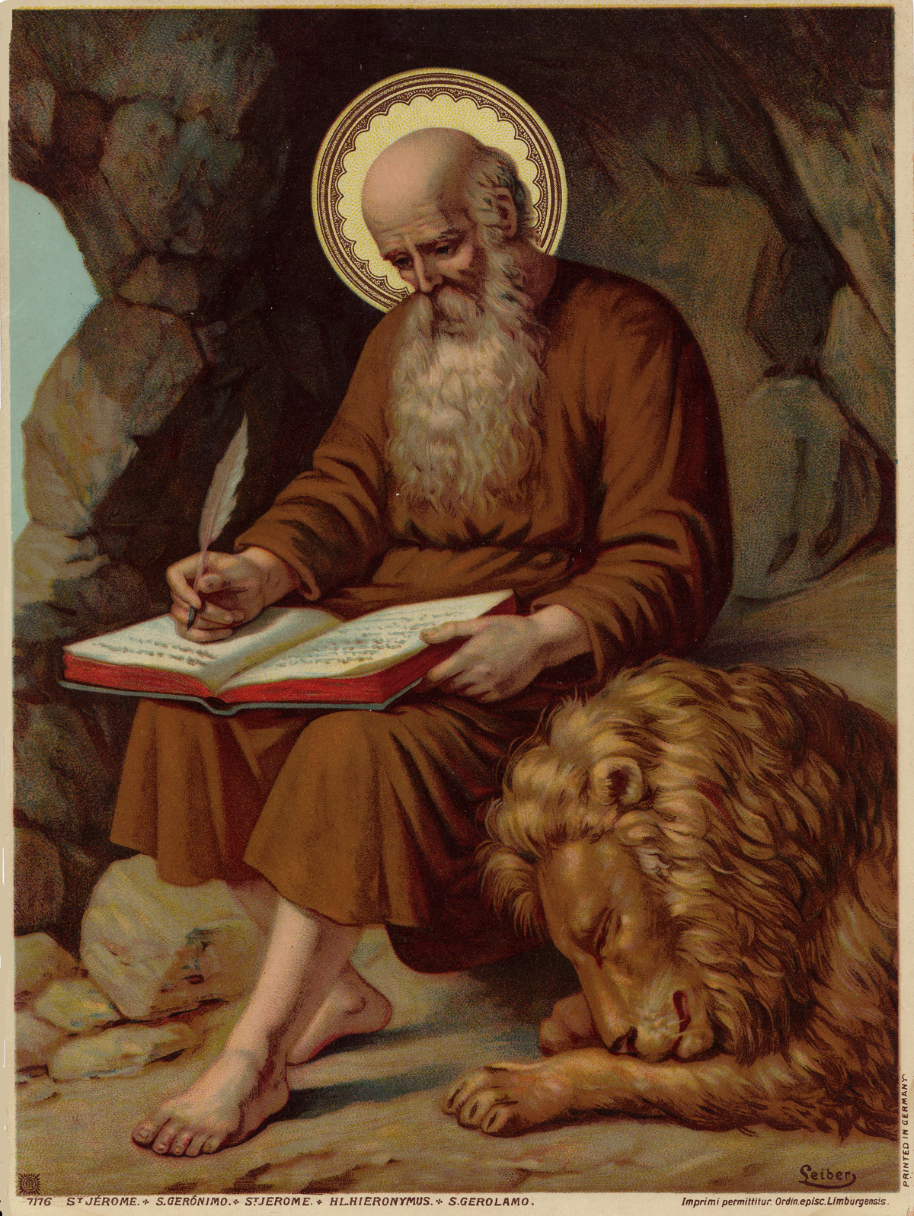
Saint Jerome, pray for us.
What gift does Saint Jerome
want to give to me?
This Photo by Unknown Author is licensed under CC BY-NC-ND

Slide 29
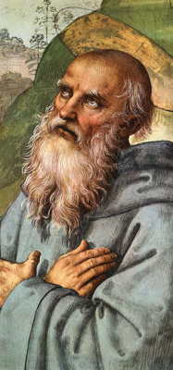
Saint Benedict, pray for us.
What gift does Saint Benedict want to give to me?
This Photo by Unknown Author is licensed under CC BY-NC-ND

Slide 30
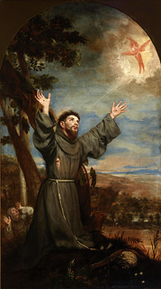
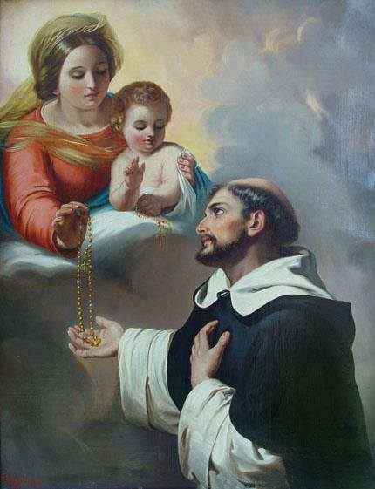
Saint Francis & Saint Dominic, pray for us.
What gift does
Saint Francis want to give to me?
What gift does
Saint Domonic want to give to me?

Slide 31
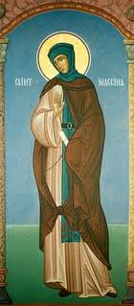
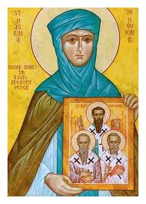
Saint Macrina, pray for us.
What gift does Saint Macrina
want to give to me?

Slide 32
Saint Scholastica, pray for us.
What gift does Saint Scholastics
want to give to me?
This Photo by Unknown Author is licensed under CC BY-NC-ND

Slide 33
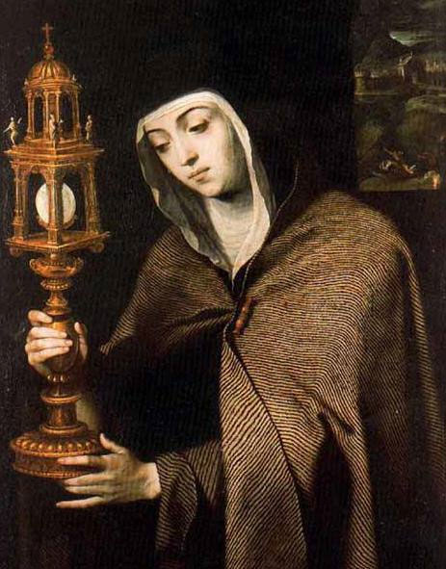
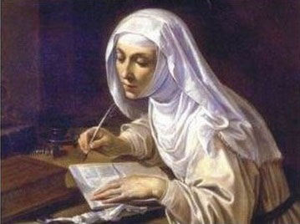
Saint Clare & Saint Catherine of Siena, pray for us.
What gift does
Saint Clare want to give to me?
What gift does
Saint Catherine
of Siena want to give to me?

Slide 34
Saint Teresa of Jesus, pray for us.
What gift does Saint Teresa of Jesus
want to give to me?
This Photo by Unknown Author is licensed under CC BY-NC-ND

Slide 35
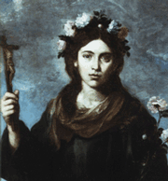
Saint Rose of Lima, pray for us.
What gift does
Saint Rose of Lima
want to give to me?

Slide 36
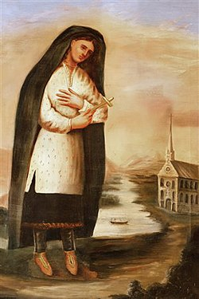
Saint Kateri Tekakwitha, pray for us.
What gift does
Saint
Kateri Tekakwitha
want to give to me?

Slide 37
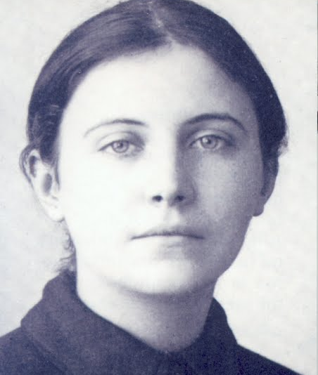
Saint Gemma Galgani. Pray for us.
What gift does
Saint Gemma what to give me?
This Photo by Unknown Author is licensed under CC BY-NC

Slide 38
Saint Louise de Marillac, pray for us.
What gift does Saint Louise de Marillac
want to give to me?

Slide 39
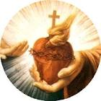
Saint Margaret Mary Alacoque, pray for us.
What does
Saint Margaret Mary Alacoque
want to give me?

Slide 40
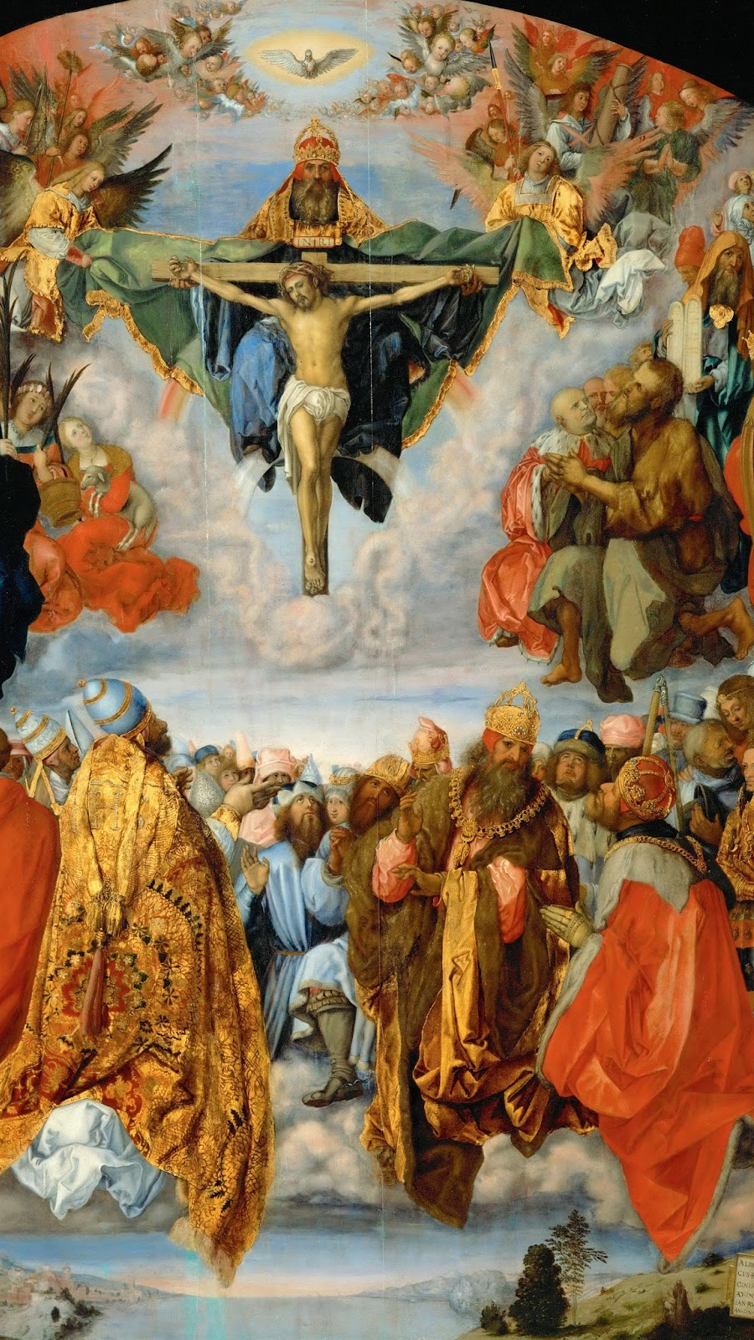
All holy men & women, saints of God, pray for us.
What gift do these holy men and women want to give to me?
This Photo by Unknown Author is licensed under CC BY-SA-NC

Slide 41
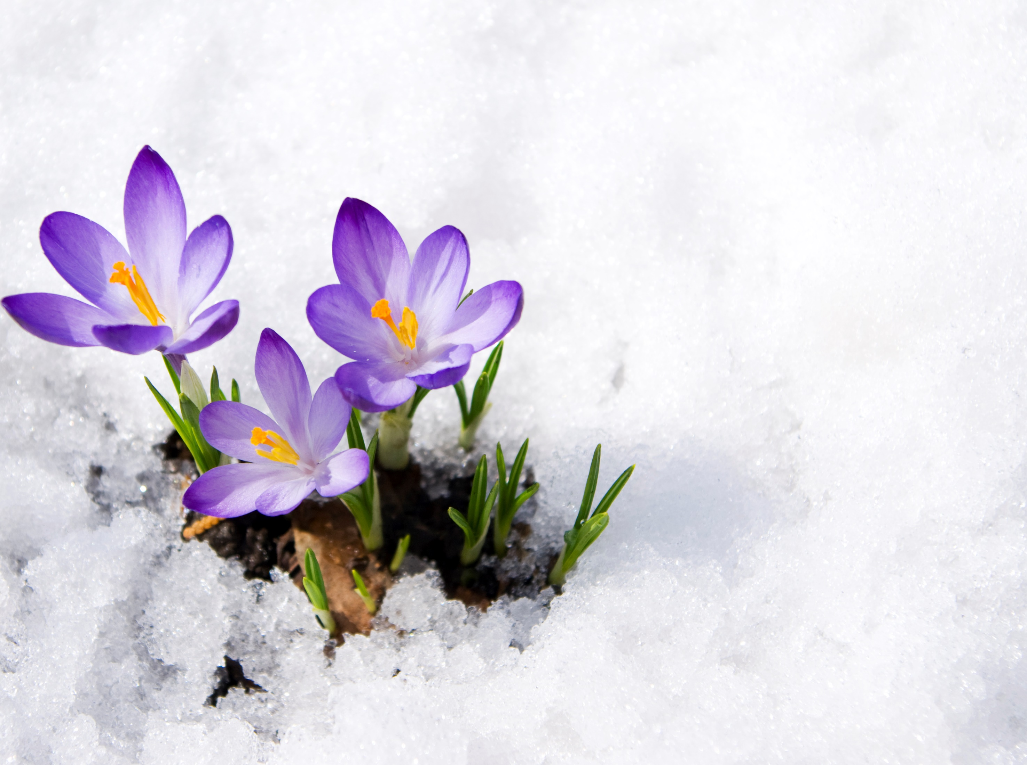
We have acknowledged our unworthiness, we have asked the intercession of the saints, God’s friends.
Our prayer continues

