Slide 1
In Memory of Pope Francis

Slide 2
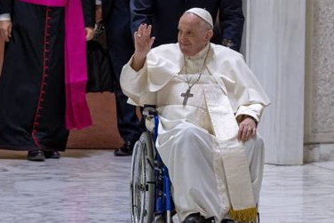
Pope Francis:
“Happy Easter to everyone!”
Easter Sunday, April 20, 2025 in St. Peter’s Square
Compiled by the Office for Catechesis & Evangelization, Diocese of La Crosse, WI. Photos from Catholic News Service (CNS)

Slide 3
Important Dates
Jorge Mario Bergoglio was born on Dec. 17, 1936, in Buenos Aires, Argentina, and entered the Society of Jesus (Jesuits) at age 21.
Following his ordination in 1969, he served as a Jesuit provincial, seminary rector, and professor before St. John Paul II appointed him auxiliary bishop of Buenos Aires in 1992.
He became archbishop of the Argentine capital in 1998 and was created cardinal in 2001.

Slide 4
Pope Francis
The surprise election of Cardinal Bergoglio on March 13, 2013, at age 76 marked several historic firsts: 1) He became the first Jesuit pope 2) The first Pope from the Americas 3) The first Pope to choose the name Francis, inspired by St. Francis of Assisi’s devotion to poverty, peace, and creation.

Slide 5
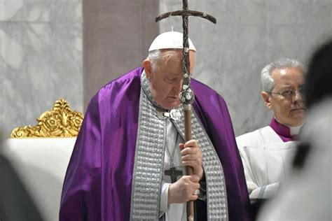
During his tenure, Pope Francis canonized 942 saints, more than any other pope in history.

Slide 6
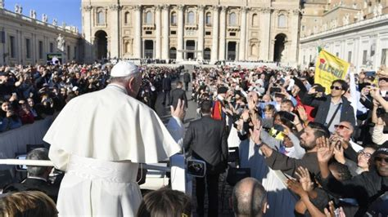
“Pope Francis’ papacy was marked by two master themes: mercy and evangelization… Pope Francis had a keen awareness of the destructiveness of sin, and he encouraged the Church to show the world the merciful face of Christ. He also emphasized the importance of our personal witness to the light of faith, drawing others to the life-giving joy of the Gospel.” +Bishop Robert Barron
Notes:
Pope Francis in the pope mobile greeting those in St. Peter’s Square.

Slide 7
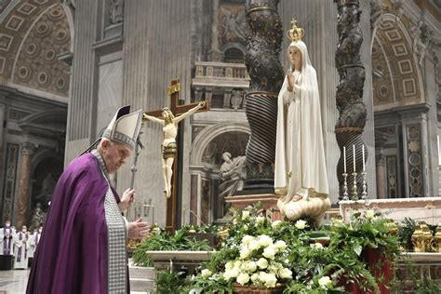
Notes:
Pope Francis had a deep devotion and love for Our Blessed Mother Mary.

Slide 8
Pope Francis proclaimed the Jubilee Year of Hope 2025
“Hope does not disappoint, because the love of God has been poured out into our hearts through the Holy Spirit who has been given to us.” (Romans 5:5)
Notes:
Pope Francis opened the “Holy Door” for the Year of Hope

Slide 9
Pope Francis passed away on Easter Monday, April 21.
The 88-year-old pontiff led the Catholic Church for 12 years.

Slide 10
The body of Pope Francis was laid out in state inside his private chapel in the Vatican, Monday, April 21, 2025.

Slide 11
Pope Francis’ coffin was carried Wednesday morning, April 23rd in solemn procession to St. Peter’s Basilica, where the late pontiff will lie in state for three days for mourners to pray, and pay their final respects.

Slide 12
The funeral Mass for Pope Francis will be on the morning of April 26 in St. Peter’s Square.

Slide 13
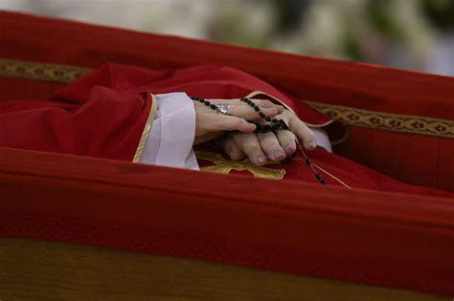
Pope Francis December 17, 1936 – April 21, 2025
Eternal rest grant unto him, O Lord. And let perpetual light shine upon him.
Notes:
Pope Francis’ hands are folded in a prayerful manner with his Rosary wrapped around them. Please consider praying the Novena in Memory of Pope Francis

Slide 14
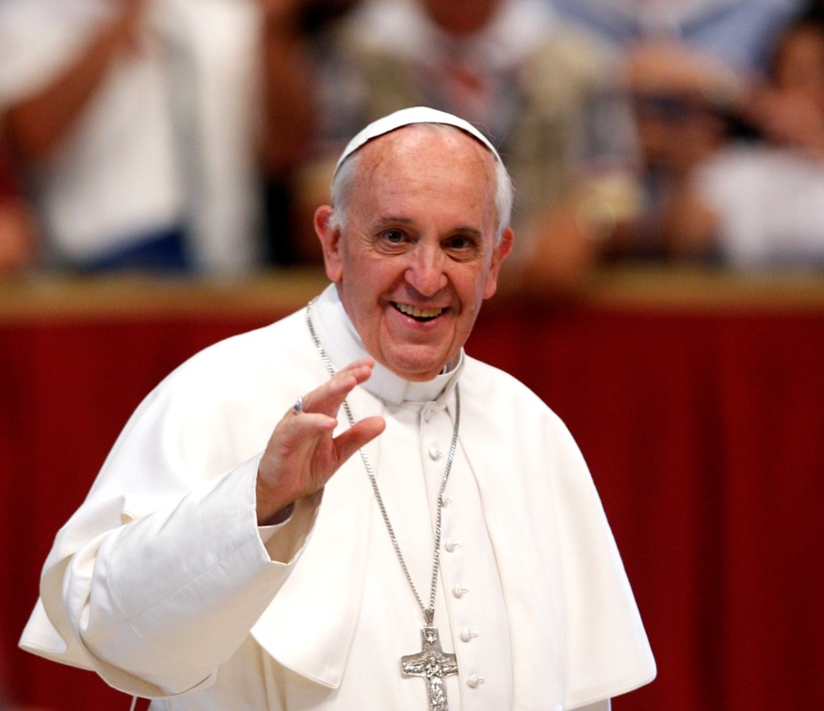
Pope Francis, We Thank You for Serving Us!

