Slide 1
The Election of a New Pope

Slide 2
Let Us Pray for the Election of a New Pope
St. Peter holds the keys, signifying what Christ said to him: “I will give to you the keys to the Kingdom of Heaven.” (See Matthew 16:19, CCC 553, 1444)
This statue of St. Peter is in front of St. Peter’s Basilica, and featured in the next three slides where the conclave is being held.

Slide 3
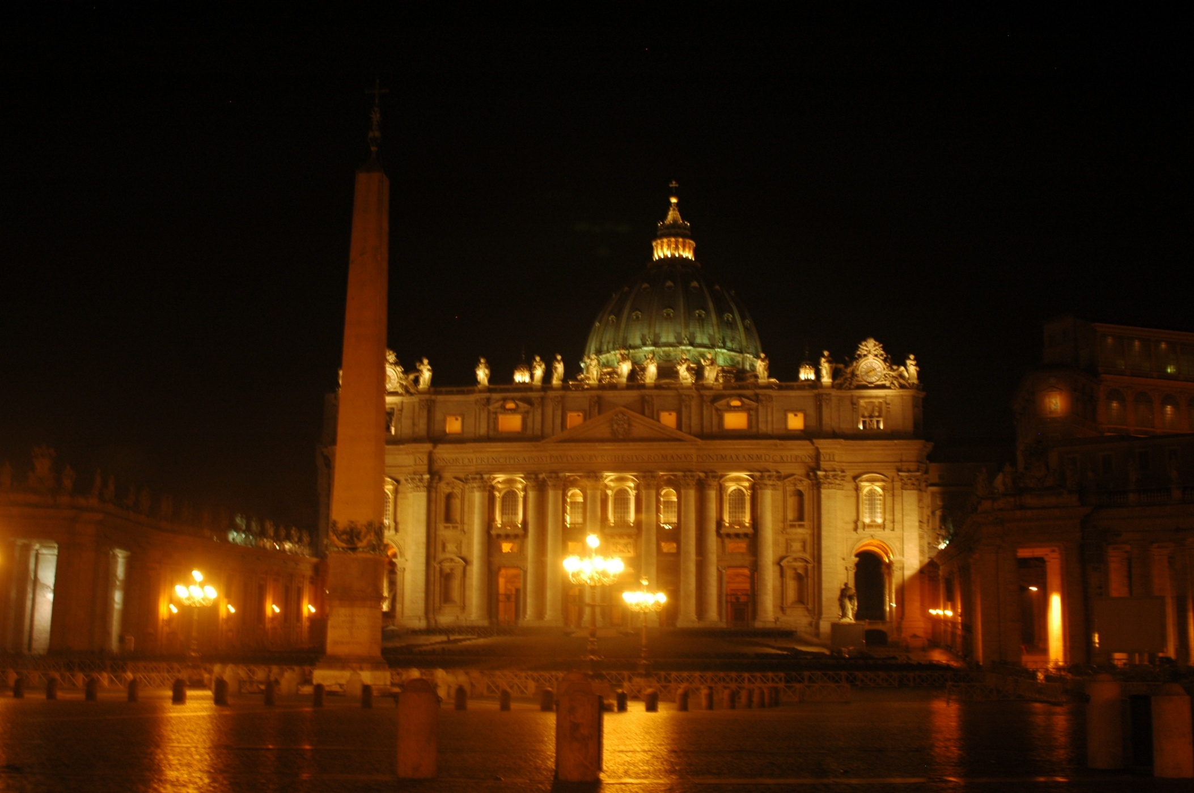
Notes:
St. Peter’s Basilica

Slide 4
The colonnade represents the arms of “Mother Church” reaching out in love to Her children.
Notes:
The colonnade reaching out from St. Peter’s Basilica

Slide 5
Notes:
St. Peter’s Square packed with pilgrims

Slide 6
The Cardinals from around the world arrived in Rome for the conclave which begins on May 7th.

Slide 7
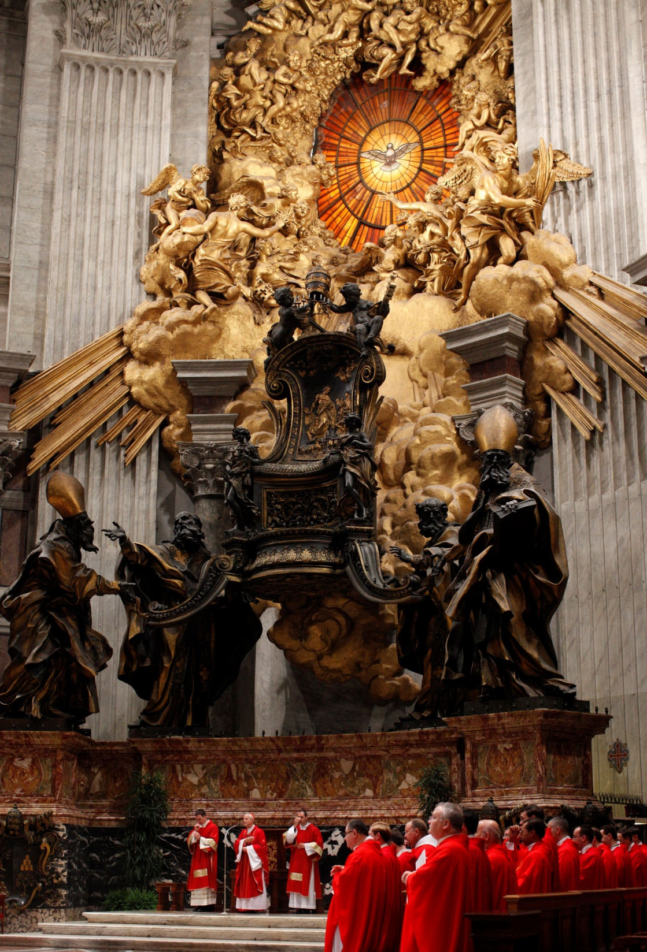
The Cardinal Electors will gather at St. Peter’s to pray the Rosary and will begin the Conclave with Holy Mass. -------- The Chair of St. Peter in St. Peter’s Basilica

Slide 8
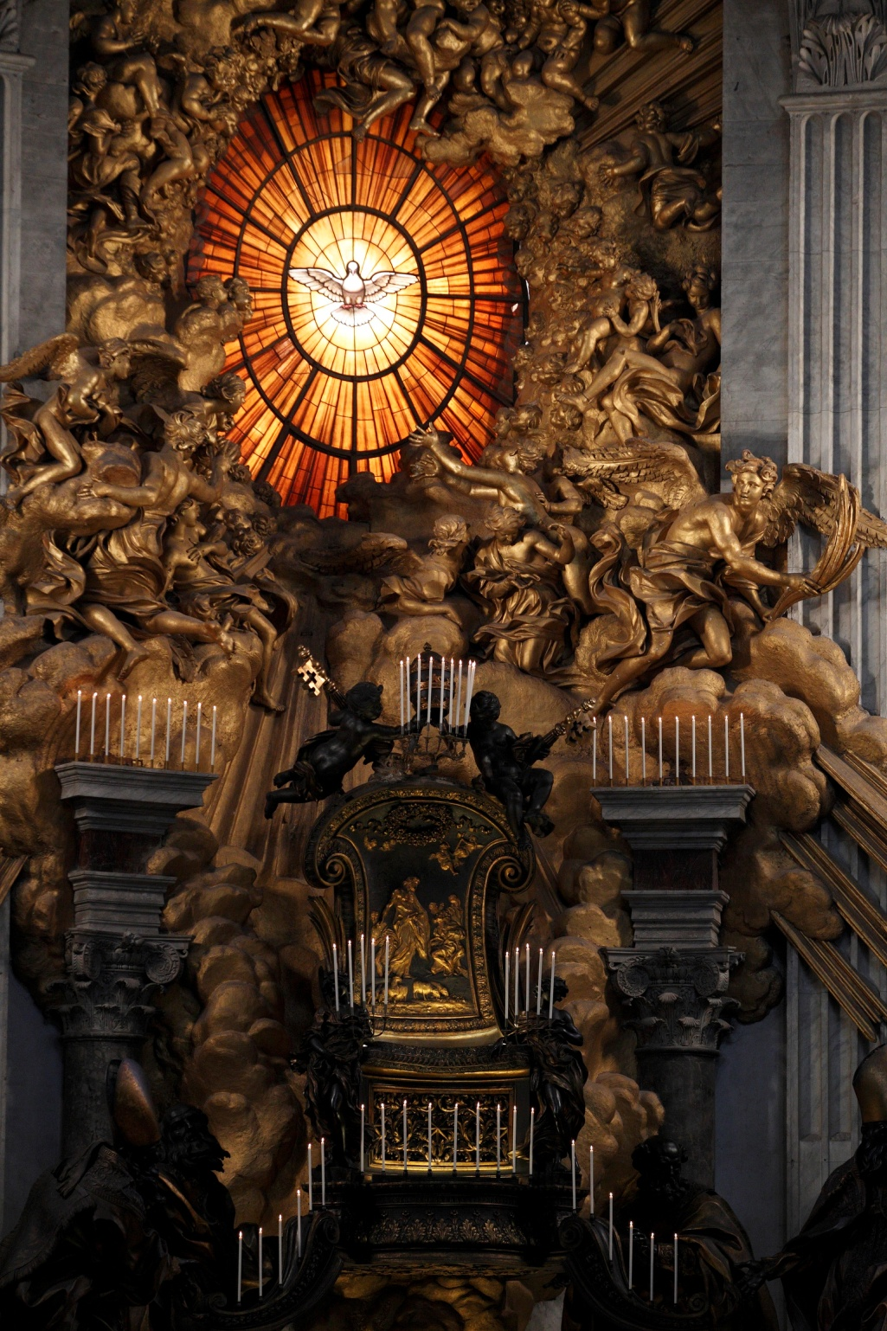
The Pope is the successor of Saint Peter, upon whom Jesus Christ built His Church. (Matthew 16:17-19)
The chair, or CATHEDRA, is a symbol of a bishop’s authority. This large chair represents the chair of St. Peter.
Notes:
See handout on Apostolic Succession

Slide 9
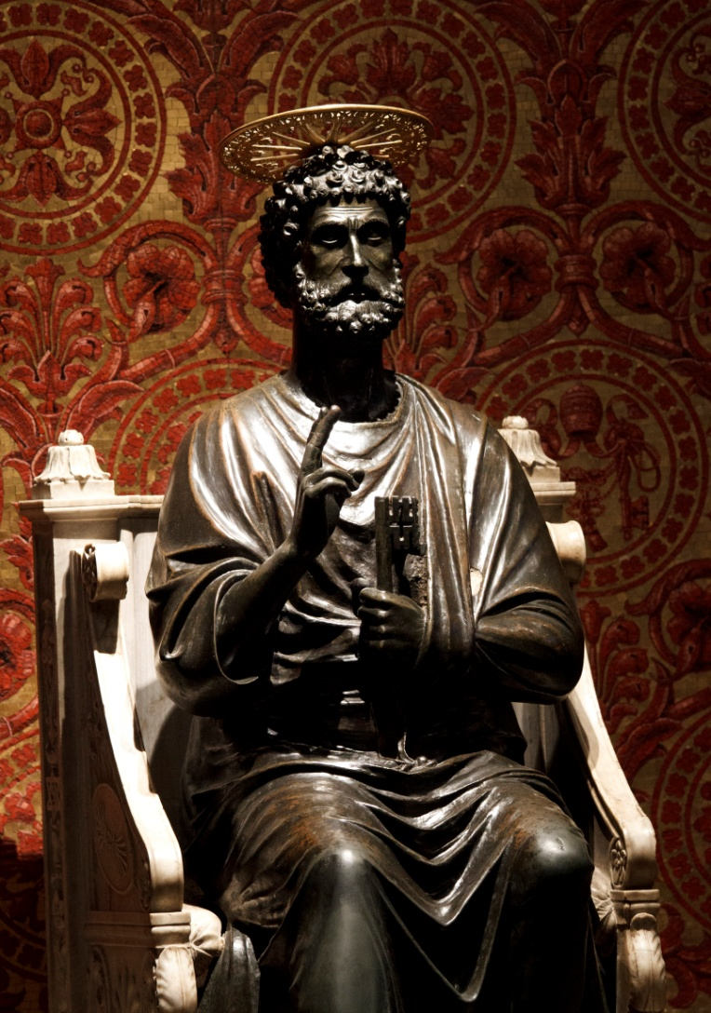
All over the world, all Catholic bishops are part of an unbroken lineage that goes back to the time of the Apostles, which is only found in the one Church that Jesus founded. Apostolic Succession is the foundation for our unity as a Church.
Notes:
Jesus chose Peter and the other Apostles to be the first bishops. Apostolic Succession is the handing on of apostolic preaching and authority from the Apostles to their successors, the bishops. Cardinals are bishops and each bishop is a modern-day Apostle. You will find online with the power point a handout that further explains Apostolic Succession

Slide 10
Balloting for the new Pope takes place in the Sistine Chapel. The ceiling in the Sistine Chapel was painted by Michelangelo from 1508 to 1512. He also painted “The Last Judgment” fresco above the altar from 1535 to 1541.

Slide 11
Conclave means “with a key.” All Cardinals under the age of 80 will process into the Sistine Chapel to elect the new pope. The Chapel is a locked area, protected by the Swiss Guard, to ensure the confidentiality of the process. Cardinal-electors do not send or receive mail; nor use a telephone, television or radio; or read newspapers. The Cardinals are in seclusion, in prayer, under the guidance of the Holy Spirit.

Slide 12
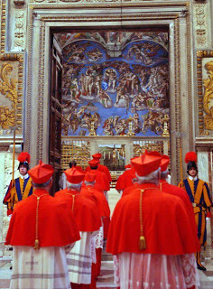
The Cardinal-Electors will enter the Sistine Chapel, chanting “Come Holy Spirit,” invoking divine help with their decision.

Slide 13
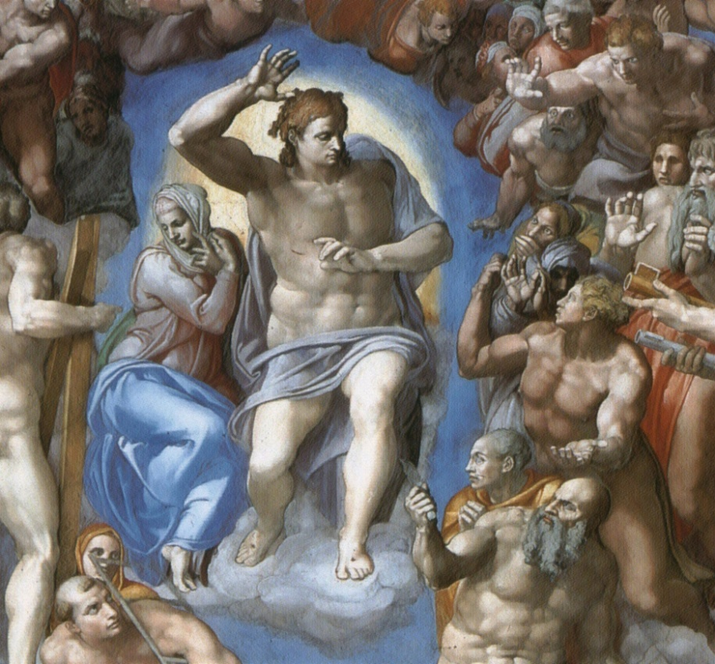
One round of voting is expected on May 7th On each subsequent day, two votes are taken in the morning and two votes in the afternoon until a successful vote.

Slide 14
The Election of a New Pope
By secret ballot, a candidate must receive a two-thirds majority of the vote in order to be elected. When the newly elected Cardinal gives assent to his election as Supreme Pontiff, the Cardinal Dean asks, “By what name do you wish to be called?”
The new Pope will announce his name. Another title for the Holy Father is “the servant of the servants of God,” for authority is given to the pope not for his personal advantage, but for the benefit of those confided to his care.

Slide 15
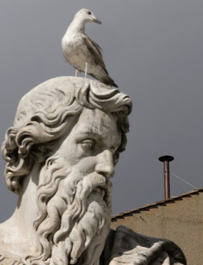
A chimney is installed on the roof of the Sistine Chapel. A stove in the conclave is set to burn ballots each morning and afternoon.
If balloting is not successful, the smoke burns black with the help of an added chemical.
If balloting is successful, a chemical is added to produce white smoke – the signal to the world that the Church has a new Pope!

Slide 16
The “Room of Tears”
The new Pope will dress in the “Room of Tears”—perhaps so-called because of the emotion of the moment. When he returns to the Chapel a Gospel passage connected to the Petrine ministry is read, a brief prayer is given, and the Cardinals process, one-by-one to the new Pontiff, congratulating him and promising their obedience. The Pope and the Cardinals sing the Te Deum together.

Slide 17
“Habemus Papam!”
After the new Pope changes into the white papal vestments and then greets each of the Cardinals, the senior cardinal deacon will appear on the central balcony of St. Peter’s and announce Habemus Papam – we have a Pope! The new Pope will then appear to greet the world and give all a blessing.

Slide 18
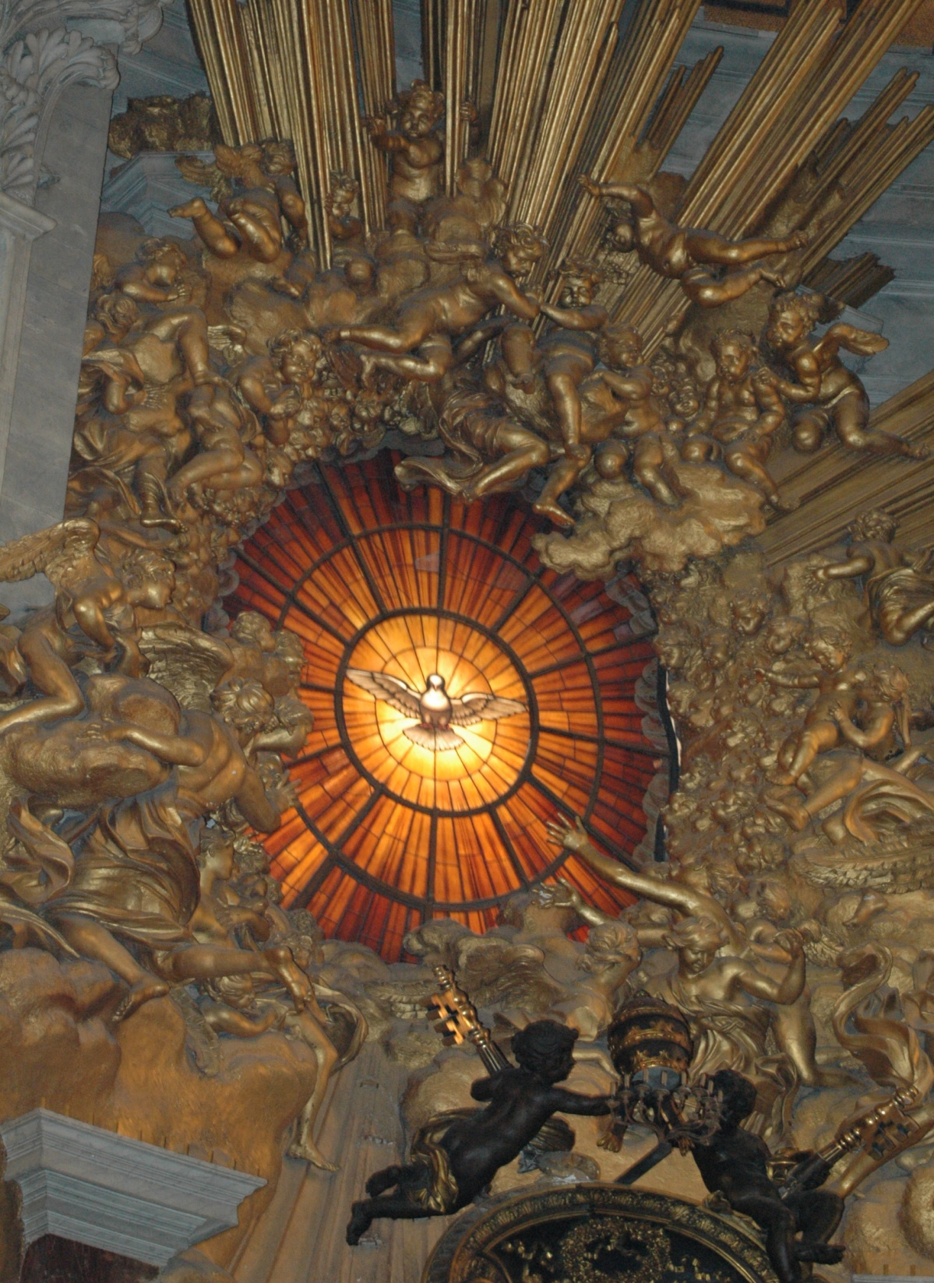
Prayer for the Election of a New Pope
O God, Eternal Shepherd, Who govern Your flock with unfailing care, grant in Your boundless fatherly love a pastor for Your Church who will please You by his holiness and to us show watchful care. Through our Lord Jesus Christ, Your Son, who lives and reigns with You in the unity of the Holy Spirit, one God, for ever and ever. Amen. (Roman Missal, Collect)
Window in St. Peter’s – symbol of God the Holy Spirit

