Slide 1
Habemus Papam
“We have a Pope!”

Slide 2
133 Cardinal Electors participated in the Conclave:

Slide 3
The “Room of Tears”
After his election on May 8, Pope Leo XIV dressed in the “Room of Tears”—perhaps so-called because of the emotion of the moment.
When he returned to the Chapel, a Gospel passage connected to the Petrine ministry was read, a brief prayer was given, and the Cardinals processed, one-by-one to the new Pontiff, congratulating him and promising their obedience.
The Pope and the Cardinals sang the Te Deum together.”
Notes:
The word Petrine refers to the ministry of St. Peter, our first pope

Slide 4
Pope Leo XIV waves to the crowds in St. Peter’s Square after his election as pope on May 8, 2025.

Slide 5
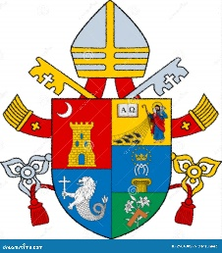
Pope Leo XIV
Born: September 14, 1955
Ordained a Priest: June 19, 1982
Ordained a Bishop: December 12, 2014
Elevated to Cardinal: September 30, 2023
Elected Pope: May 8, 2025

Slide 6
His Holiness, Pope Leo XIV

Slide 7
The 267TH Pope
With joy in our hearts and reverence in our voices, we share history in the making: a new pope has been elected.
Habemus Papam! The bells of St. Peter’s Basilica ring out as Catholics around the world rejoice in the election of our new Holy Father, Pope Leo XIV, formerly Cardinal Robert Francis Prevost, O.S.A.
Cardinal Prevost is an American prelate born in Chicago in 1955. A member of the Order of Saint Augustine, he has served extensively in both the United States and Peru as a missionary, educator, and Church leader. After earning a doctorate in canon law in Rome, he held key roles in formation and ecclesiastical governance in Peru, including judicial vicar and seminary professor. He later served as Prior General of the Augustinians globally. Appointed bishop of Chiclayo, Peru in 2015, he went on to become a member of several Vatican congregations. In January 2023, Pope Francis named him Prefect of the Dicastery for Bishops and President of the Pontifical Commission for Latin America.

Slide 8
Pope Leo XIV’s excerpted Message to Rome and to the World May 8, 2025
“Peace be with you all!...God loves us, God loves you, and evil will not prevail! We are all in God's hands. Therefore, without fear, united hand in hand with God and each other -- let us go forward. We are disciples of Christ. Christ goes before us.
The world needs His light. Humanity needs Jesus as the bridge to be reached by God and His love. Help us to build bridges, with dialogue, with encounter, uniting us all to be one people always at peace.” - Pope Leo XIV

Slide 9
Pope Leo XIV, the Vicar of Christ on earth
Notes:
The Vicar of Christ on earth means the representative of Christ on earth

Slide 10
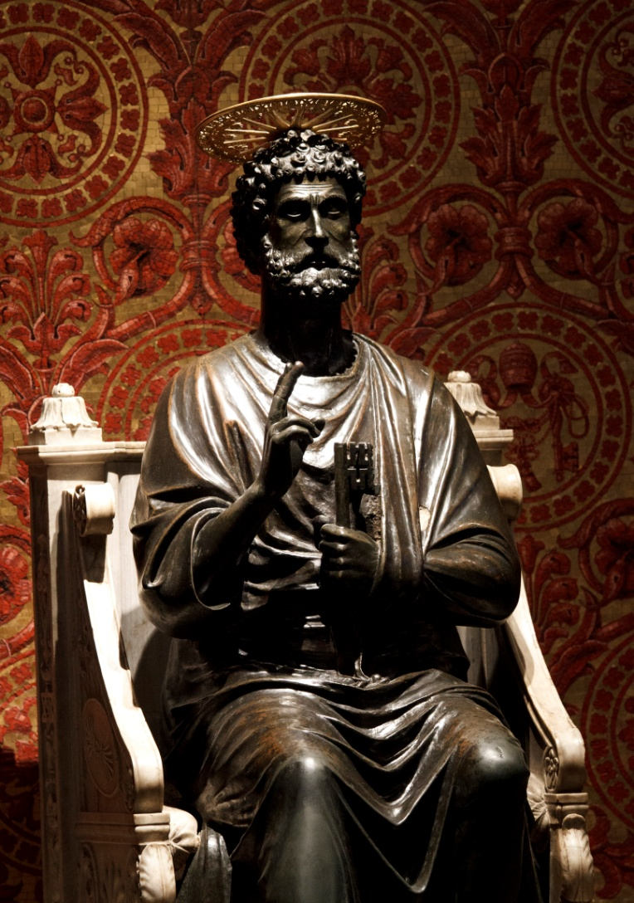
Pope Leo XIV is the successor of St. Peter – “the Rock” on which Jesus founded the Church -------- The Statue of St. Peter in St. Peter’s Basilica Vatican City

Slide 11
“We must seek together how to be a missionary Church, a Church that builds bridges, dialogue, always open to receive, like this square, with the open arms of “Mother Church;” Everyone, everyone needs our charity, our presence, dialogue and love.” -Pope Leo XIV

Slide 12
“Today is the day of Supplication to Our Lady of Pompeii. Our Mother Mary always wants to walk with us, be close, help us with her intercession and love.
So I would like to pray together with you for this new mission, for the whole Church, for peace in the world, and let us ask Mary, our Mother, for this special grace. Hail Mary, full of grace, the Lord is with you…”
Notes:
Pray the Hail Mary together

Slide 13
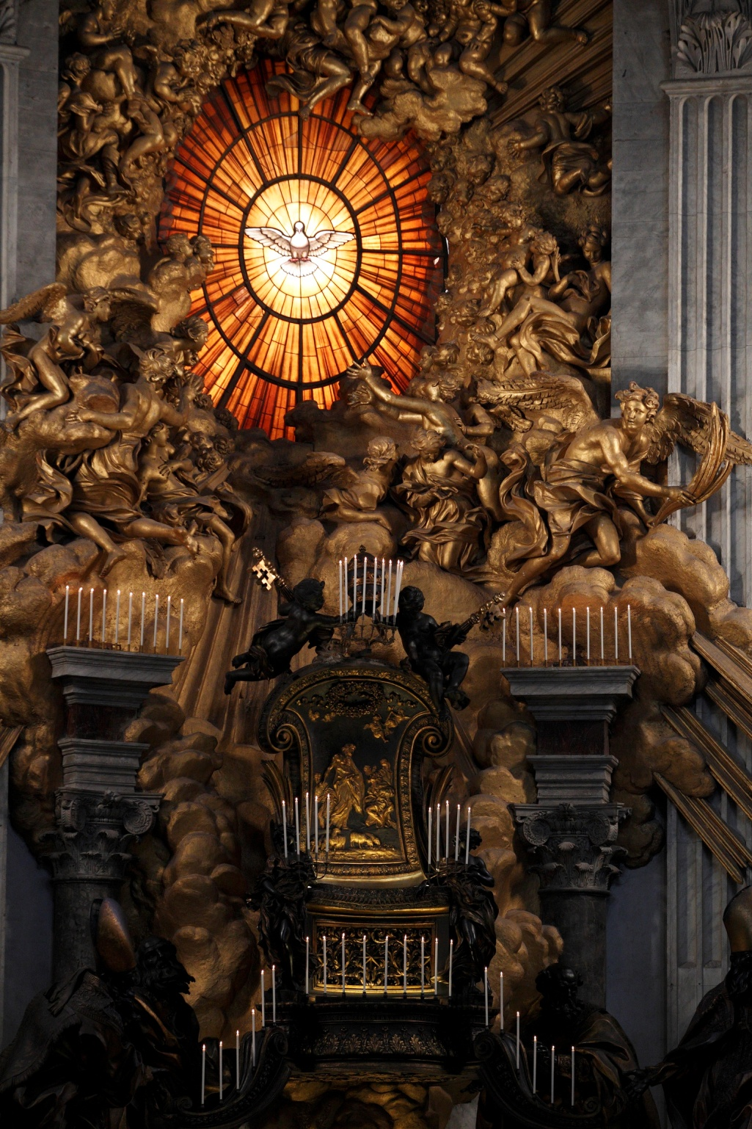
This represents the chair of St. Peter, the symbol of authority. The Pope is the successor of Saint Peter, upon whom Christ built His Church. This Apostolic Succession is the foundation for our unity as a Church because the Apostolic Succession has been unbroken since the time of the Apostles.

Slide 14
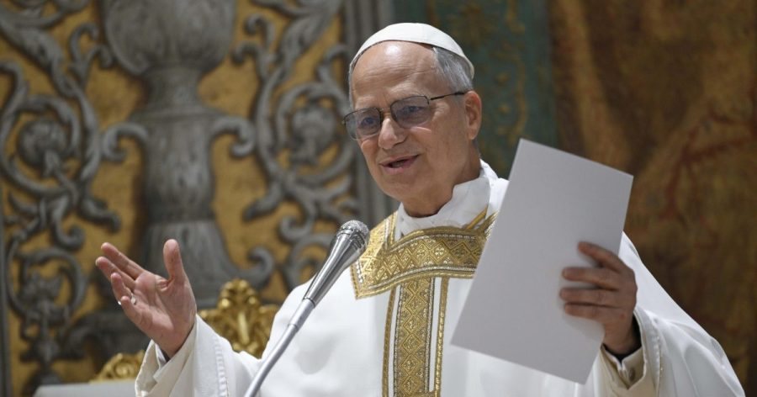
“Jesus is the Christ, the Son of the living God: the one Savior Who alone reveals the face of the Father.” Pope Leo’s homily at Mass with the cardinal electors May 9, 2025
V

Slide 15
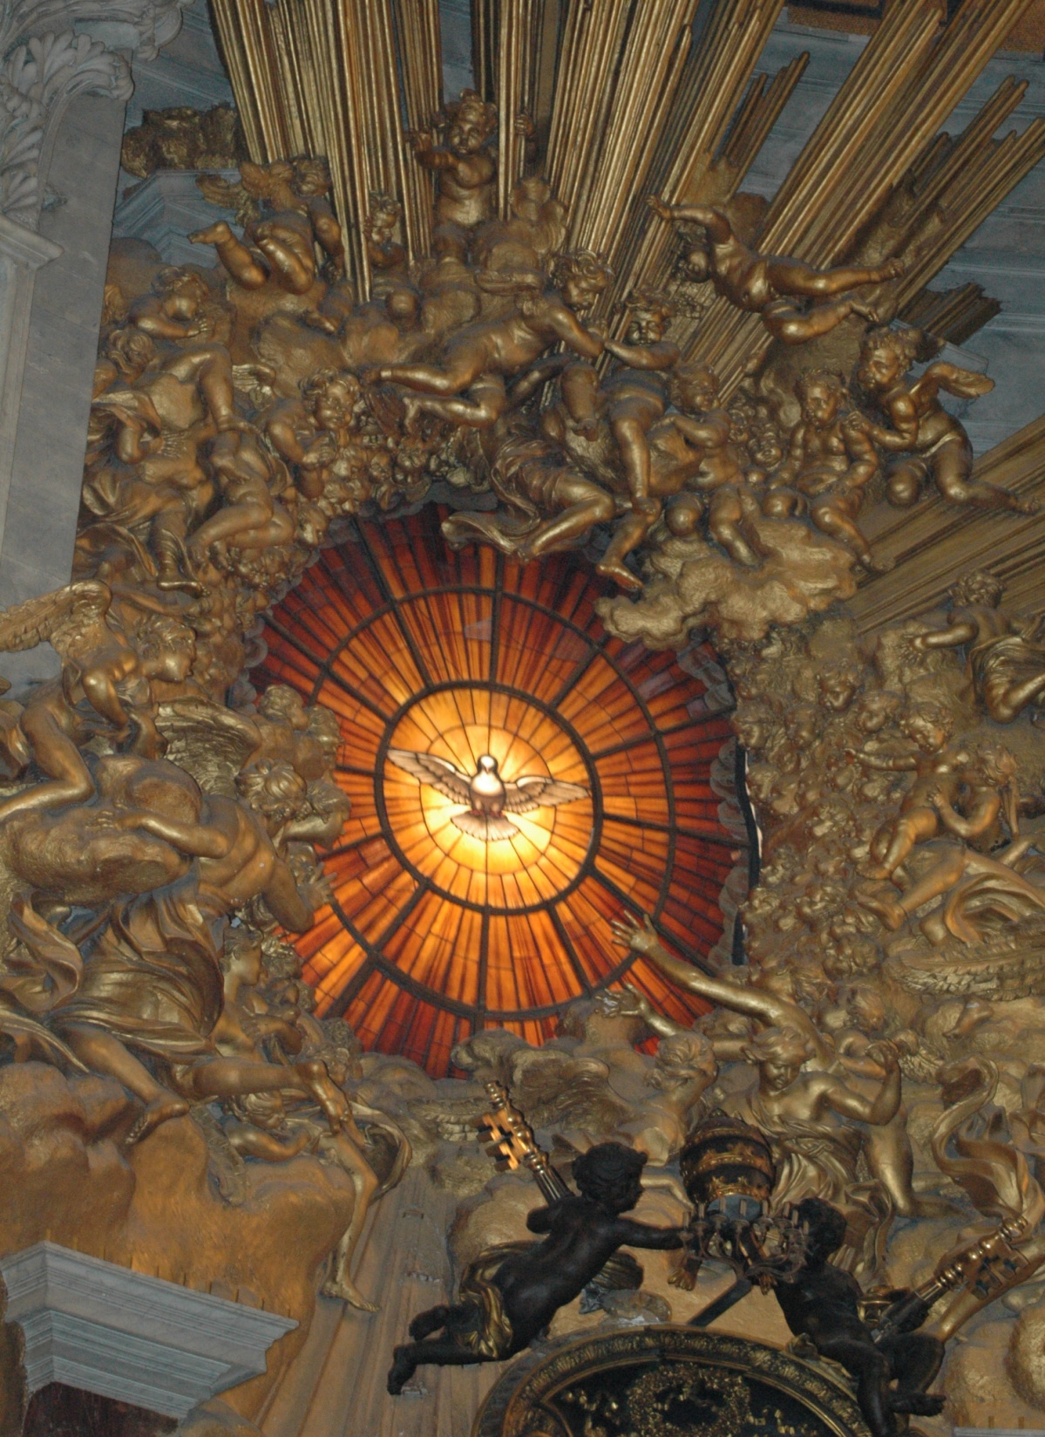
Prayer for Pope Leo XIV
O God, who in Your providential design
willed that Your Church be built upon blessed Peter,
whom you set over the other Apostles,
look with favor, we pray, on Leo our Pope
and grant that he, whom you have made Peter’s successor,
may be for your people a visible source and foundation
of unity in faith and of communion.
Through our Lord Jesus Christ, Your Son,
who lives and reigns with You
in the unity of the Holy Spirit,
God, for ever and ever. Amen.
Collect of the Mass for the Pope T he Roman Missal, Third Edition
Window in St. Peter’s – symbol of God the Holy Spirit

