Slide 1


For Your Safety and Protection
Safe Environment
Eleventh Grade

Slide 2
God created you!
Notes:
God created you in His image and likeness.
That means that you are a beloved son or daughter of God. He dwells within you. When “the Word became flesh,” God Himself took human form and so made you holy. That means that your body and soul are precious in the eyes of God. When you reflect carefully about this great truth, you can better decide how to make important choices, for yourself and for others, so that you will always act in a way pleasing to God. To strive to please God in all things will not necessarily make for an easy life—Jesus told His disciples that we must carry the Cross after Him—but it will make for a fulfilled and happy life, because He promised this.
What strikes you about reading this statement?

Slide 3

Notes:
God is good and only wants what is best for you.
In your daily life, you need to play your part by seeking to protect yourself from sinful behaviors with their damaging effects, as well as by guarding against situations that are dangerous and people who may cause you harm. God has given you a Guardian Angel who is always with you, seeking to guard and guide you. Pray the Guardian Angel prayer each day to remind you of this.
Remember that believing and trusting in God does not mean you won’t go through suffering, but it means that you have an ally who walks with you through the suffering. You are never alone. Perhaps the best thing to remember is that God understands suffering first hand. Look at Jesus Christ, the second person of the Holy Trinity. He was fully God and fully man, and in the Gospels we read about how He suffered in the last days of His life: physically, emotionally, spiritually, and psychologically. He suffered every way a human being can suffer. So when you are suffering remember, when you pray, that God has been there, He understands, and He is present. Trust in the presence, love, grace, and mercy of our Lord.

Slide 4
God knows
YOU
and loves you unconditionally.
Notes:
Jesus knows everything about you and loves you unconditionally. How do we know this?
Jesus has told us through His Word in the Sacred Scriptures.
“Before I formed you in the womb I knew you.” (Jeremiah 1:5)
“For God so loved the world that He gave His only Son, so that all who believe in Him might not perish but have eternal life.” (John 3:16)

Slide 5
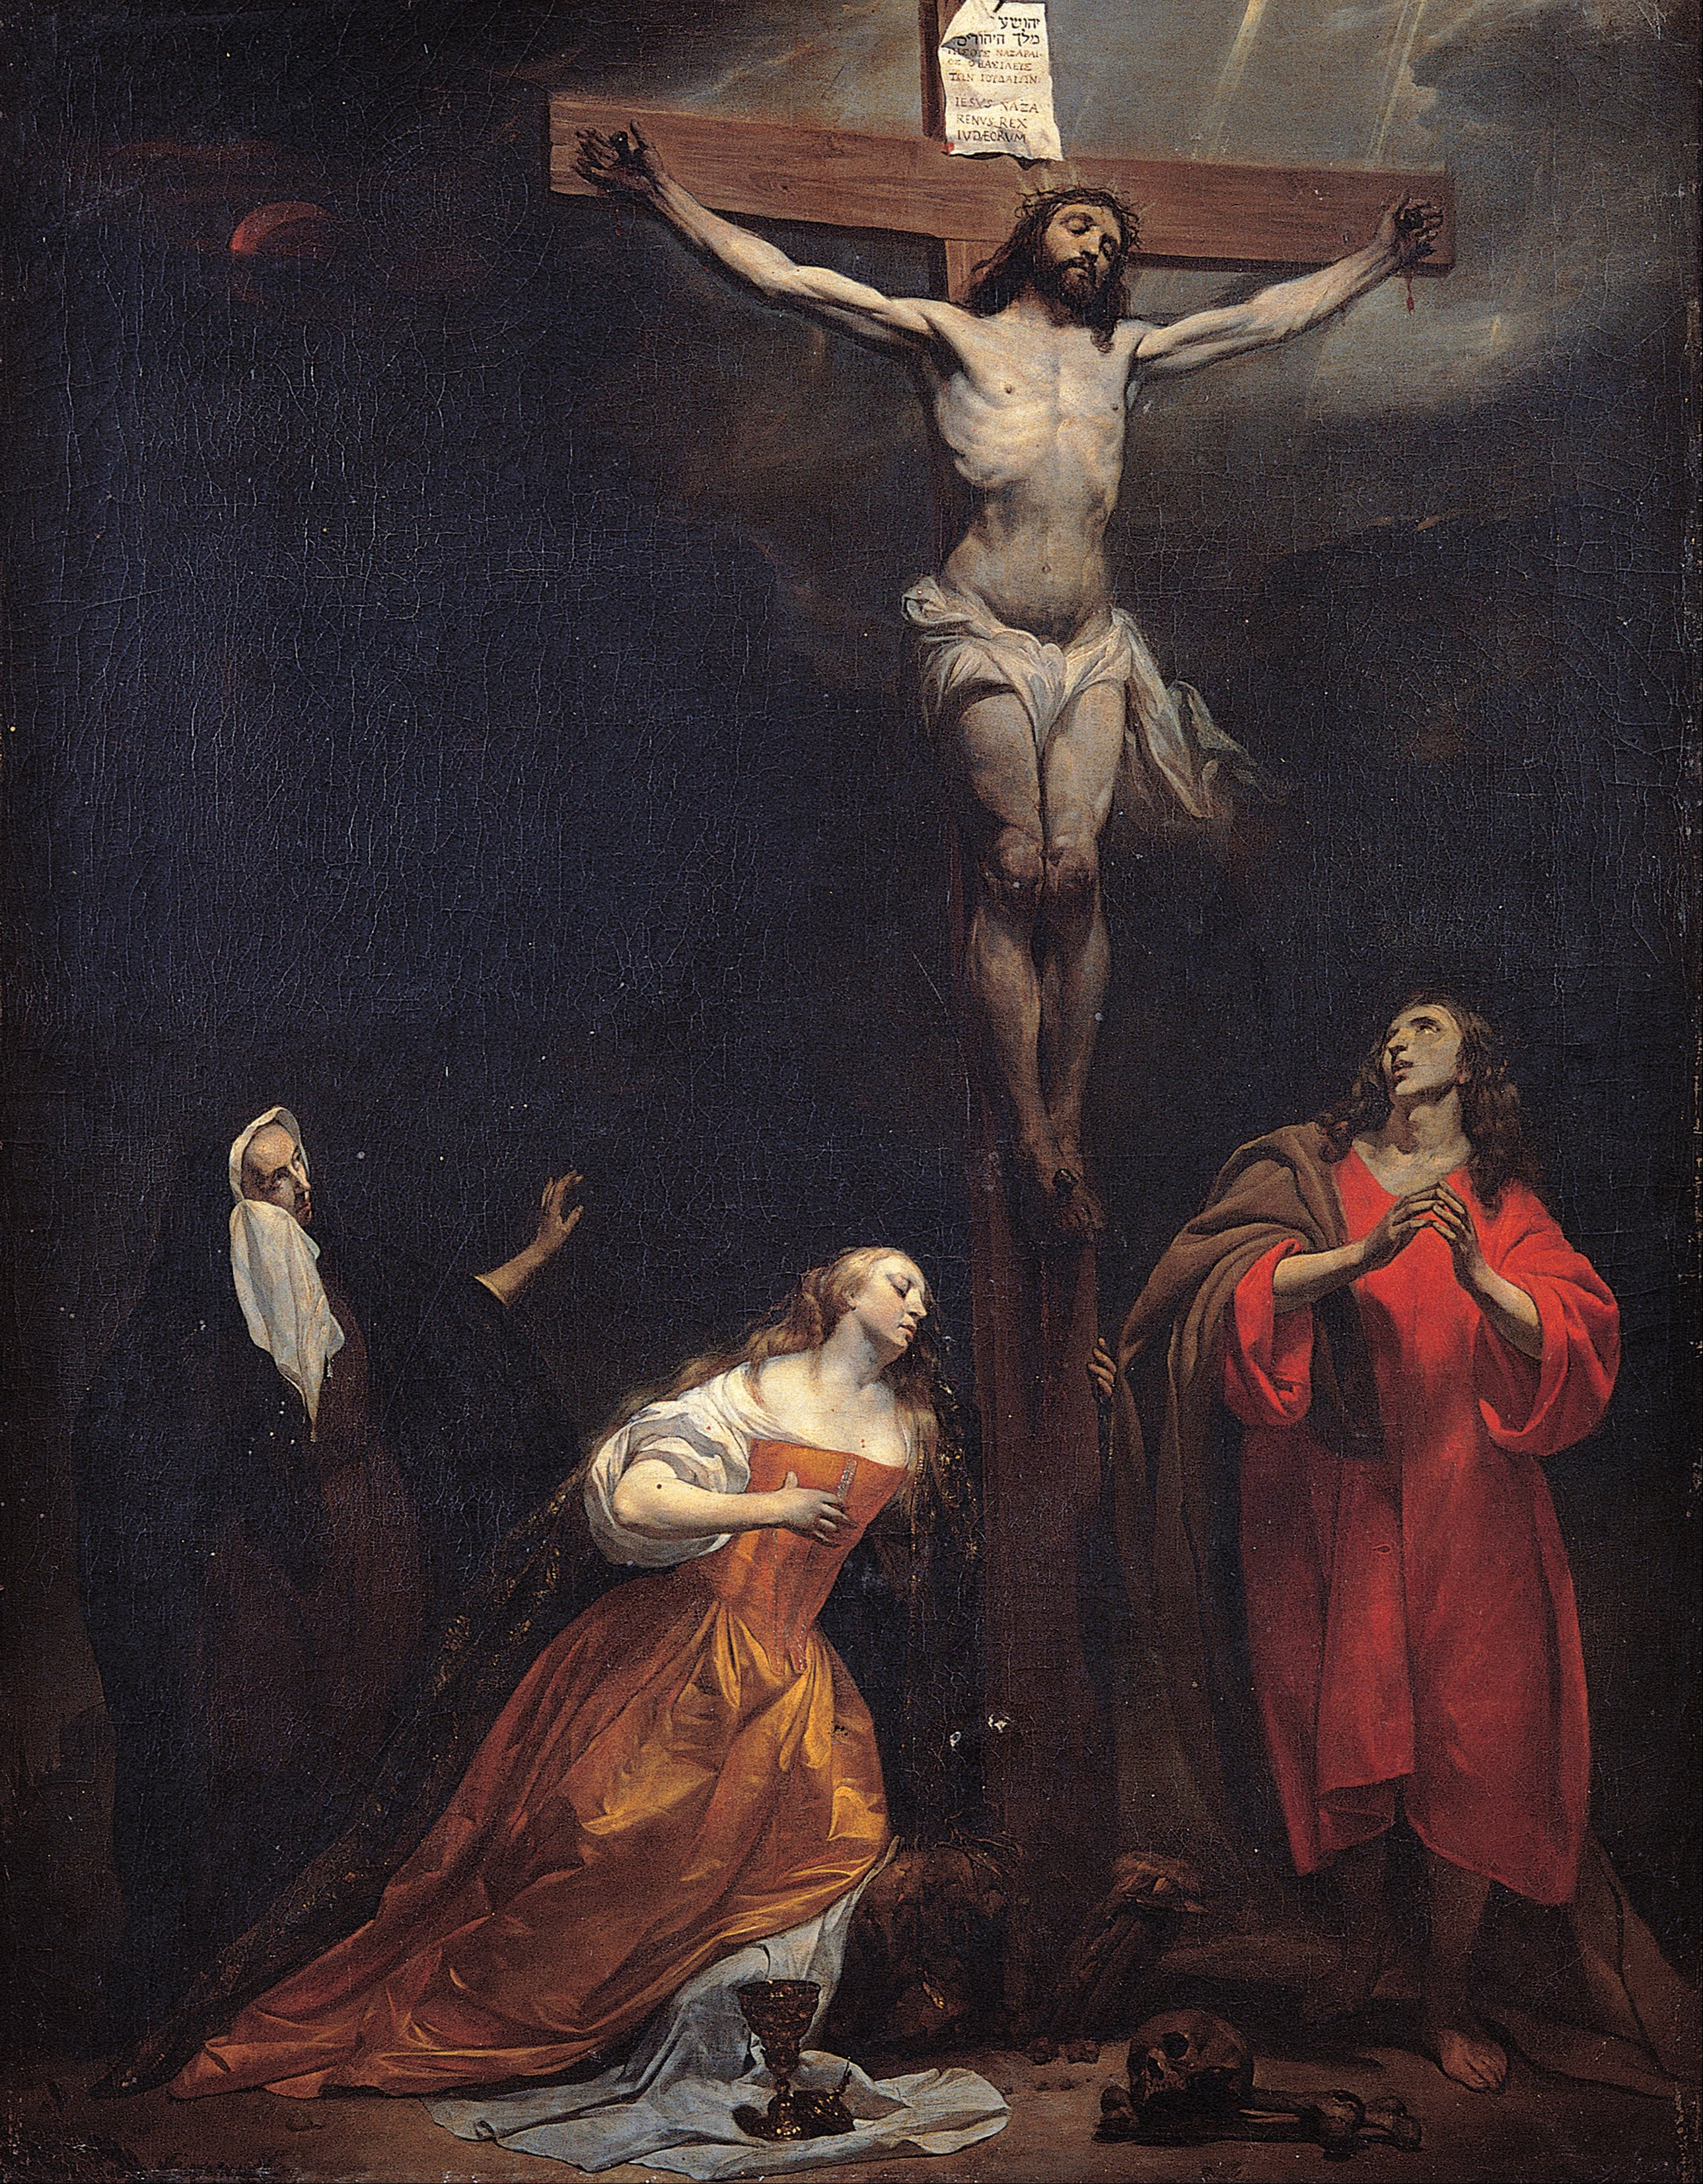
Notes:
You are a beloved son or daughter of God.
He dwells within you. When “the Word became flesh,” God Himself took human form and so made us holy. That means that our body and soul are precious in the eyes of God. When we reflect carefully about this great truth, we can better decide how to make important choices, for ourselves and for others, so that we will always act in a way pleasing to God. To strive to please God in all things will not necessarily make for an easy life—Jesus told His disciples that we must carry the Cross after Him—but it will make for a fulfilled and happy life, because He promised us this.
Jesus understands pain, fear and suffering because, as the second Person of the Holy Trinity, He experienced them, and He wants to support and strengthen us by His love when we are lonely, uncertain or anxious. Jesus gave everything for you! When we look at the Cross, Jesus’ open arms invite us to receive that love by opening our hearts to Him in prayer and through the Sacraments.

Slide 6
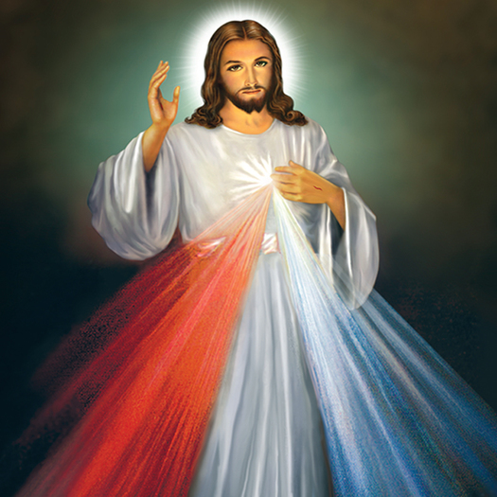
“Jesus I trust in you.”
Notes:
You can trust Jesus. He has given everything so that you can know the difference between His will and will of the father of lies (the devil), selfishness, sin, and death. Nothing can separate you from Christ’s love, except one thing, that is choosing to separate yourself from Him. What are some ways this can happen?
“Who shall separate us from the love of Christ? Shall trouble or hardship or persecution or famine or nakedness or danger or sword? No, in all these things we are more than conquerors through Him who loved us. For I am convinced that neither death nor life, neither angels nor demons, neither the present nor the future, nor any powers, neither height nor depth, nor anything else in all creation, will be able to separate us from the love of God that is in Christ Jesus our Lord. (Romans 8: 35, 37-39)
A great saint of the last century, St Faustina, taught us this simple but powerful prayer: “Jesus, I trust in you.”

Slide 7

God is the only one who can love you perfectly.
Notes:
God is the only one who can love you perfectly. And when you have a relationship with God and experience His love, you have a greater desire to love others the way God loves you. The way you show your love for God is to love every person you encounter in the same way He loves you. This doesn’t mean every person has to be our best friend, but you need to welcome every person with kindness.
What is your commitment to speak with and listen to Jesus each day?
Allow students time to write something down.

Slide 8
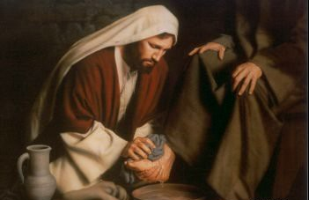
“I no longer call you slaves but I call you friends.” Jesus
Notes:
Jesus caught the disciples completely by surprise by washing their feet. Jesus told them, “I no longer call you slaves but I call you friends.” These words are meant for you too.
You can be a slave to many things in your life such as:
Addiction
Money
Materialistic Things
Popularity
Sports
But a relationship with Christ is loving Him out of your own free will. Following Him is also done out of your own free will. Living as Christ taught us to live does not mean we are bound by a bunch of rules, but we have guidance to help us avoid the earthly things that can easily enslave us, and to help us avoid causing others to fall into sin. This is true friendship.

Slide 9

Each person is unique, unrepeatable, and has inherent dignity from God.
Notes:
Each person is unique, unrepeatable, and has inherent dignity from God, with a unique role in His plan. Therefore, each person is to be shown respect, even if the individual is impaired in some way. We are to honor and esteem each person because he/she is a child of God.
• Complete respect is to begin in our relationship with God in obeying His commands and responding to His desire that we spend time with Him in prayer each day.
• Secondly, we are to respect ourselves, maintaining a proper balance in all matters.
• God has given us our parents and so we are to respect them, followed by a special respect for priests, religious, teachers, law enforcement officers, elders, siblings, relatives, bosses, fellow employees, neighbors and those in authority.
• We are to show respect for our neighbor and his conscience through charity. Everyone should look upon his neighbor (without any exception) as ‘another self’, protecting his life and keeping in mind what is necessary for living it with dignity.
• Respecting others should involve meekness, benevolence, courtesy and tact toward them.
• We must respect the soul and body of each person, avoiding the possibility of inducing others to do evil. If we sin against someone or cause him to sin, we wound his conscience and we sin against Christ because each person is created in the image of God
• We must take care of our physical health and avoid every kind of excess by avoiding the abuse of alcohol, tobacco, and the use of illicit drugs which cause serious damage.

Slide 10

How do we show respect to others?
Notes:
How do we show respect to others?
Speak kindly
Refrain from idle complaints
Speak charitably of others
Pay attention
Listen well
Discover silence so that you can learn to recognize the inner promptings of the Holy Spirit
Acknowledge others
If you feel called to disagree, do so with sensitivity
Respect even a subtle “No”

Slide 11
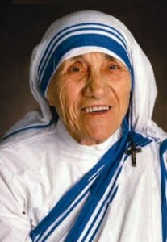
“Your true character is most accurately measured by how you treat those who can do ‘Nothing’ for you.” ~ St. Teresa of Calcutta
Notes:
St. Teresa of Calcutta said, “Your true character is most accurately measured by how you treat those who can do ‘Nothing’ for you.” How often do we treat people by the way we imagine they can do something for us, whether it be increase our popularity, financial status, or any other desires we might have? When we see people as a tool or a commodity, then we do not see their true identity as a child of God.
This is the friendship above all others. This helps us to understand why the Eucharist is the greatest treasure of the Church, and why receiving Christ in Holy Communion is the greatest of all blessings. Jesus is offering the gift of Himself, the gift of intimate friendship. We are to imitate Jesus in respecting others. How? Strive to lay down any selfishness, and treat every person with respect.

Slide 12

Think of true friendship like a base coach in baseball.
Notes:
Think of true friendship like a base coach in baseball. In baseball, the base coach is watching out for the best interest of the runner. Not only is the coach encouraging, but also looking out for danger. The coach is a guide for the runner to make it safely home. However, the runner is the one who makes the choice to act.
We would not have any good friends without making choices for their good and choosing to make a gift of ourselves to them in love. And yet, a true friend is far more a gift of God than an achievement of ours. We have freedom to accept or reject whomever the Lord gives us to love. When we live by the “golden rule”, doing to others what we would have them do to us – treating each person with respect, compassion and authentic love – we manifest the love of the Father, completing what He has done for us. True friendship means that we have to love our friends enough to lead them away from paths that separate them from God. True friendship means saying no to sin for the good of ourselves and the other person. Our SECULAR culture says that to love someone, we must accept everything they do. But true love is loving others enough to steer them from the things that could harm them and accompanying them on the path to discover who they truly are as a child of God.
How do you cooperate with the power of God’s grace, received in prayer and the Sacraments, to forgive another person when they offend you?

Slide 13
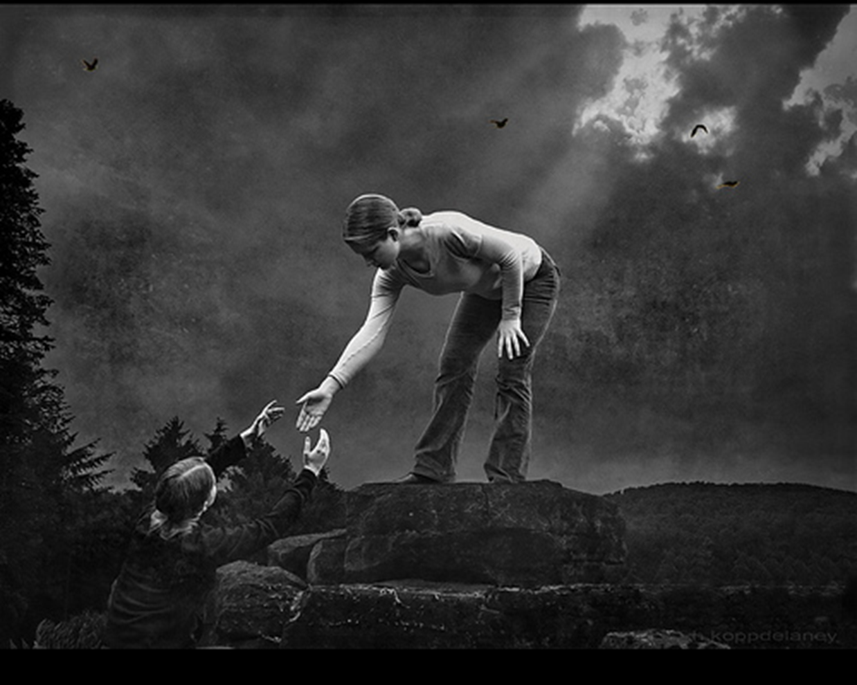
Do your friendships lead you and the other person closer to Christ?
Notes:
True friendship is leading one another to a deeper relationship with Christ. This is also true with dating relationships. In all of our relationships, we are responsible for the care of another person’s soul. If we are a true friend, why would we do anything to damage the soul of another person?
Sometimes we only focus on what the other person can do for us and forget about living out the virtue of respect. Sometimes we reduce the act of respecting someone to not causing harm to another person. But the virtue of respect is much deeper than that.
“Truly I tell you, whatever you did for one of the least of these brothers and sisters of mine, you did for me.” ~ Jesus

Slide 14

God wants what is best for you.
You have to do your part.
Practical steps to avoid danger:
Notes:
Avoiding potential danger means that you must be careful to avoid situations that may be harmful to you and to others, and also be persistent in helping your friends in the same way.
The following are practical steps to avoid potential danger:

Slide 15
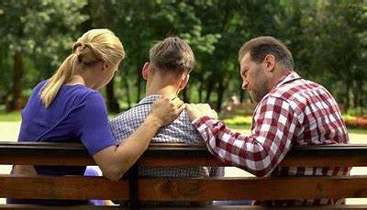
See your parents as your greatest ally.
Notes:
Talk to your parents and see them as your greatest ally.
Don’t hide things from your parents, but let them be part of your life. Let them know where you are at all times, who you are with, etc. Even allow them to meet, and get to know your friends. Also, make sure your parents know of any regular meetings or correspondence (email, etc.) with an adult, school counselor, priest, youth minister, etc.

Slide 16

Ask questions, think ahead, and use good judgement.
Notes:
Ask questions, think ahead and use good judgment. Pray for the strength to say no to plans that could be unsafe. Take time for silence so that you can learn to recognize the inner promptings of the Holy Spirit, who will guide you on the right path.
Asking questions gives you the information you need to make an informed decision. Don’t be afraid to speak up, because chances are you are not only speaking for yourself, but for others around you may not feel comfortable to speak up. Be brave: pray for the grace to be a leader, and take a stand.

Slide 17

Notes:
Always be aware of your surroundings, and trust your instinct that a situation could be dangerous.
Sacred Scripture, the very Word of God, lights our path to what is good, true and beautiful – to what brings peace, joy and fulfillment. Read the Word of God in Sacred Scripture a few minutes each day, beginning with the New Testament. Pray for the grace to be obedient to where the good God is leading you.
Christ is the Guide who will lead you along the right path. Remember you never walk alone because Christ is with you whether you recognize it or not. To recognize this better, spend time with Him in conversation each day through prayer and silence.

Slide 18

Notes:
Refrain from using foul language and from sexually offensive humor in conversations. “Consider what a great forest is set on fire by a small spark. The tongue also is a fire…” No human being can tame the tongue. It is a restless evil, full of deadly poison. With the tongue we praise our Lord and Father, and with it we curse human beings, who have been made in God’s likeness. Out of the same mouth come praise and cursing. My brothers and sisters, this should not be. (by analogy) Can both fresh water and salt water flow from the same spring?” (James 3:5-6, 8-11)
Your words have meaning. They can be used to love and build people up or they can be used to tear people down. They can be used bring the Gospel message to people, or they can be used to cause people to stray from God. The words you speak and the way you speak those words have an effect on others.
Remember gossip, verbal bullying, cyberbullying are very destructive. Influencing others to form negative opinions about people is a form of control and manipulation. These are wounds that cut deep and can stay with people for life. A comment that you say in passing may become a wound for someone that never goes away.
Self control is a fruit of the Holy Spirit. Ask the Holy Spirit to strengthen you with the power of His grace to train your tongue in order to speak with others with great respect.

Slide 19
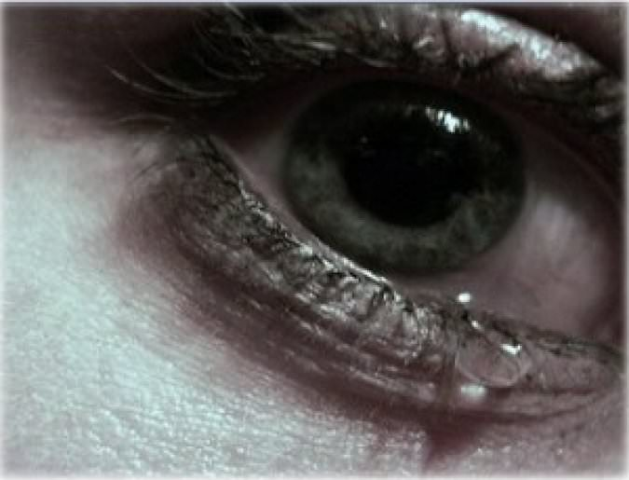
Guard against relationships that involve deception, manipulation, intimidation or exploitation.
Notes:
Guard against relationships that involve deception, manipulation, intimidation or exploitation.
Relationships are important, but the key to a good relationship is how we treat each other. Sometimes people who are misguided see a relationship the same way they see a possession. A good relationship requires mutual respect and love for the God-given dignity of ourselves and the other person. People are to never be treated as objects or possessions. If you are being treated as an object or a possession, then you should tell a trusted adult and completely break free from that relationship.
Do not use another person or allow yourself to be used. Respect the rights, dignity and worth of each person.
Using another person can be done in a physical form and/or psychological form. Sometimes people allow themselves to be used because they want to be liked. But true friendship does not use another person and no friendship is worth being taken advantage of in any form.

Slide 20

Notes:
You are a person to be loved, not a body to be used. You will want to wear clothing that does not draw specific attention to one part of your body. Therefore, it is necessary to dress modestly.
The way you dress is important because it is an outward sign of an internal understanding. You want to show you respect yourself as a son or daughter of God by the way you dress. So, the question is, “Do you see yourself as a son or daughter of God which is the source of your identity?”
For many people, their idea of self-worth depends on what other people think and say about them. Sometimes we base our self-worth on how many “likes” or comments we receive on social media. The foundation of your self-worth should be the knowledge that you were created by God out of love and that you are His child. Your job is to protect that knowledge and not allow it to be stolen by the ways secular culture says you should define yourself and your worth.
How do you present yourself as a child of God? What is it about you that people instantly recognize as showing your awareness that you are a child of God?

Slide 21
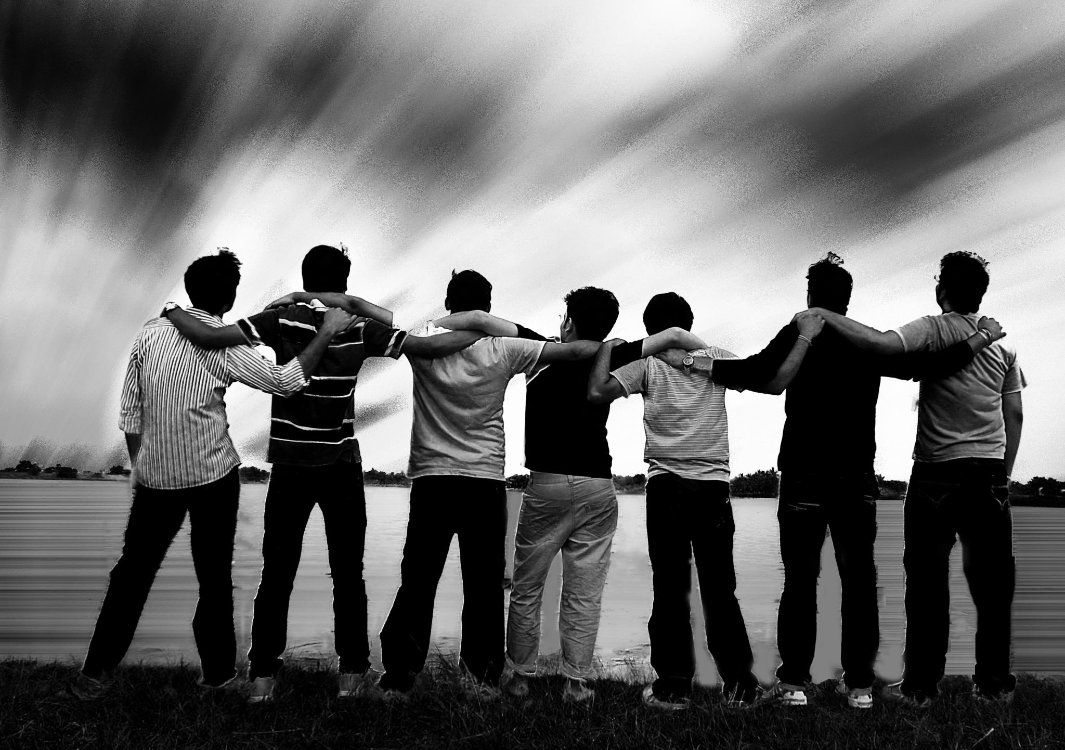
How many friends can you truly count on?
Notes:
Use the “2 by 2” principle
Use the “2 by 2” principle – when with an adult or out with people your own age, always be with a trusted friend who you can depend on. Therefore, always go places in groups. Commit to looking out for one another’s well-being, always knowing where the other person is.
What friends come to mind that you can count on? What is it about them that gives you reason to trust them?

Slide 22

Notes:
Avoid numbing your conscience with drugs and alcohol.
Avoid drugs and alcohol. When people are intoxicated, they are completely unsafe, physically and spiritually, because their consciences are numbed and they are unable to make good decisions. Avoid others who are intoxicated. Even people you know well cannot be trusted in that state.
Also, be aware that consuming alcohol and/or drugs is a way for people to mask pain. As a friend, how do you invite people to trust you and allow you into their lives? If you discovered someone was abusing alcohol and/or drugs, would you know who to approach – such as your parents, a teacher, or a youth minister?

Slide 23

Stay away someone who has abused another person
Notes:
If you know of someone who has abused another person, they should not be near you.
Many times someone who has abused another person before will do it again. They tend to see people as objects and/or possessions. They truly need professional help to understand other peoples’ dignity and worth.

Slide 24

Communicate your concerns
Notes:
Communicate your concerns
Communicating your concerns means telling someone in authority when you are uncomfortable with a situation or a person, and most especially if you have been abused or you suspect that someone else may have been abused. Pay attention to your own intuitions/feelings. Even if abuse is not occurring, it is still important to let others know when you have concerns. Remember the following:
Be a true friend even at the risk of upsetting him/her by “overreacting”. If you are worried that a friend is being/has been abused, tell someone in authority. If you have sought help from someone in authority and that person does not take action, tell another person in authority.

Slide 25
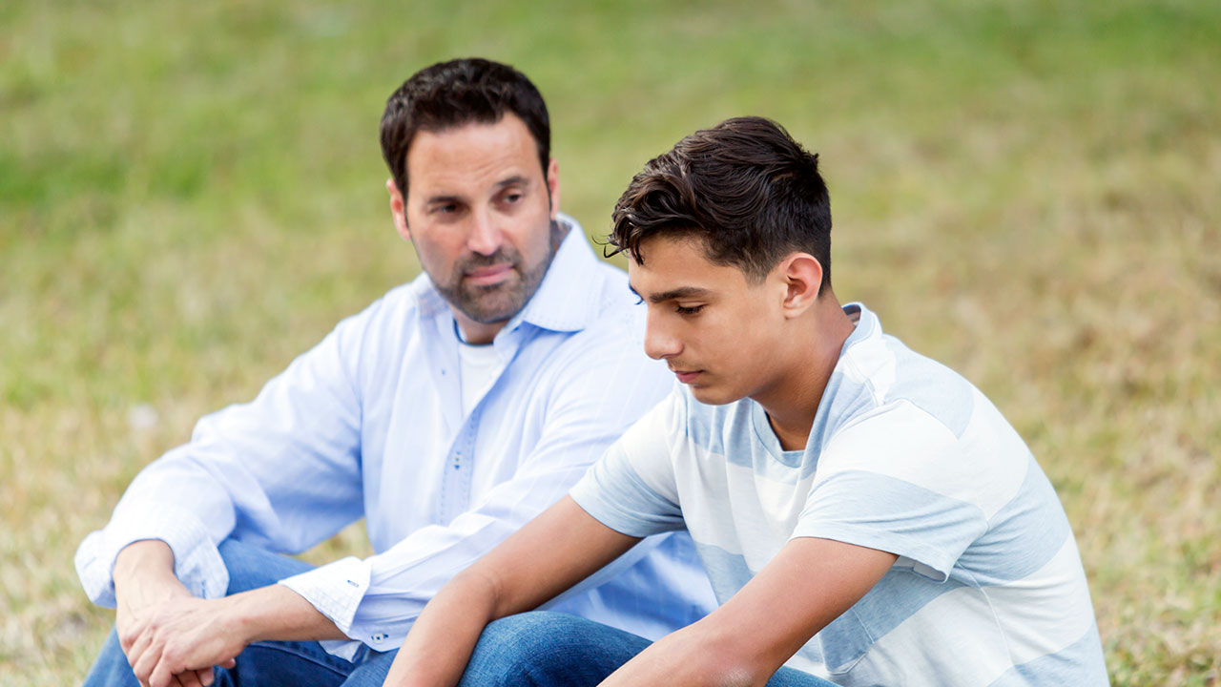
If you have been abused, speak with a trusted adult about it.
Notes:
Communicate your concerns
If you have been abused, it is not your fault, even if you have not followed the steps listed above to avoiding potential danger. Do not fear being blamed. You will not be. Speak with a trusted adult about it. DO NOT KEEP IT A SECRET. Jesus said, “The truth will set you free.”

Slide 26

Pay attention to your own intuitions/feelings.
Notes:
Communicate your concerns
Communicating your concerns means telling someone in authority when you are uncomfortable with a situation or a person, and most especially if you have been abused or you suspect that someone else may have been abused. Pay attention to your own intuitions/feelings. Even if abuse is not occurring, it is still important to let others know when you have concerns. Remember the following:
There is a network of help at home, in friends, at school, in the Church, and in various other organizations. There is always someone to turn to in every situation. Specifically:
Always talk to your parents about your concerns.
Notify a church official, school principal and/or
Do not hesitate to call the police.
If you or someone you know has a tendency to sexually destructive behavior – contact someone in authority (anyone mentioned above) for help before you or someone else gets hurt. There is no shortage of help for those who seek it.

Slide 27

Know the warning signs.
Notes:
Know the warning signs of a potential predator:
Always wants to be alone with young people.
Gives gifts to young people often without permission.
Goes overboard touching. Is not respectful of a young person’s comfort zone.
Thinks the rules do not apply to them.
Allows young people to engage in activities their parents would not allow.
Uses bad language or tells dirty jokes to young people.
Shows young people pornography
Don’t be fooled, realize that most molesters:
Look like everyone else.
Are often in a trusted role with young people
Sometimes use their church association to gain trust.
Can be very patient while they plan the abuse.

Slide 28
Remember
God loves you very much!
You have incredible worth as a child of God.
You, and every person, are to be treated with respect.

Slide 29
If you are being harmed, or if you feel sad, scared, unsafe, or uncomfortable then tell an adult that you trust right away!
Notes:
Discuss your safety plans with your parents and ask for their guidance when you are planning an outing. “What should I do if…” Always tell your parents where you are going, with whom you are going, and the time that you will return so that they can find you if needed.

Slide 30
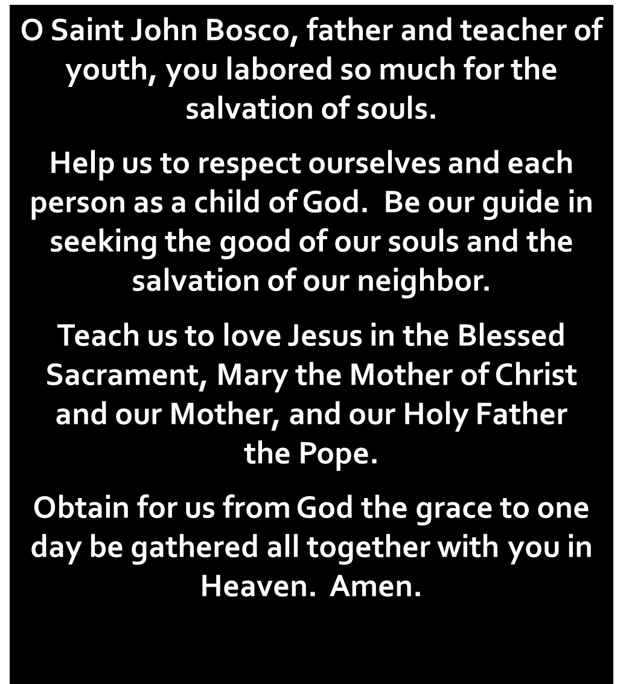
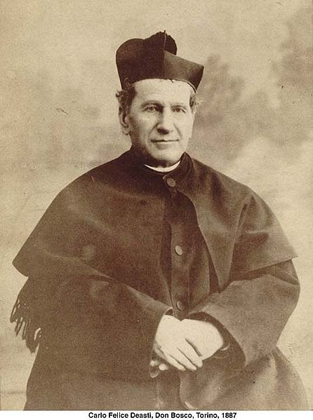
Notes:
The prayer to St. John Bosco, the patron of youth, in the virtue of respect, Diocesan Virtue Program, page 3. diolc.org/catechesis/understanding-and-living-the-virtues/respect.
Make a copy for each student:
O Saint John Bosco, father and teacher of youth, you labored so much for the salvation of souls.
Help us to respect ourselves and each person as a child of God. Be our guide in seeking the good of our souls and the salvation of our neighbor.
Teach us to love Jesus in the Blessed Sacrament, Mary the Mother of Christ and our Mother, and our Holy Father
the Pope. Obtain for us from God the grace to one day be gathered all together with you in Heaven. Amen.

